Slide 1
Expanding the universe of cancer therapies by targeting aneuploidy
Expanding the universe of cancer therapies by
targeting aneuploidy
Notes:
Targeting aneuploidy to expand the universe of cancer therapies ?
Expanding the universe of cancer therapies by targeting aneuploidy

Slide 2
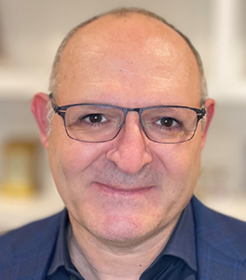
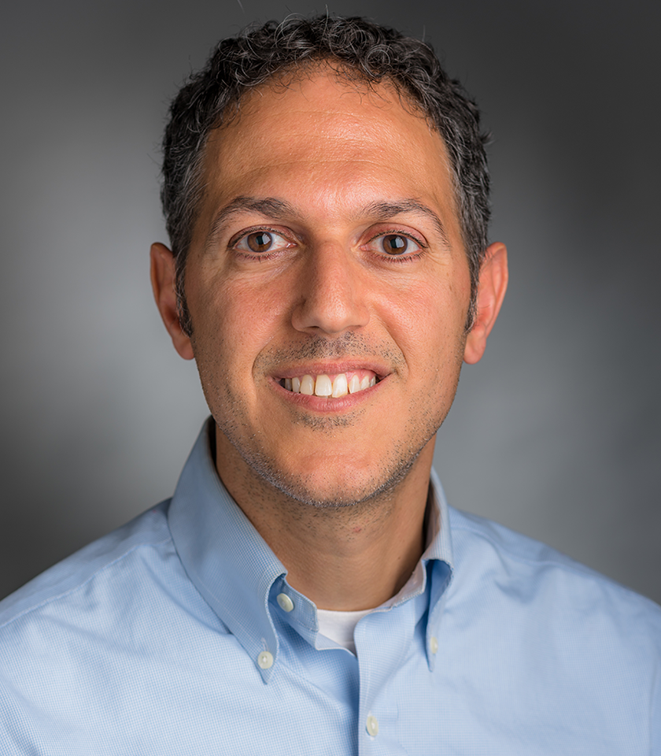
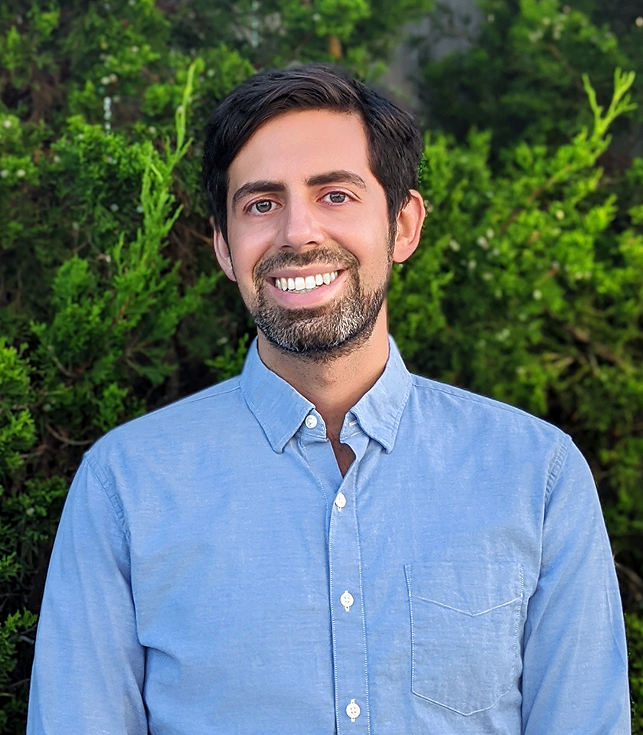
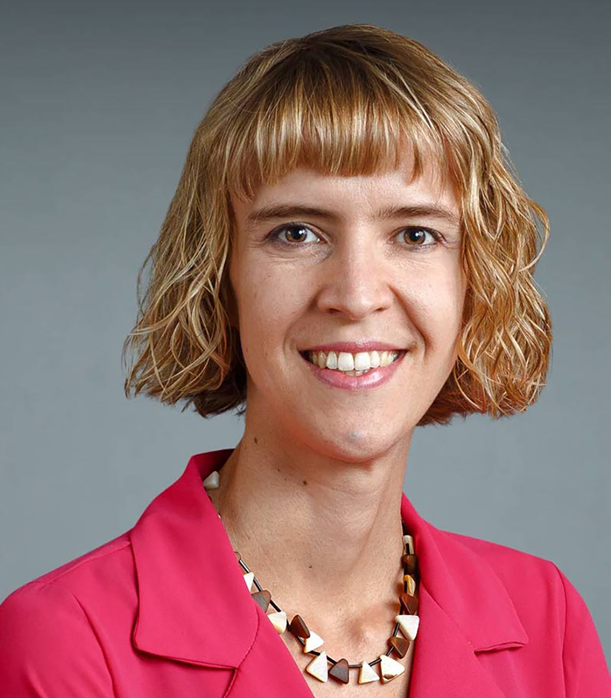
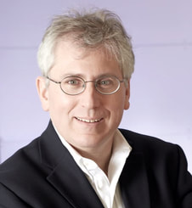
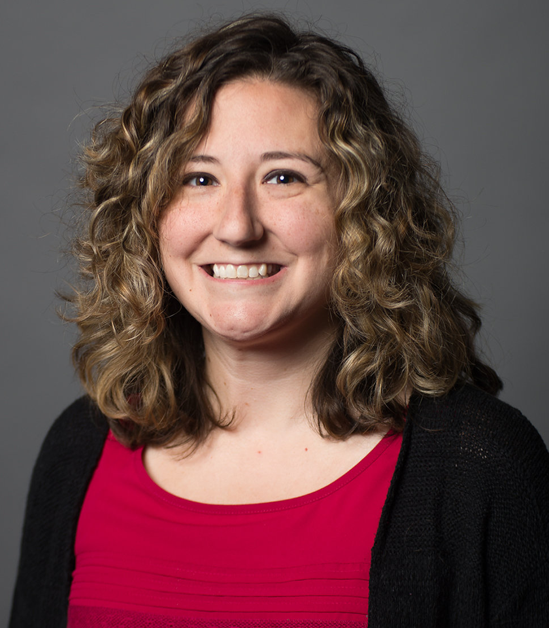
Our team – experienced biotech veterans and leaders in studying aneuploidy
Ali Fattaey, PhD. Formerly the CEO of Metabomed, formerly the CEO of Curis.
Rameen Beroukhim, MD PhD. PI at Dana-Farber. SAB at Scorpion Therapeutics.
Jason Sheltzer, PhD. PI at Yale. Co-founder of Meliora Therapeutics, SAB at Tyra Biosciences and BioIO.
Teresa Davoli, PhD. PI at NYU. SAB at io9.
Matthew Meyerson, MD PhD. PI at Dana-Farber. Co-founder of Foundation Medicine.
Alison Taylor, PhD. PI at Columbia.

Slide 3
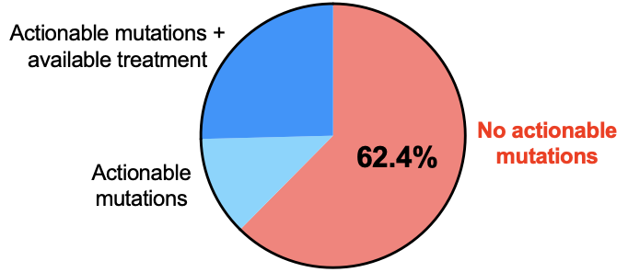
Most cancer patients cannot currently be treated with a targeted therapy
Flaherty et al., JCO 2020
Notes:
Targeted therapy has been effective, but as a clinician I am all too aware that most patients are unable to benefit from it because their tumors have no actionable mutations
Stats from the literature
Zehir et al., 2017 (MSK) ← 36.7% of patients had “actionable mutations”, but only 11% could be put on a trial/get a treatment
Haslam et al., 2023 (UCSF) ← 23% response rate for basket trials

Slide 4
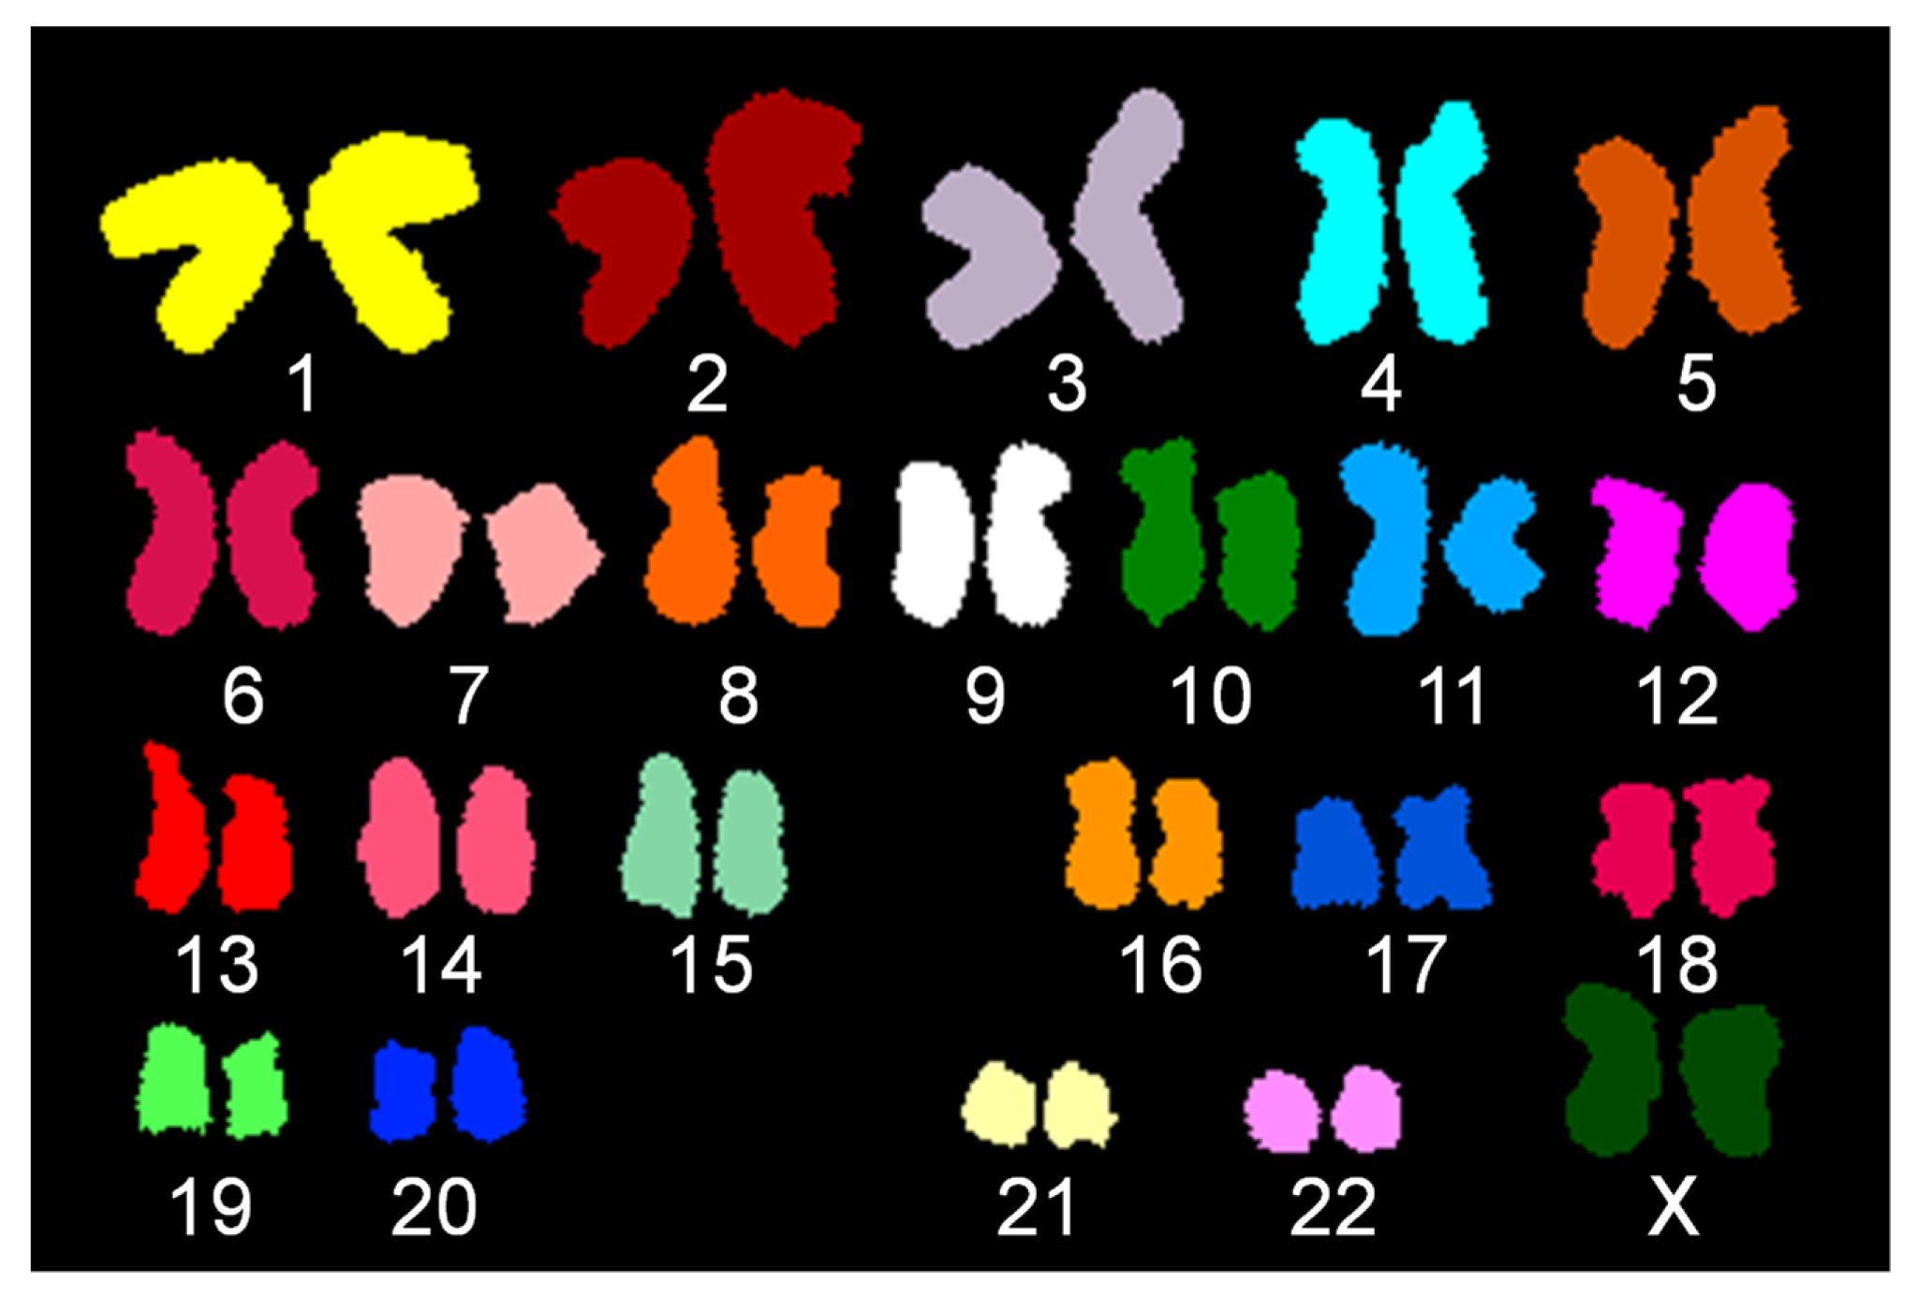
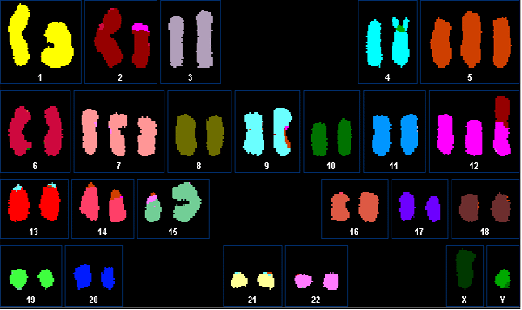
90% of cancers have massive chromosome copy number changes - a condition called aneuploidy
Normal genome
Cancer genome
Aneuploidy is ubiquitous in cancer but rare in normal tissue
Notes:
Describe how many cancers have aneuploidy, and how individual aneuploidies constitute the most common genetic events in cancer but have received little attention for therapeutics development
SKY are from https://www.cellosaurus.org/pawefish/

Slide 5
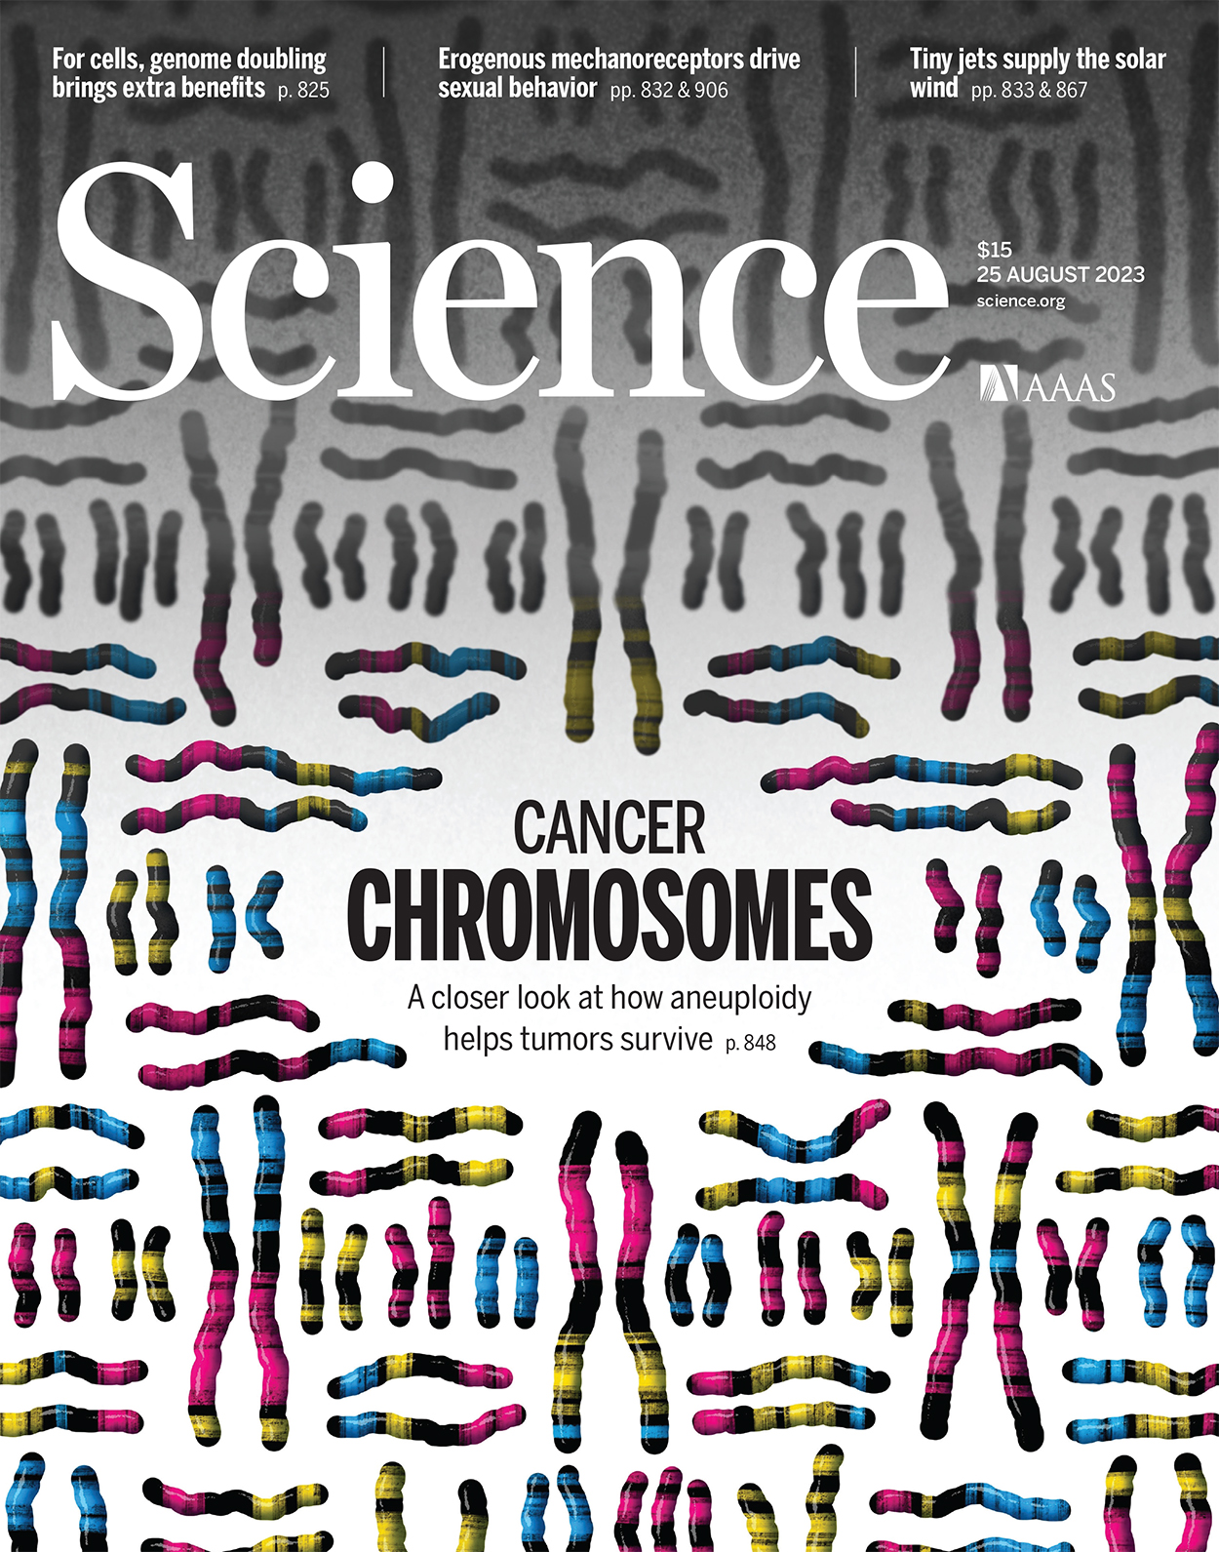
We have made breakthroughs that allow us to model and target aneuploidy for the first time
We have developed:
Tools to generate cell line and organoid models with specific aneuploid chromosomes.
Computational modeling to uncover the genes that drive high-frequency aneuploidies.
Experimental and computational techniques to identify tractable therapeutic vulnerabilities in aneuploid cancers.
Davoli Lab, Cell 2023
Beroukhim and Taylor Labs, Nature 2023
Sheltzer Lab, Science 2023
Notes:
JMS

Slide 6
Targeting aneuploidy to tackle undruggable tumors
We now have an unprecedented opportunity to develop a coordinated, systematic attack on aneuploidy in cancer
Notes:
An unprecedented way to tackle aneuploidy
Targeting aneuploidy to tackle undruggable tumors

Slide 7
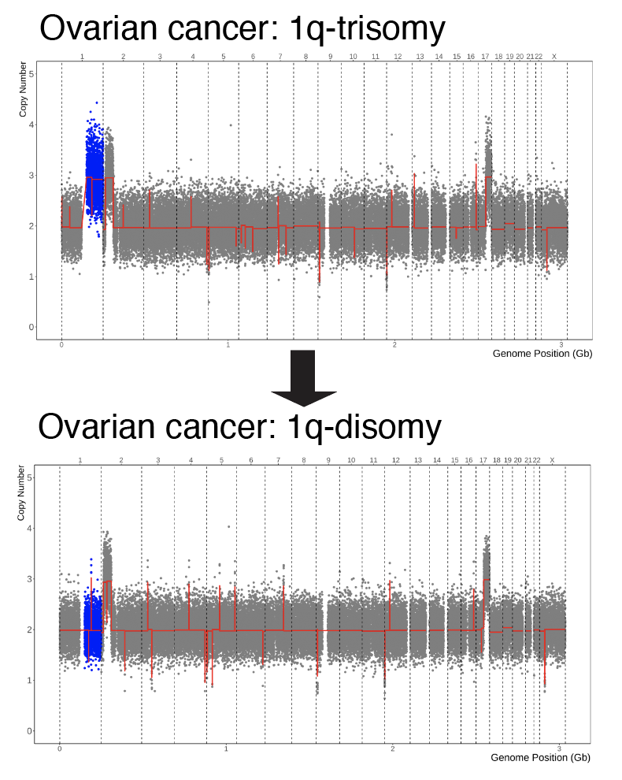
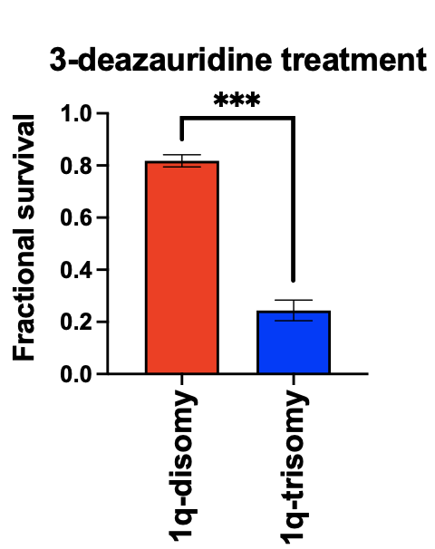
Proof of principle: UCK2 substrates are selectively toxic to cancer cells with a trisomy of Chromosome 1q
# of US cancer patients per year: >200,000
Sheltzer Lab, Science 2023

Slide 8
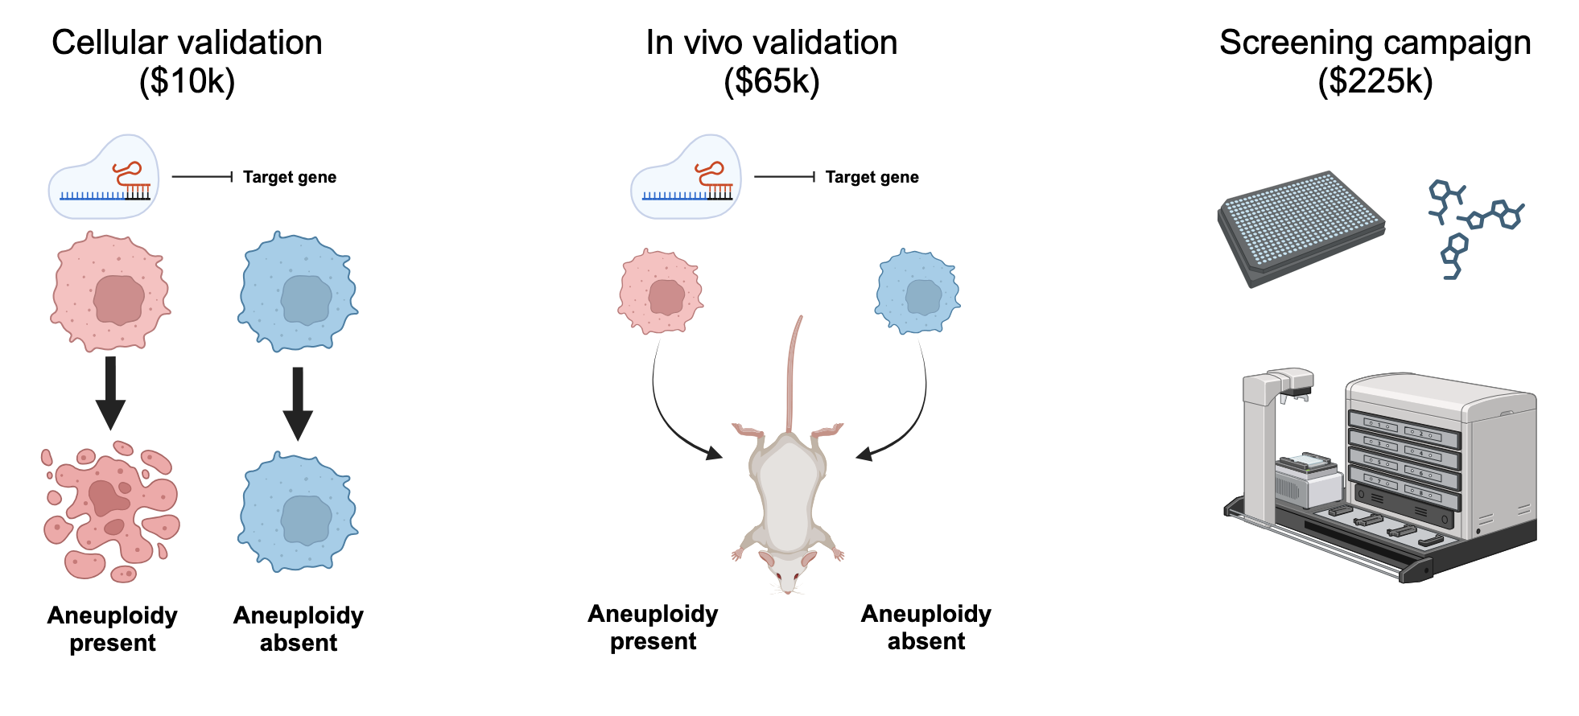
De-risking: genetic validation and generation of a tool compound to target cells with a specific aneuploidy
We identified a druggable dependency that exhibits a 95% correlation with a specific aneuploidy.
This aneuploidy is present in ~9% of all cancers.

Slide 9
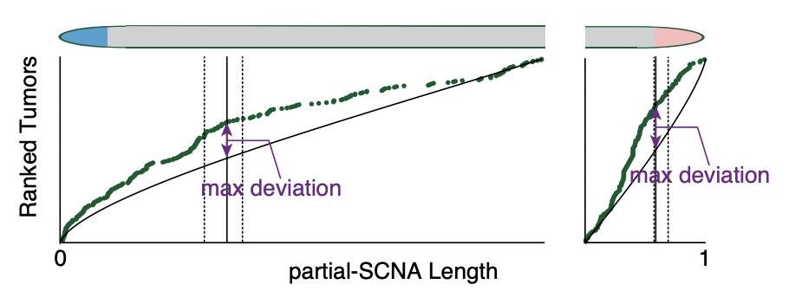
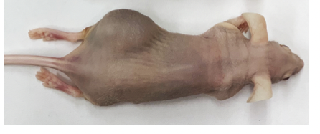
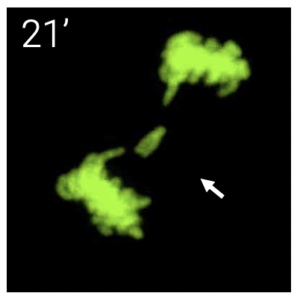
Happy to answer any questions!
1q-trisomy tumor
1q-disomy tumor

Slide 10
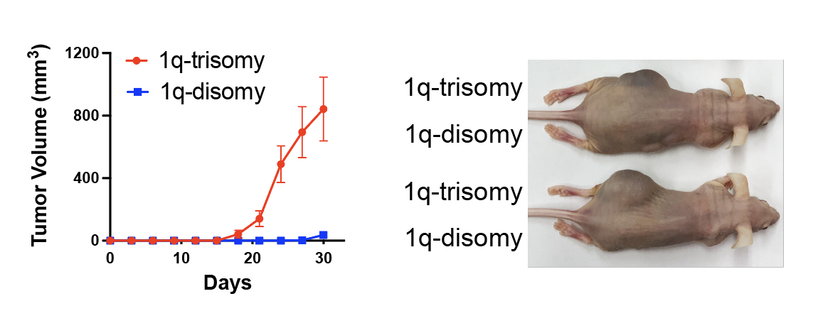
“Aneuploidy addictions” - an evolutionary trap for drug resistance
Certain aneuploidies are required for tumor formation.
Therapies could select against specific aneuploidies - but the resulting aneuploidy-loss cells will have lower tumor-forming potential!
This creates an evolutionary trap, pushing cells toward a non-malignant state.
Sheltzer Lab, Science 2023

Slide 11
“Aneuploidy addictions” - an evolutionary trap for drug resistance
Sheltzer Lab, Science 2023

Slide 12
Aneuploidies: the most common genetic events in cancer
aneuploidies
Shih et al., Nature 2023

Slide 13
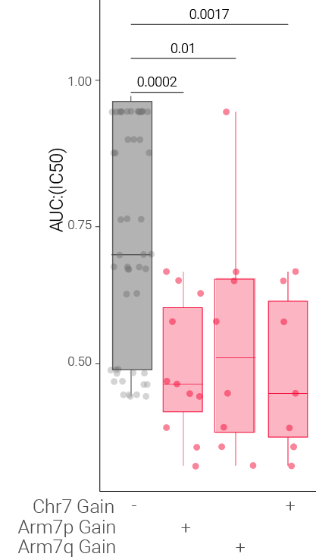
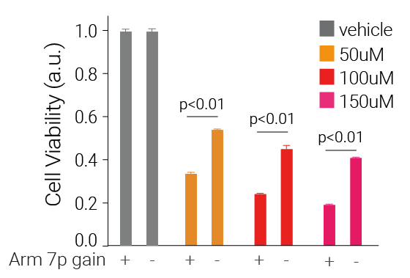
Proof of principle - 7p gains
Colon cancer line - trisomy 7p
Colon cancer line - disomy 7p
Target Market Size
Inhibitor of Gene X
Inhibitor of Gene X
Isogenic colon cancer lines
Panel of
Colon cancer
Cell lines

Slide 14
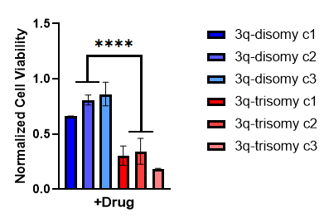
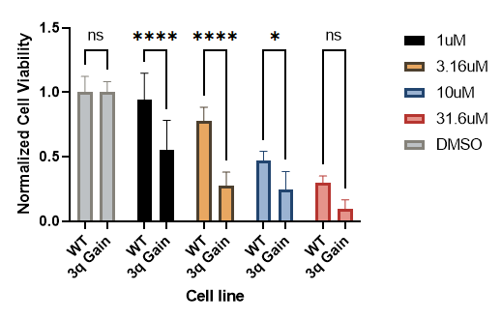
Chemical screen top hit in same pathway

