Slide 1
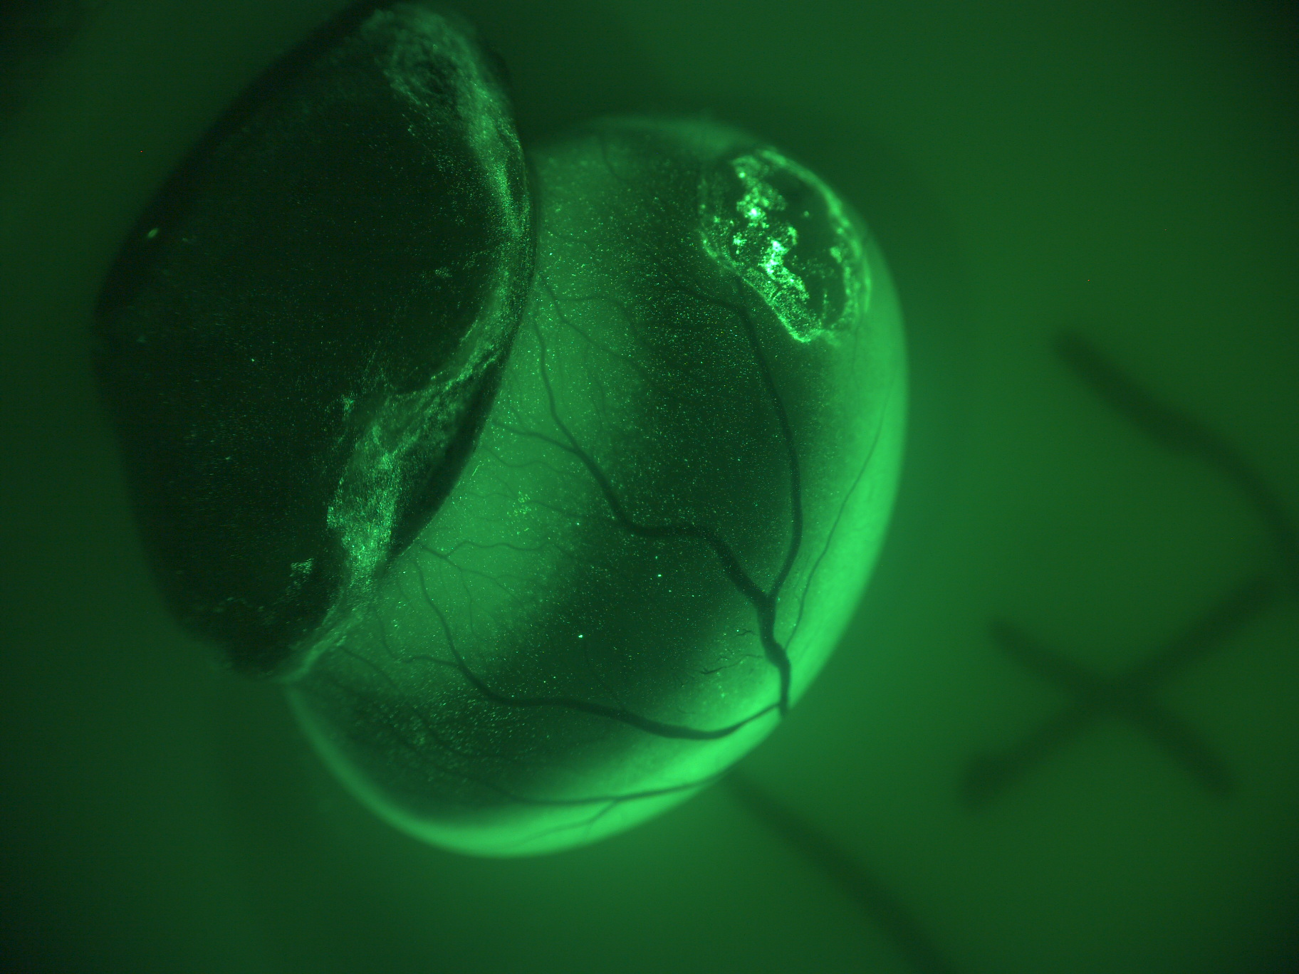
Particle-Based Fetal Therapy to Cure Spina Bifida
David Stitelman, M.D.

Slide 2
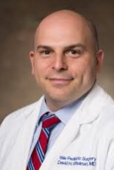
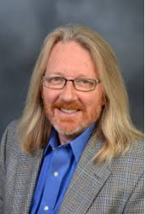
Core Team
David Stitelman, MD
Associate Professor of Pediatric Surgery
Obstetrics, Gynecology & Reproductive Sciences
Surgical Director Yale Fetal Care Center
Mark Saltzman, PhD
Professor of Biomedical Engineering
Mert (Ozan) Bahtiyar, MD Professor Obstetrics, Gynecology & Reproductive Sciences
Medical Director Yale Fetal Care Center
Business Development and Licensing Support
John Puziss, PhD (John.Puziss@yale.edu)
Executive Director of Business Development, Yale Ventures
Shannon Anderson, PhD (Shannon.Anderson@yale.edu)
Business Development Associate, Yale Ventures
2

Slide 3
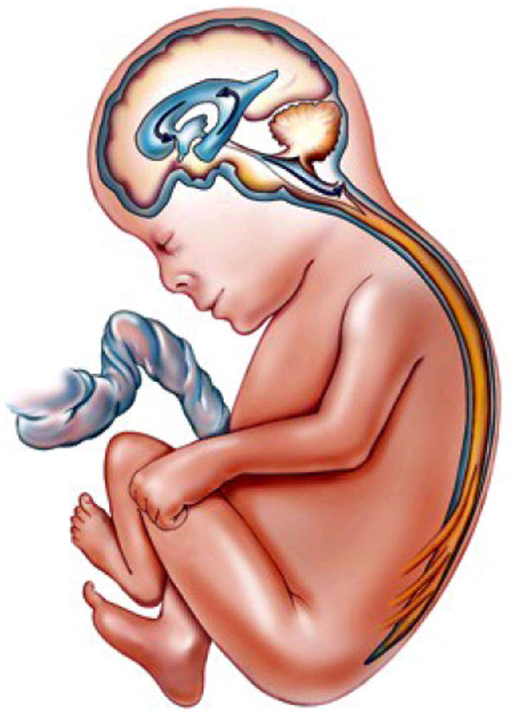
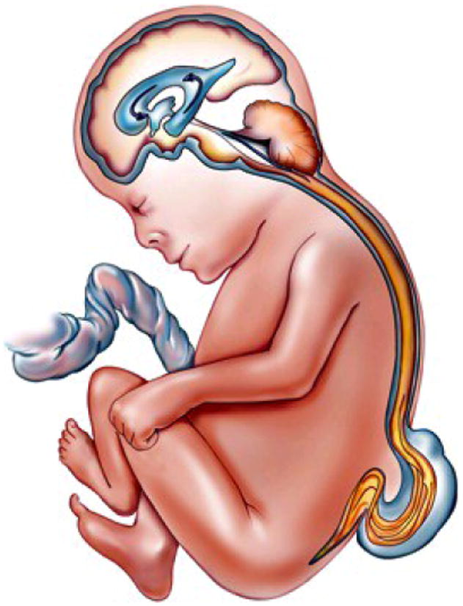
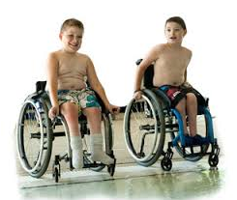
Spina Bifida is a Disease with Significant Unmet Need
Spina Bifida
Birth defect resulting in exposed spinal cord
1,500 Cases/Year in USA
50,000 Cases/Year Globally
Outcomes
Permanent disability, lower limb paralysis
$1.5 B / Year (USA)
Standard of Care
Most Common: Postnatal surgery
Best Outcomes: Fetal surgery
Notes:
Update this!

Slide 4
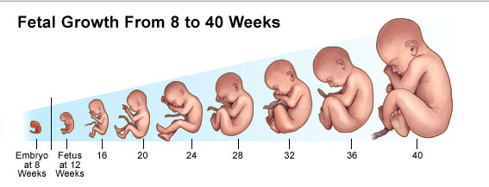
Open Prenatal Surgery is Invasive & Difficult to Access
Prenatal Spina Bifida Repair is Invasive
>80% are Excluded from Fetal Surgery
Week 4: Neural Tube
Fails to Close
Outcome | Fetal | Postnatal
Brain Shunt | 40% | 82%
30-Month Walking Independently | 42% | 21%
Gestation of Delivery | 34.1 weeks | 37.3 weeks
Week 16:
Legs still move
Week 24:
Open fetal repair
We Sought to Create a Minimally Invasive Therapy, Delivered at 16 Weeks

Slide 5
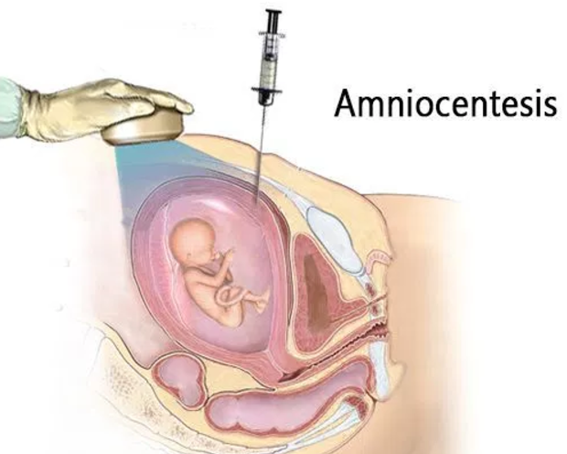
Our Minimally Invasive Spina Bifida Cure (Pending US Patent US 2020-0113821)
Our Solution
Injected Particles Delivered Percutaneously
Targeted to the Defect
Loaded with Growth Factor

Slide 6
Advantages of Particle-Based Fetal Therapy
 | Stage of Development | Minimally Invasive | Early in Pregnancy | Off-the-Shelf Drug | Community Hospital Procedure
Fetal Surgery | In practice |  |  | N/A
Fetal Surgery MSC implant | Phase 1/2
Particle Based Fetal Therapy | Pre-clinical

Slide 7
US market estimate ~$600M with 1,200 Cases /Year
Preliminary US Market Assessment
Fetal Surgery Exclusions per Year | 1,200
X
Price per Patient | $500K
Annual Market | $600M

Slide 8
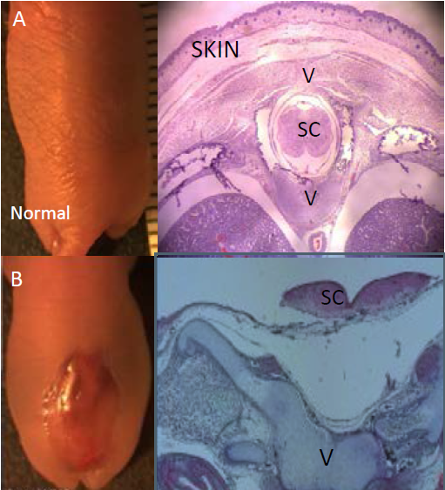
Particles in vivo Result in Fetal Repair
Small Animal Model Recapitulates Spina Bifida
Targeted Fluorescent Particle Delivery
Normal
Spina Bifida

Slide 9
Particles in vivo Result in Fetal Repair
Small Animal Model Recapitulates Spina Bifida
Growth Factor Loaded Particles Cure Spina Bifida
Normal
Skin
Spina Bifida

Slide 10
Funding and Next Steps
 | 2023 | 2024 | 2025 | 2026 | 2027
Validation in Rodent Model | Particle Binding Fetal Repair
Particle Binding Study in Fetal Lamb
Consult with FDA on Regulatory Requirements
Long-term Outcome Study in Fetal Lamb
Particle Scale-Up
$40K
Binding/Short Term Safety
$160K
Regulatory Strategy Report
$100K
CRO Particle Scale-Up
IND-Enabling Study
Blavatnik Funds
Next Steps

Slide 11
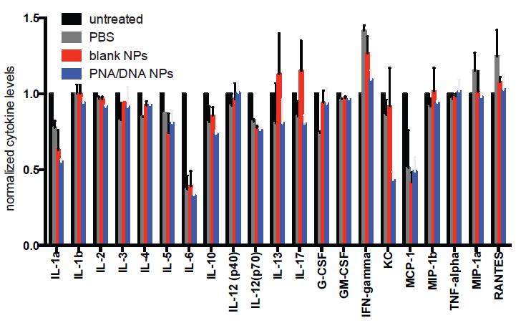
Safety Data

