Slide 1
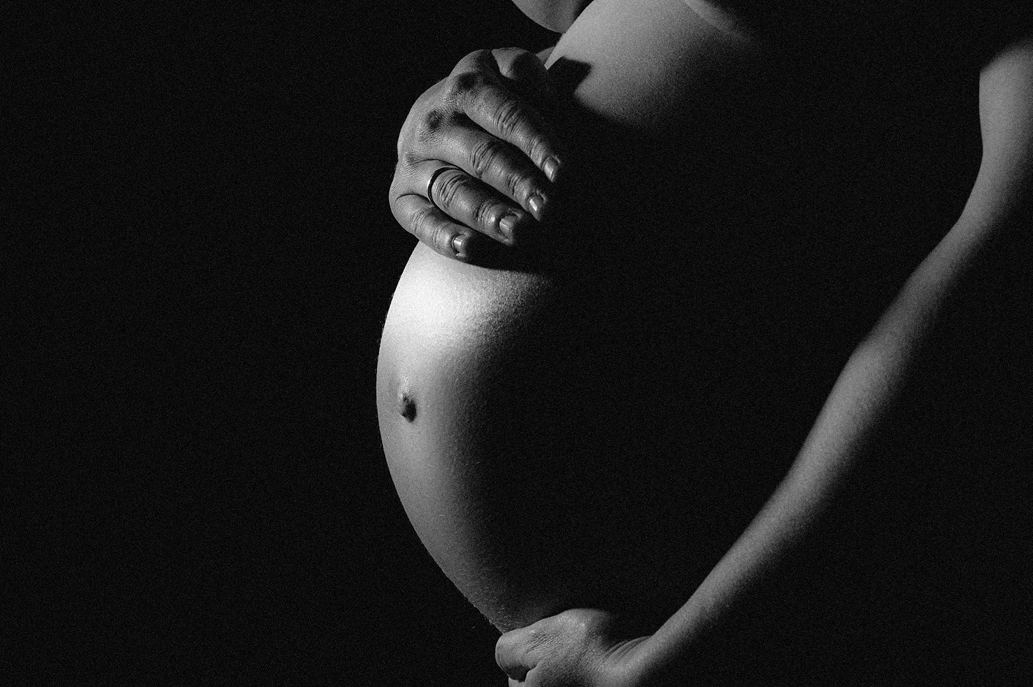
Non-invasive fetal electroencephalography (EEG)
Jose Cortes-Briones, PhD
Emily Lee, MD
Notes:
Hi, my name is Dr. Jose Cortes Briones and I am excited to present on non-invasive fetal electroencephalography, or EEG

Slide 2
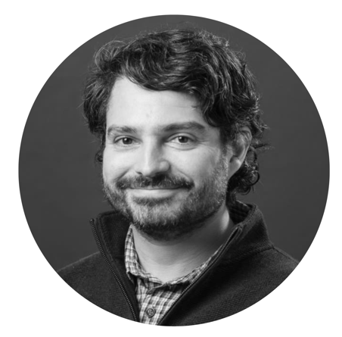
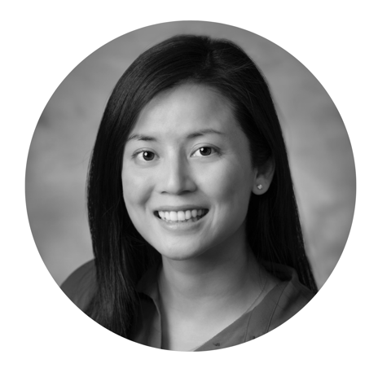
Our team
Jose Cortes-Briones, PhD
Assistant Professor of Psychiatry
Director of Yale Psychophysiology Laboratory
Technical director of the MEG Imaging of Neuropsychiatric Disorders (MIND) Center
Electrical engineering background
BUSINESS DEVELOPMENT
Natalie Makableh, Yale Ventures
Jordan Wesel, Yale Ventures
SCIENTIFIC SUPPORT
Juan Urrutia, Electrical engineering
CLINICAL SUPPORT
Mert Ozan Bahtiyar, MD, Professor, Chief of Yale Maternal-Fetal Medicine
Imran Quraishi, MD, Associate Professor of Neurology
LAB MEMBERS
Ella Miller, Research Assistant
Ethan Berry, Research Assistant
Carly Hewes, Research Assistant
Emily Lee, MD
Assistant Professor, Adjunct of Obstetrics, Gynecology, and Reproductive Sciences
NIH K12 Women’s Reproductive Health Research Scholar
Notes:
Along with Dr. Emily Lee, we would not be here without our expert team of engineers, clinicians, researchers, and support from Yale Ventures.

Slide 3
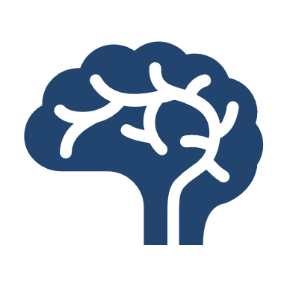
Every year, over 35,000 babies suffer from brain injury at birth in the U.S. alone
Fetal brain injury occurs during 9 of every 1,000 births & is a leading cause of worldwide lifelong disability due to low oxygen states at birth
Children with brain injury during birth have 26 times the cost of lifetime medical care
Brain injury from birth is the leading cause of childhood death and it is caused by low oxygen (hypoxia)
How can we prevent fetal brain injury at birth?
Notes:
Every year in the U.S, over 35,000 newborn babies suffer from brain injury during birth. Low oxygen states during birth can cause irreversible brain injury leading to associated healthcare and lifetime costs. (click next)
So, how do obstetricians prevent brain injury throughout this process?

Slide 4
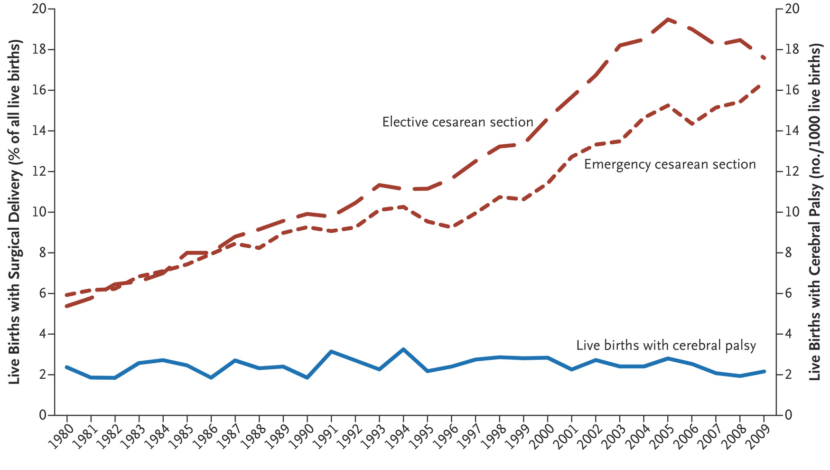
Fetal heart rate monitoring is used in over 90% of births but has NOT decreased the rate of brain injury
Oxygenation of the fetus
Cesarean section rates
Cerebral palsy rates
Heart rate changes can be misleading because they reflect downstream effects low oxygen status which causes brain injury
Notes:
Currently, we use fetal heart rate monitoring to detect low oxygen states in the fetus. However, despite its widespread adoption, the rates of cerebral palsy (a form of brain injury) have NOT decreased -shown in blue. Instead, the rates of c-section (in red) (click next) have increased.
(click next)
What might explain this? When the baby’s brain detects low oxygen states, the heart rate will THEN respond as a downstream effect, which (click next) can be misleading and cause delays.
So, can we move from current (click next) cardiac methods, go upstream, (Click next) and directly monitor the baby’s brain?

Slide 5
But what if we could directly monitor the baby’s brain?
THE SCIENCE
Fetal neurologic activity can be evaluated by electroencephalography (EEG), providing information on sleep, conscious states, hypoxia & acidemia.
EEG provides an earlier detector of fetal low oxygen states before the heart rate changes.
THE BARRIER
However, prior fetal EEG required invasive monitoring, limited fetal positions & active labor.
This prior approach is not feasible for large-scale clinical use and as a result is not used anywhere.
THE INNOVATION
Advances in artificial intelligence & signal processing makes non-invasive fetal EEG possible.
We have developed a proprietary non-invasive method & algorithm to measure fetal EEG.
Notes:
The science support this! Fetal brain activity can be precisely measured by EEG and has been shown to be an earlier detector of fetal low oxygen states prior to heart rate changes.
(Click next)
So why don’t we use EEG if it is so much better?
Unfortunately, prior fetal EEG required invasive monitoring, by attaching a negative pressure suction electrode to the baby’s head which was not practical given its invasive nature and associated risks
(Click next)
Our innovation is to harness advances in artificial intelligence to make fetal EEG non-invasive. We have developed a proprietary algorithm to obtain fetal EEG from the maternal abdomen, which was not possible prior due to significant electrical noise from muscle, cardiac, and movement activity of both the mother and baby.

Slide 6
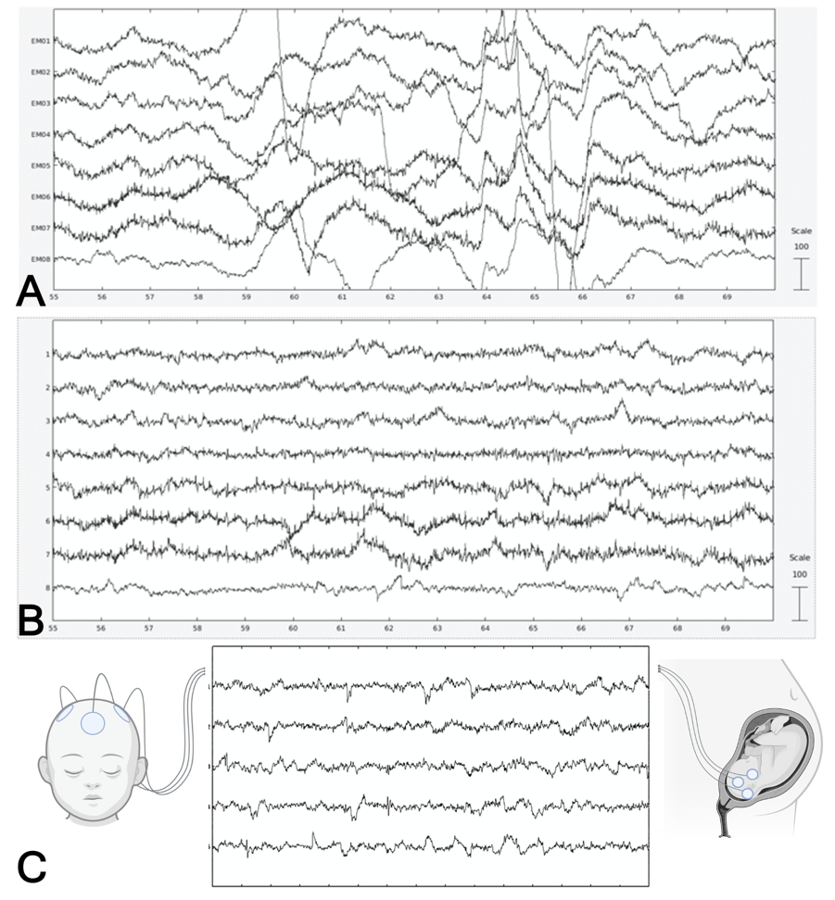
Non-invasive fetal EEG can directly measure the baby’s brain activity
Our non-invasive fetal EEG uses AI to reconstruct the baby’s brain activity
We can measure a direct marker of brain health
Non-invasive, clinically feasible
Earlier detector of brain injury compared to current methods
We have validated our method in a population of pregnant patients
Notes:
Our non-invasive fetal EEG uses AI to identify the baby’s brain activity, a direct marker of brain health. Here is a representative work of (A) abdominal EEG monitoring without our algorithm, (b) application of one of our DNNs and (c) (click next) finalized clean EEG which has been validated to resemble age-matched newborn EEGs in characteristic patterns.

Slide 7
Our goals & milestones
2021
Development of algorithm
2022
NIH K12 award for $125,000
Clinical validation in pregnant population
Provisional patent filed
2023 – July – November (5 months)
Begin development of clinical nomogram
Development of device prototype
Presented at two international conferences
Begin design of patient satisfaction study
CONFIDENTIAL – DO NOT SHARE
Notes:
We have accomplished a lot in a short amount of time. In the last 2 years, (click next) we developed an algorithm, (click next) received NIH funding for (click next) clinical validation and (click next) filed a provisional patent with Yale Ventures. (click next)
In June of this year, we received the Accelerator award for $30K, which was crucial in jumpstarting (click next) beginning the development of a clinical nomogram(click next) and development of a device. (click next) We were invited to present our work at two international conferences (click next) and obtained IRB approval to begin a consumer survey on the device design.

Slide 8
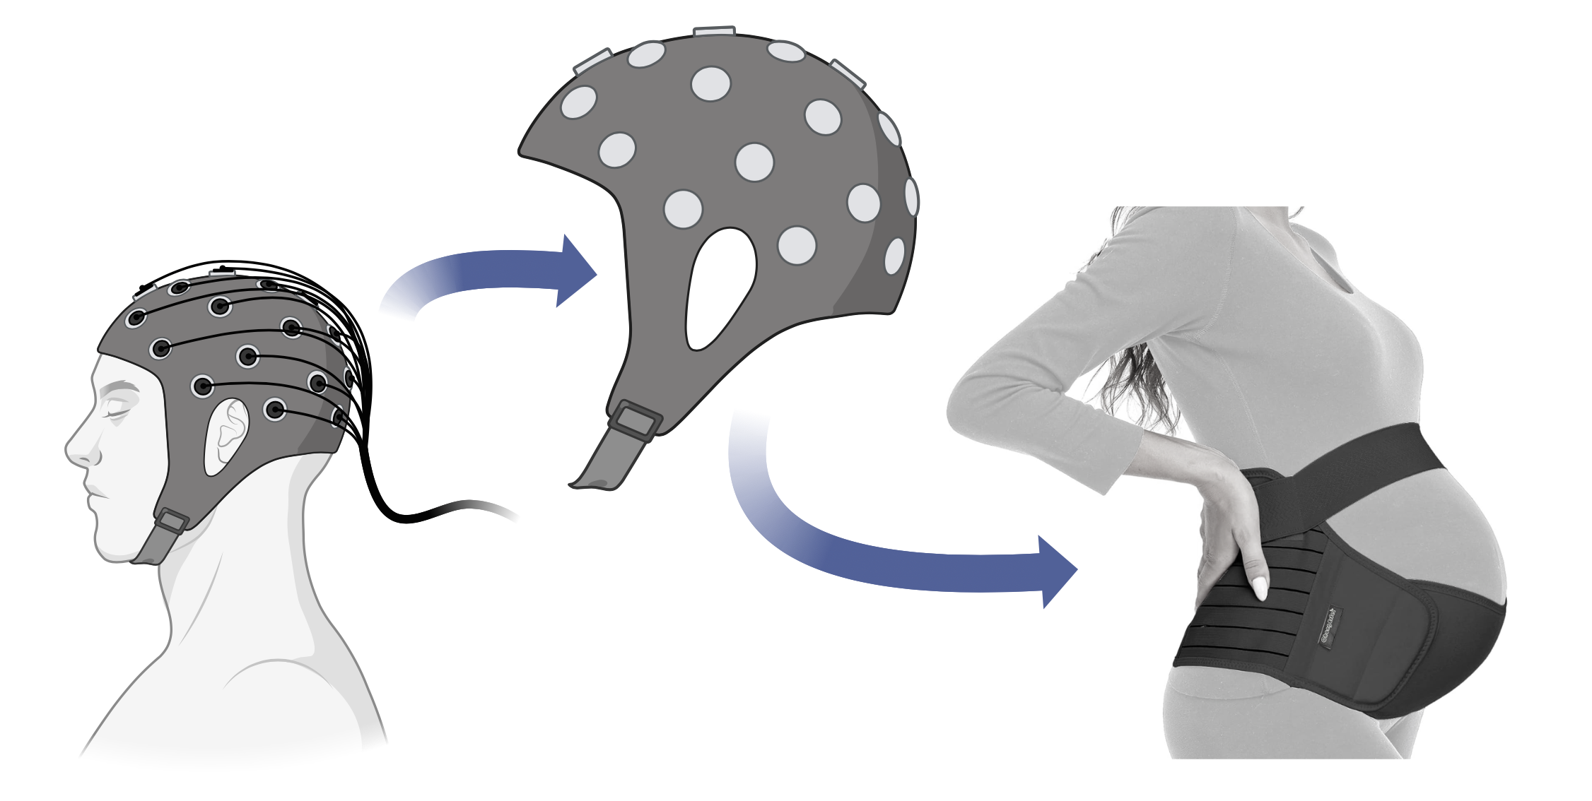
Development and testing of device prototypes
Goal for wearable device was patient comfort, potential for remote monitoring, and improvement in the algorithm
Inspiration for the device came from the combination of two existing products: wearable EEG monitoring caps and maternity support belts
We have worked through four prototypes with significant improvements.
Notes:
With the accelerator fund we focused on a practical but effective wearable belt device for patient comfort, potential for remote monitoring, and algorithm improvement. We took inspiration from already existing EEG caps and maternity belts. (click next) We have designed and made multiple iterations of the prototypes to share with you today with Ella Miller, a research assistant from our lab.

Slide 9
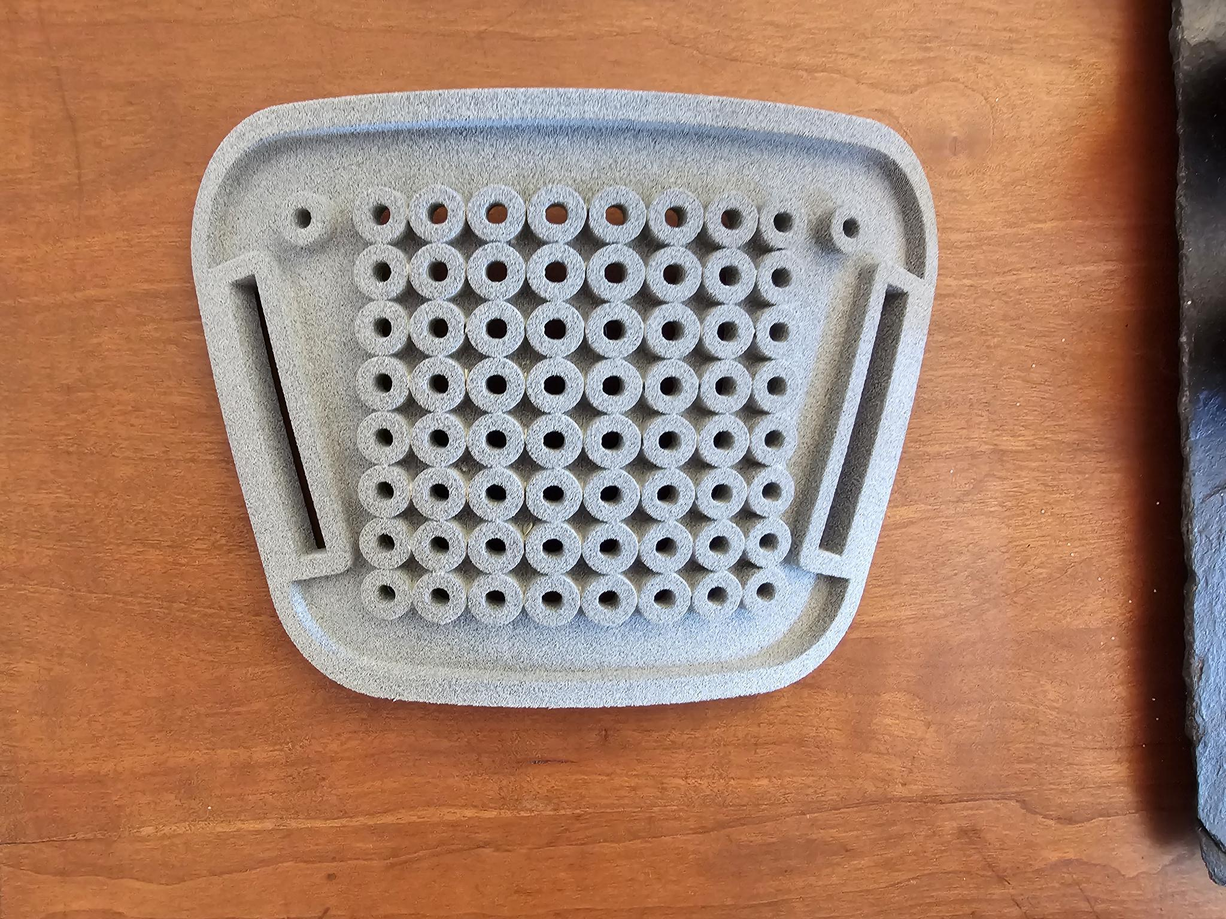
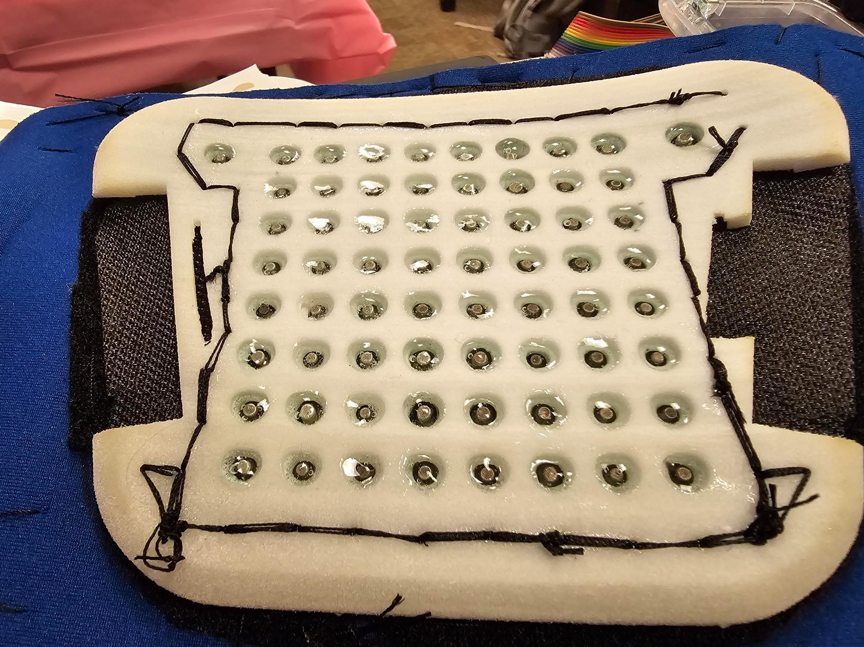
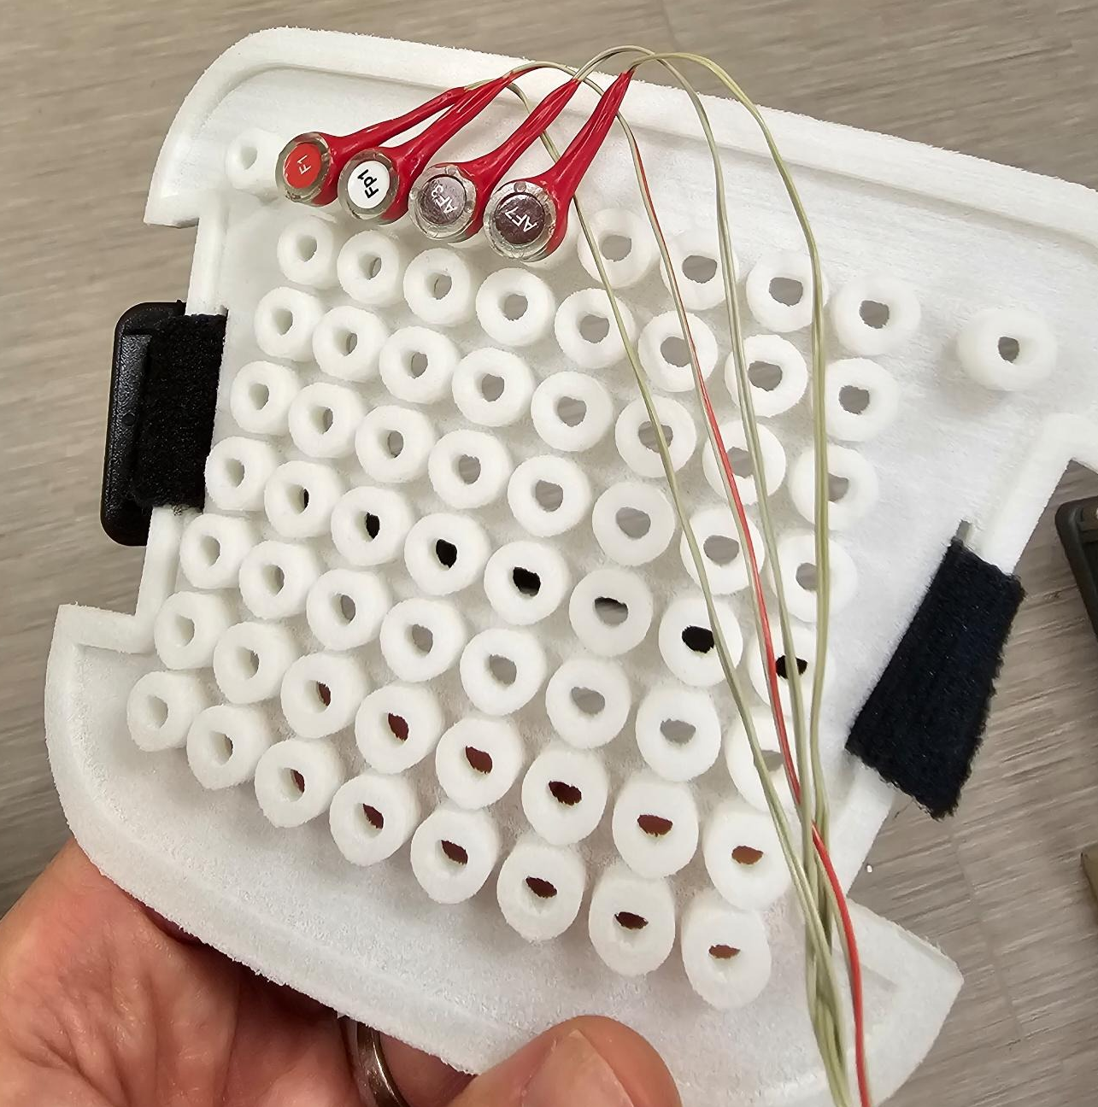
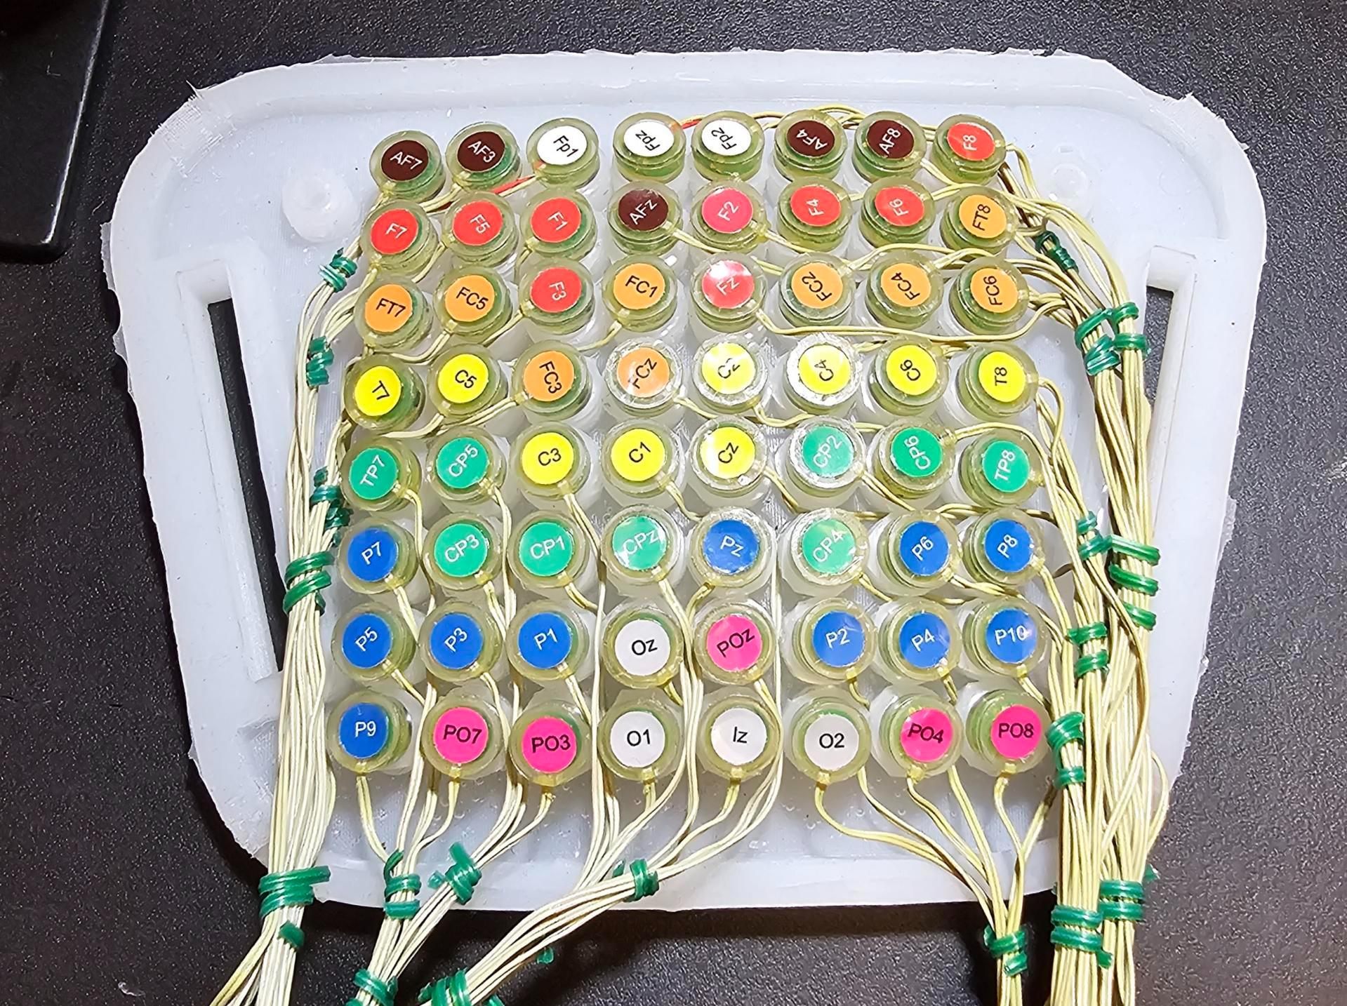
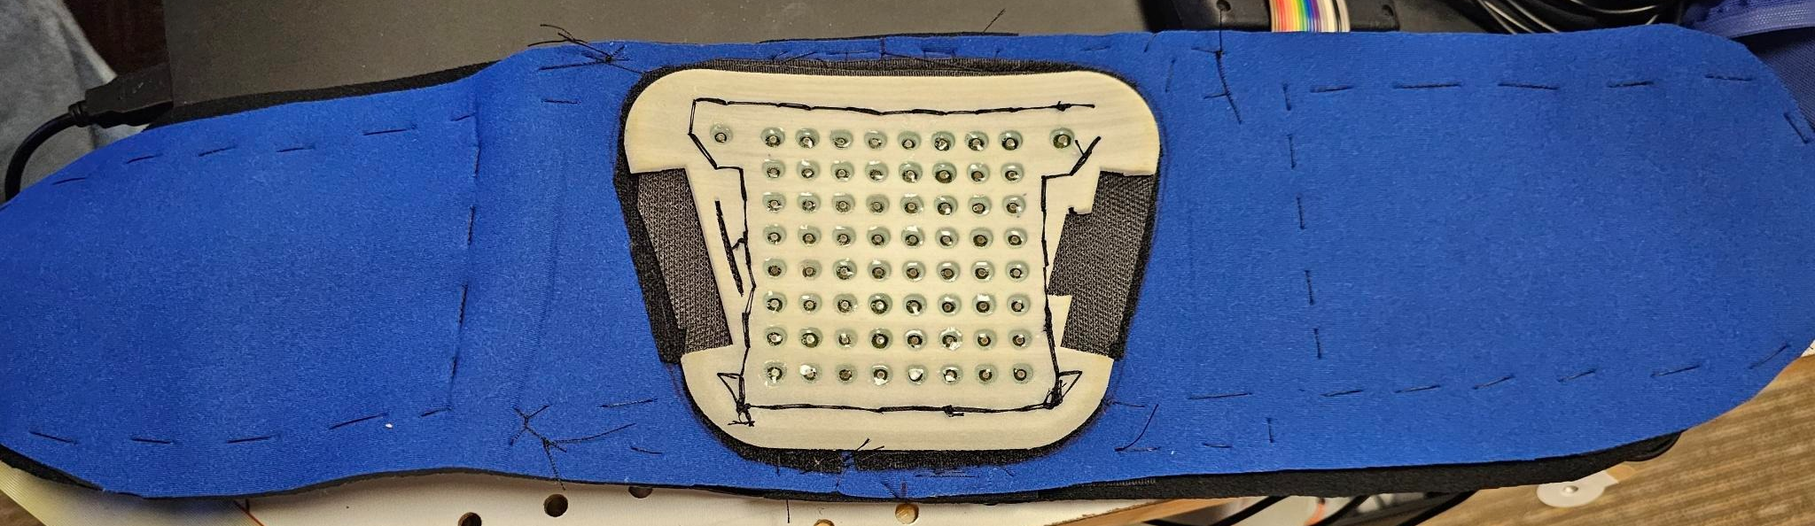
Development and testing of device prototypes
Version 1 & 2
3D-printing of original sketch using thermoplastic polyurethane (TPU) which was remade using a more flexible material and thinner material to be able to conform to a maternity belt.
Version 3
Printed using thermoplastic elastometer (TPE) for increased flexibility but the material was porous (difficult to clean between patients from the electrodes gel)
Version 4
Re-made using silicone with ideal flexibility but with difficult keeping electrodes in place. Flexible tubing was used to secure electrodes as a solution.
Notes:
click next x2) Our first two versions were 3D printed from our original sketch made of thermoplastic polyurethane and improved onto for flexibility.
(click next x2) Our third version was remade with thermoplastic elastometer for even better flexibility to sew into a maternity belt. However, the material was porous which was difficult to disinfect between patients.
(click next x2) Our last and current model is made of silicone for ideal flexibility and practicality. We attached the electrodes in a fixed pattern as shown.
This final prototype allows for ease of application and standardization of electrode placement.

Slide 10
The competitive landscape and our innovation
 | Use throughout pregnancy | Non-invasive | Innovation beyond cardiac monitoring | Potential for remote monitoring | Patent | Fetal brain monitoring
Frasch Lab
Non-invasive fetal EEG
Notes:
Although fetal monitoring is not new to the market, (click next) we are the only group working on innovations in non-invasive fetal brain monitoring, offering several significant and unique competitive advantages with the goal of disrupting the fetal monitoring sector.

Slide 11
Our solution has strong potential market
3.75 million births
4,600 clinic devices
per year in the US alone
1 per 10 obstetricians
19,000 hospital devices
Recurring sales
Device maintenance
Annual software subscription
Replaceable EEG electrodes
for use in labor
Notes:
Non-invasive EEG has a strong potential market. In the US there are 3.75 millions births a year. We estimate both inpatient and outpatient use for this technology and the projected device demand in the US. Recurring sales will come from device maintenance, annual software subscription, and replaceable EEG electrodes between patients.
===========
3800 hospitals that deliver 2021 = 5 per hospital
46,000 OBGYNS 2021

Slide 12
Partner in our next steps
2021
Development of algorithm
2022
2024-2025
(2 years - $300K)
NIH K12 award for $125,000
Clinical validation in pregnant population
Provisional patent filed
Finalizing prototype and optimizing production
2023
Development of clinical nomogram
Finish patient/consumer satisfaction study
Development of device prototype
Integrating software and hardware
Presented at two international conferences
Commercialization and licensing
Begin design of patient satisfaction study
Notes:
Today, we are proud to share the work we have accomplished thus far and invite you to partner with us. We are applying for 2-year funding to continue in our momentum to finalize our prototype and optimize production, finish a patient consumer satisfaction study, integrate software into the hardware device, and work on commercialization and licensing.
The funds would go towards engineers and research personnel, prototype equipment costs, and commercialization costs.
Receiving funding would build on our already existing traction and move us towards our goal to improve the health of mothers and babies.

Slide 13
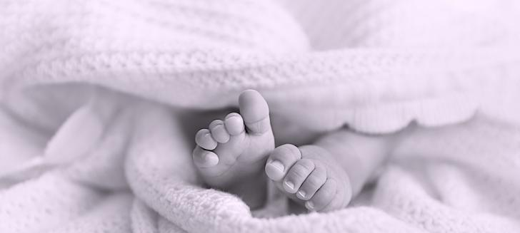
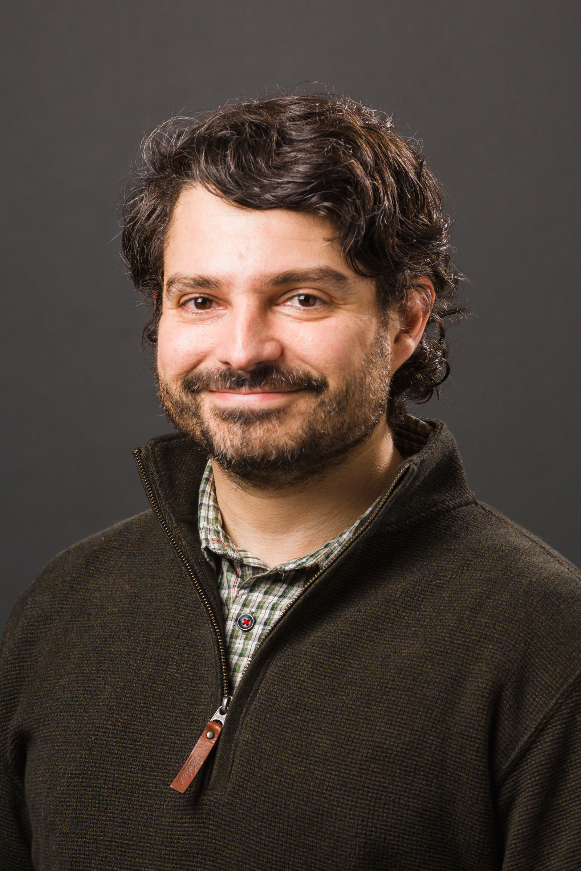
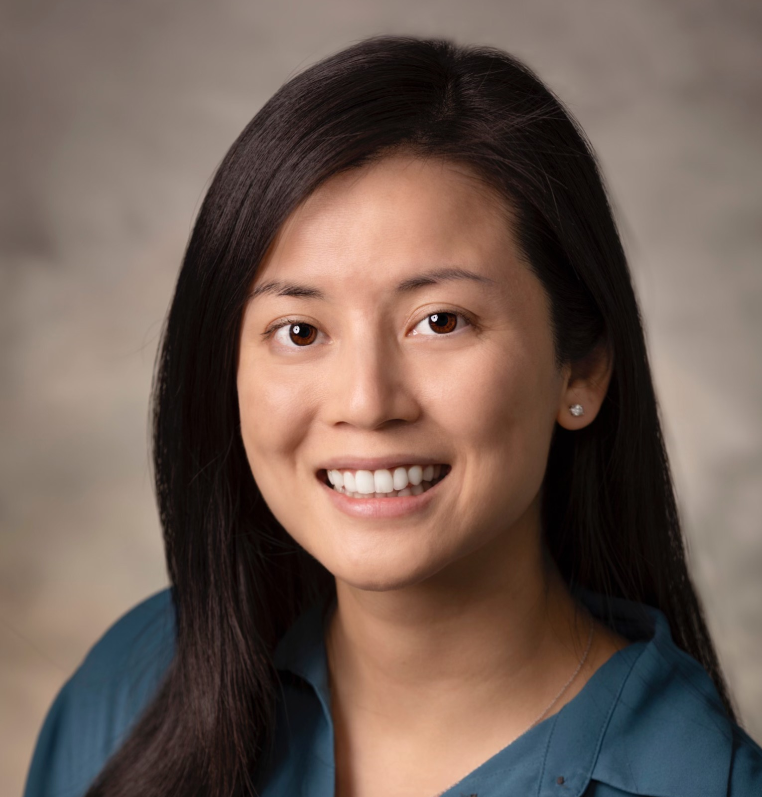
Jose Cortes-Briones, PhD jose.briones@yale.edu
Emily Lee, MD
emily.lee@yale.edu
Notes:
Thank you for your time and we’d love to take questions or comments now. Meanwhile, Ella will pass around a couple of prototypes.

