Slide 1
Exoscope
Taking the bite out of heart transplant monitoring
Yale PitchFest 2023

Slide 2
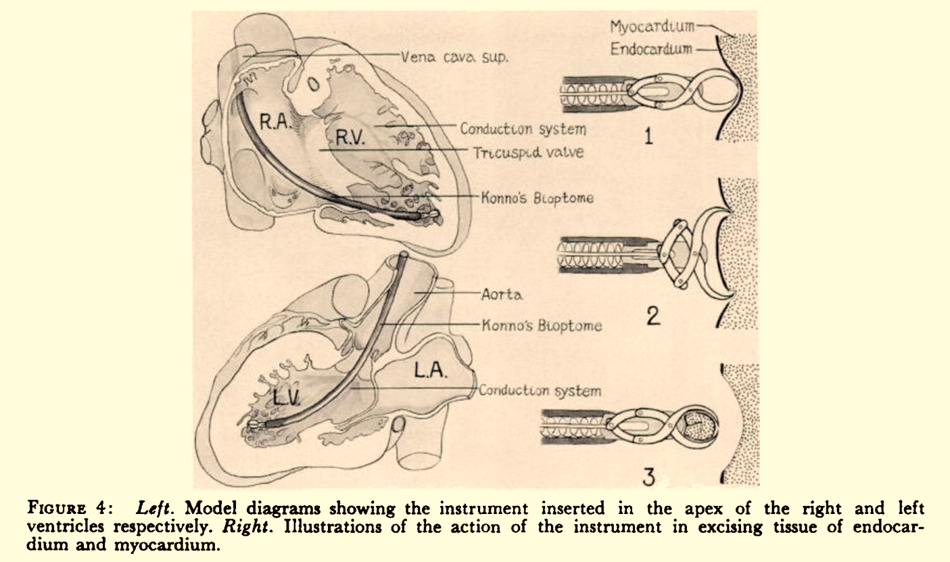
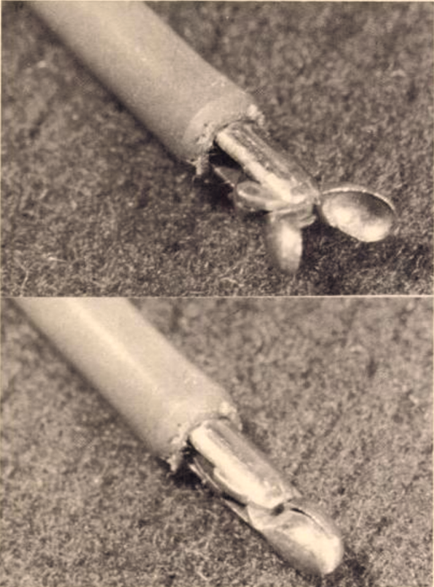
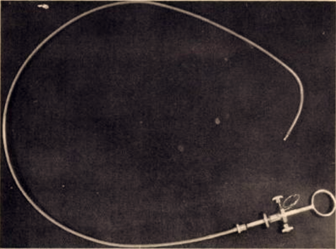
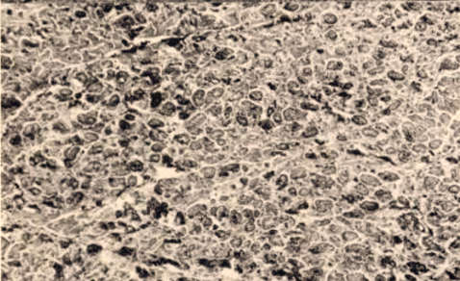
The last breakthrough in heart transplant rejection monitoring was in 1963
Konno & Sakakibara. (1963). Endo-myocardial biopsy.
Diseases of the chest, 44, 345–350.

Slide 3
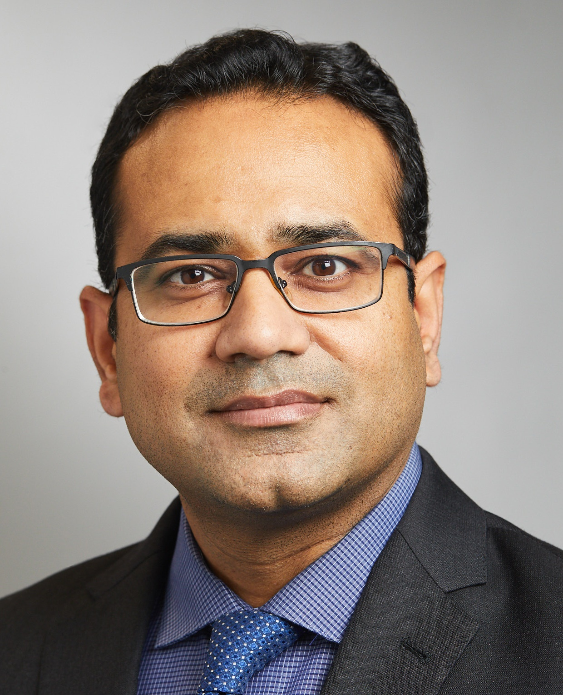
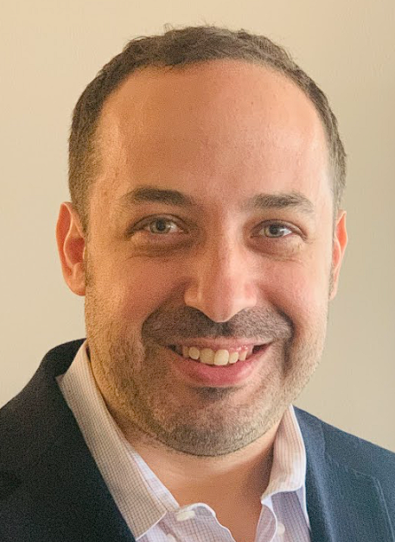
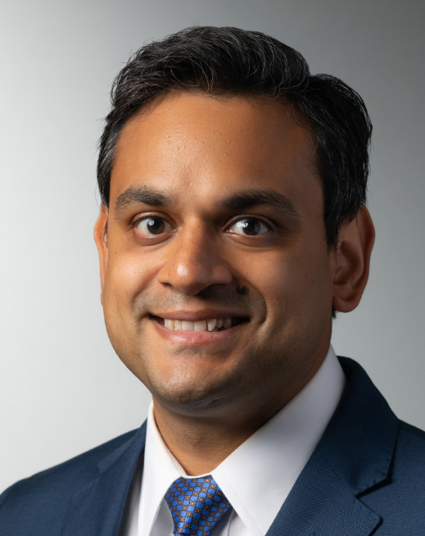
60 years later, Exoscope is developing the next breakthrough
Academic inventor, co-founder, PI |  | Co-founder, CEO
Academic inventor, co-founder |  | Clinical Advisor
Dr. Prashanth Vallabhajosyula Assoc. Prof. Cardiac Surgery Assoc. Program Director, Cardiothoracic Surgery Director, Aortic Institute |  | Joseph Gennaro, PhD Full-time commitment Yale spin-out / tech transfer experience 4 patents in microfluidics / assay dev
Laxminarayana Korutla, PhD Senior Research Scientist, Yale School of Medicine 11+ years of exosome-based diagnostic research |  | Dr. Sounok Sen Assistant Professor Medical Director, Cardiac Transplantation

Slide 4
9,000 heart transplants / year
65,000 living patients
# global annual transplants by organ
$530M TAM*
50% die by year 10
*65,000 patients, 4 tests/year, $2,000/test.

Slide 5
Walking the immunosuppression tightrope
infection
malignancy
acute rejection
Year 1
Years 2-5
Year 6+
Contribution to mortality in heart transplant recipients
Hsich 2022, Giuliano 2020

Slide 6
Goal: enable precision care without surgical biopsy
Surgical biopsy
Up to 20x in 2 years
$10k-$60k cost
Discordant reads in severe rejection
Circulating DNA/RNA
n/a for first 1-2 months
Can only rule out rejection
Poor correlation with rejection severity
Breakthrough diagnostic
Works from first week on
No surgical follow-up
Enables precision treatment

Slide 7
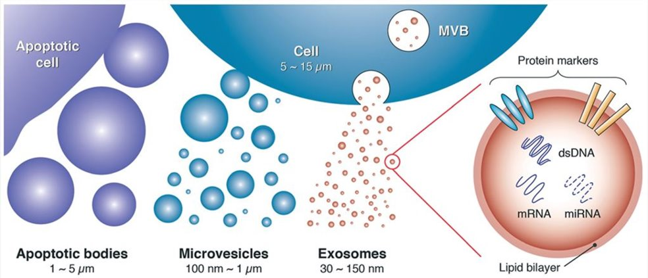
Exosomes are nanoscale vesicles that mediate intercellular communication
Contreras-Naranjo JC, Wu HJ, Ugaz VM 2017

Slide 8
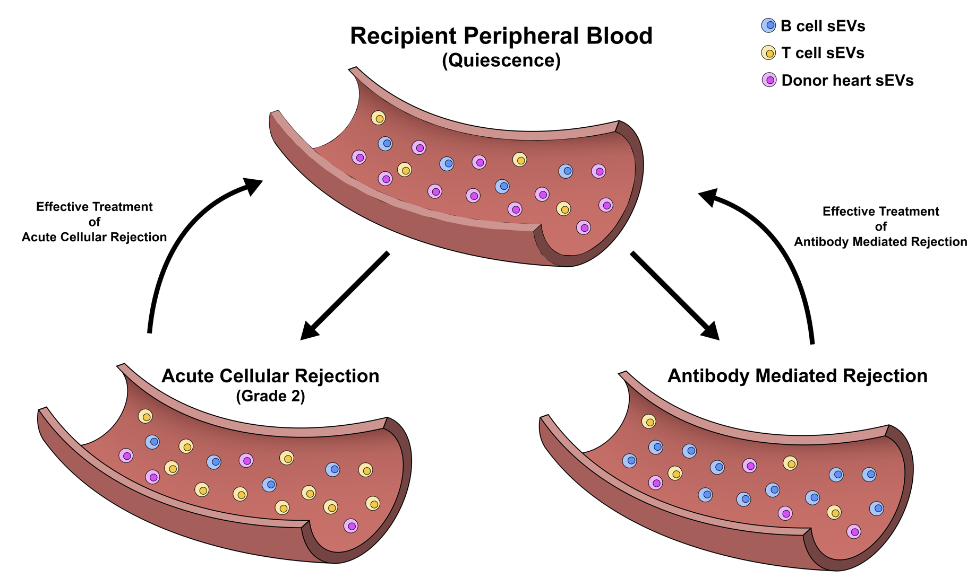
Exosomes provide molecular window into rejection pathophysiology
*Protected by 5 patent applications co-assigned to Yale

Slide 9
12-patient / 70-sample pilot validates high performance of 8 biomarkers
Exoscope biomarkers
Commercially available assays
Detected all rejection episodes
Highly time-specific
Started working in first week
Detailed data available on request with CDA

Slide 10
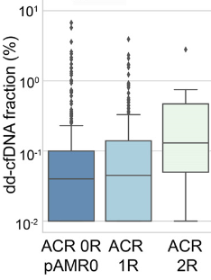
Our biomarkers correlate with rejection severity
Exoscope biomarkers*
Commercially available assay
p=.002
p=3.9x10⁻⁵ | p=5.6x10⁻⁶ | p=8.3x10⁻⁶ | p=6.0x10⁻⁵
p=6.9x10⁻⁷ | p=9.9x10⁻⁶ | p=9.1x10⁻⁵ | p=1.6x10⁻⁵
*Detailed data available on request with CDA
p-values for Grades 0/1R vs 2R/3R rejection
Kim 2022

Slide 11
Use of development award: enabling clinical trial
Discover biomarkers
Clinical pilot
Retrospective validation --
900 samples in hand from 60 patients with IRB/consent
Clinical trial
Study outcomes:
Determine predictive power for acute rejection in larger, true-prevalence cohort
Demonstrate reduced mortality, increased QOL, and/or reduced cost in simulated surgery-free care
Category | Consumables | Labor | Total
Exosome enrichment / quality control | $16,000 | $36,000 | $52,000
Protein biomarker analysis (Keck Proteomics Core) | 25,000 | 120,000 | 145,000
RNA biomarker analysis | 45,000 | 20,000 | 65,000
Regulatory / Process / Bioinformatics | -- | 38,000 | 38,000
Cost to analyze 400 samples (out of 900 available) | $86,000 | $214,000 | $300,000

Slide 12
Thank you!
prashanth.vallabhajosyula@yale.edu
joe@exoscope.bio

Slide 13
Surgical biopsy: standard of care in heart transplant surveillance
Biopsy shows rejection?
More treatment
More infection, cancer
Baseline treatment
Increased risk of rejection
Surgical biopsy
Expensive
Invasive
Imprecise
50% of heart transplant patients die in 10 years

Slide 14
Existing liquid biopsies have not replaced surgical biopsy
Surgical biopsy
Baseline treatment
Month 1-2?
Liquid biopsy positive?
Surgical biopsy
Existing liquid biopsies
n/a for first 1-2 months
Can only rule out rejection
Poor correlation with rejection severity

Slide 15
Opportunity to improve patient outcomes and reduce cost of care
Improve quality of life
Molecular window into rejection
Precisely guide treatment
Reduce mortality
Reduce burden of care
Exoscope goal
Works from first week on
No surgical follow-up
Enables precision treatment

Slide 16
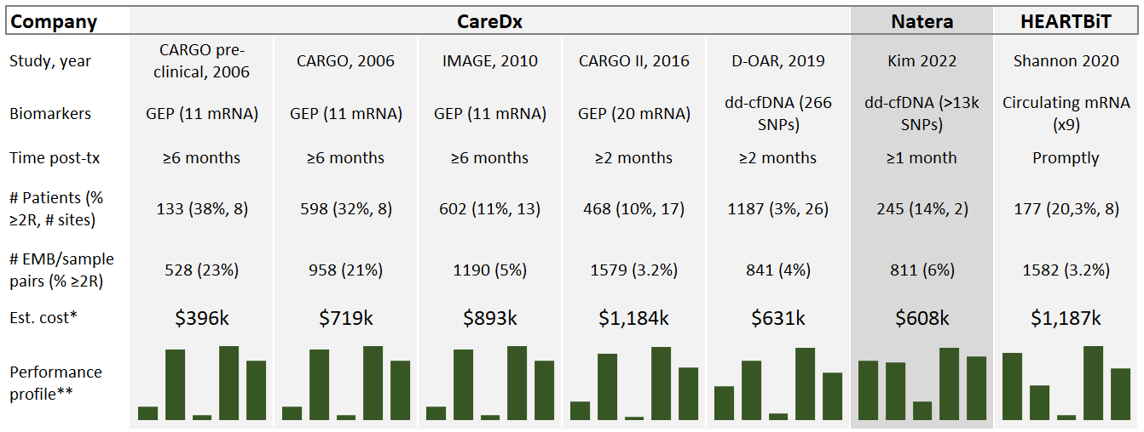
Comparable Liquid Biopsy Validation Studies
*Assumes liquid biopsy costs $500. For clinical studies, assume clinic bears cost of standard care.
**Vertical bars depict sensitivity, specificity, positive predictive value, negative predictive value, and area under the curve on 0-100% scale. All statistics for discriminating ≥2R vs 0/1R. Detailed data with sources available upon request.

Slide 17
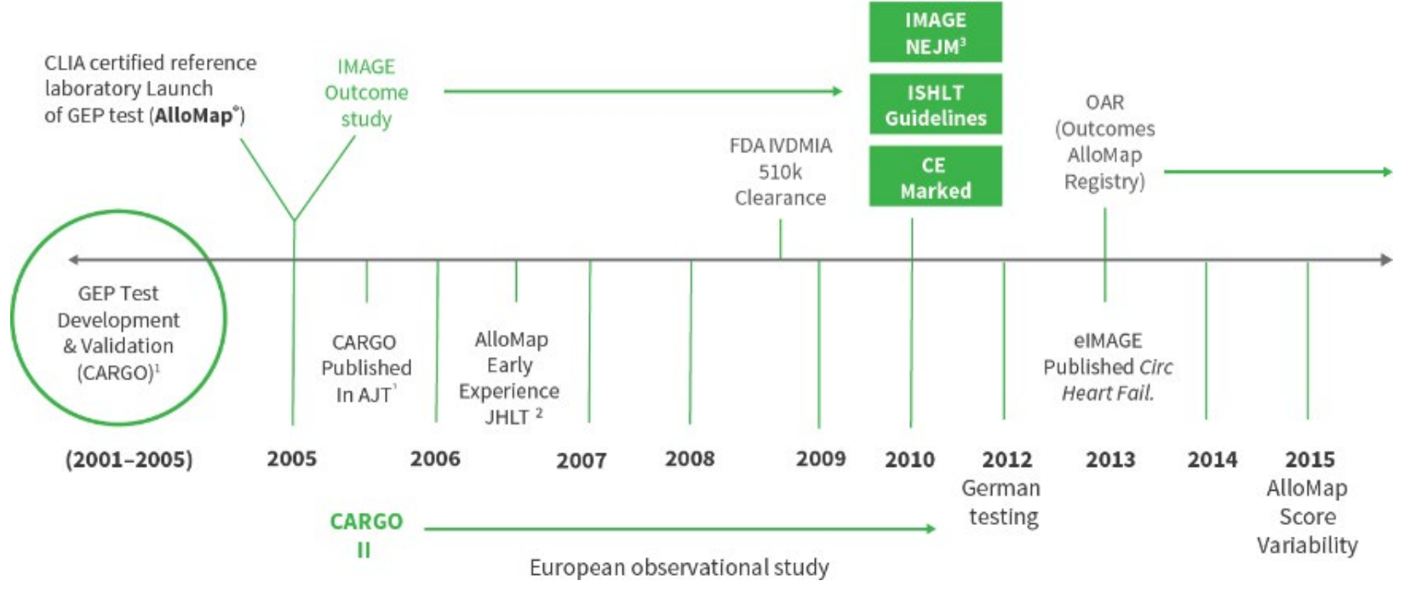
Comparable Liquid Biopsy Validation Timeline
Deng 2016

