Slide 1
Therapeutic Immunization for Cancer (From Kennel to Clinic…Bark to Bedside)
The therapy is in clinical trials in canine cancer and awaiting licensing by the USDA as a veterinary cancer biologic.
Yale IP with granted claims for both human and dogs.
Therajan.com
Notes:
Tran, MIF – D-DT (https://ventures.yale.edu/yale-technologies/bispecific-mif-d-dt-targeting-enhance-immunotherapy-responses) – 0:15-0:36
Manifest (https://ventures.yale.edu/yale-technologies/manifest-technologies-inc) – 0:45-1:00

Slide 2
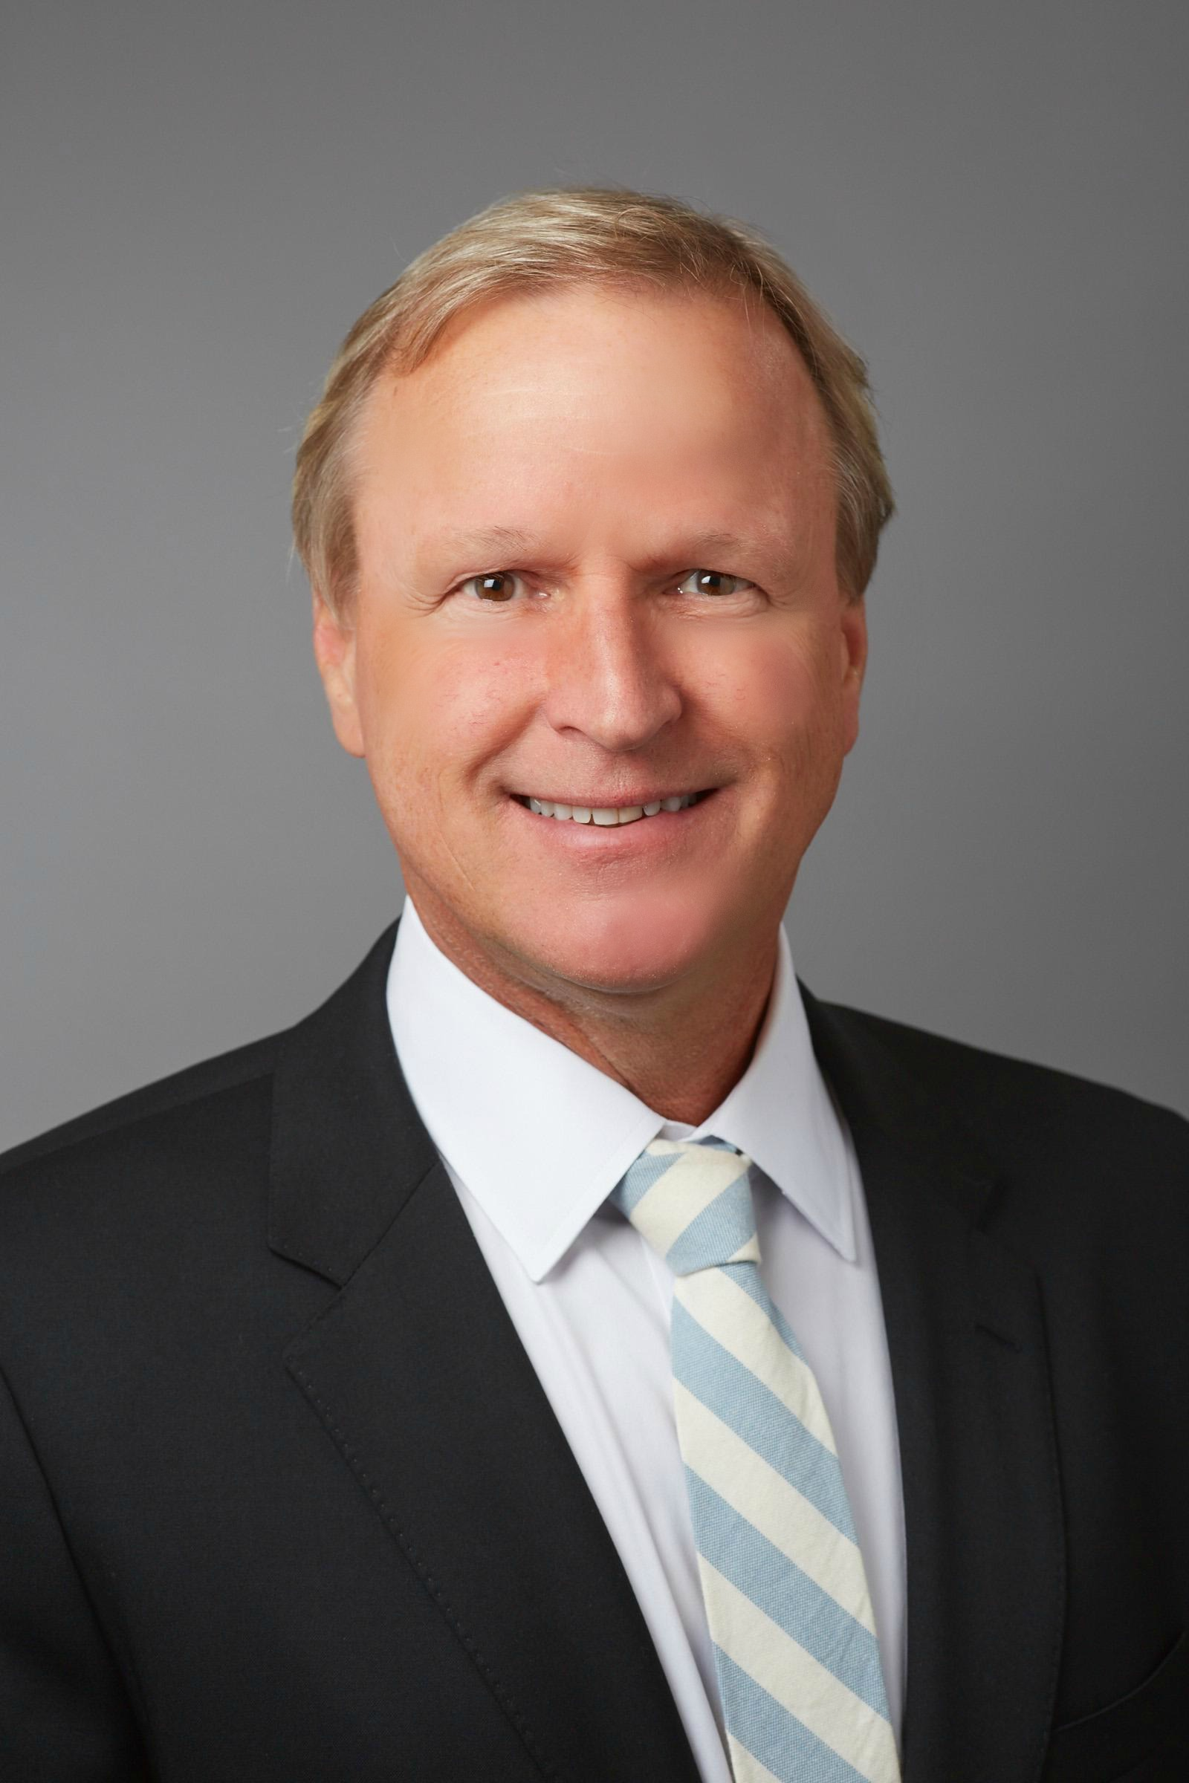
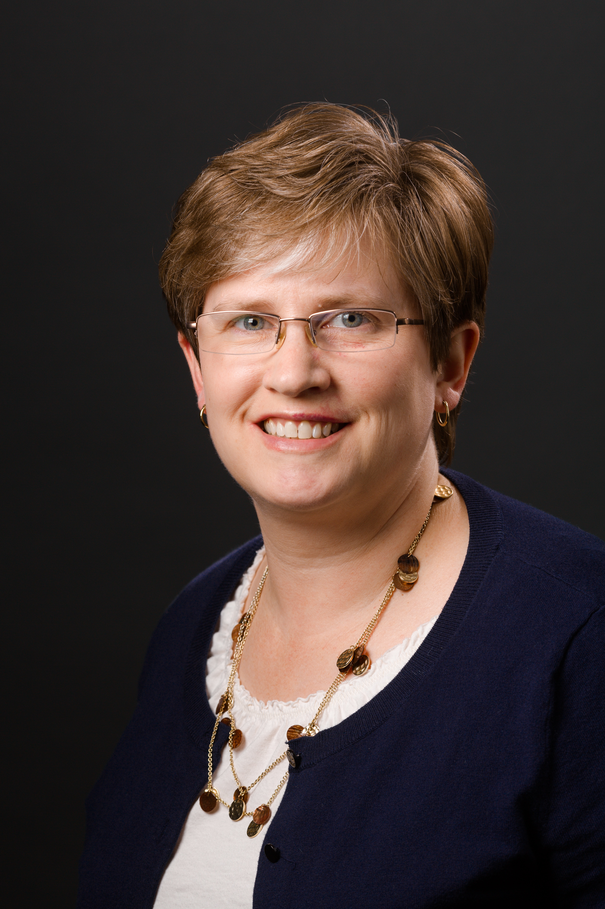
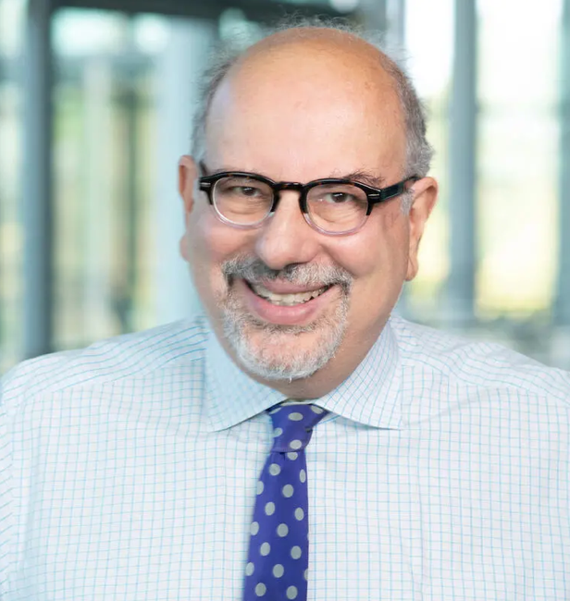
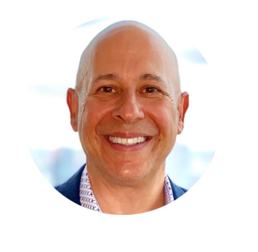
Management Team for Human Cancer Therapy
Mark J. Mamula, Ph.D.
Professor of Medicine, Yale University School of Medicine
Co-founder / CEO
Cancer Immunologist
Yale Cancer Center
Hester A. Doyle, Ph.D.
Research Scientist, Yale University School of Medicine
Immunologist; cancer therapeutics
Barry Nalebuff, Ph.D.
Milton Steinbach Professor of Management Yale University
Business Development lead
Cofounder Honest Tea, NBA advisor, Board of Nationwide Insurance
Howard Weisman, Chairman/CEO Paxmedica
Expert in medical biotechnology; Business advisor
PRE-IND Advisor
Co-Founder Sofregen
Former Chair/CEO EKR Therapeutics

Slide 3
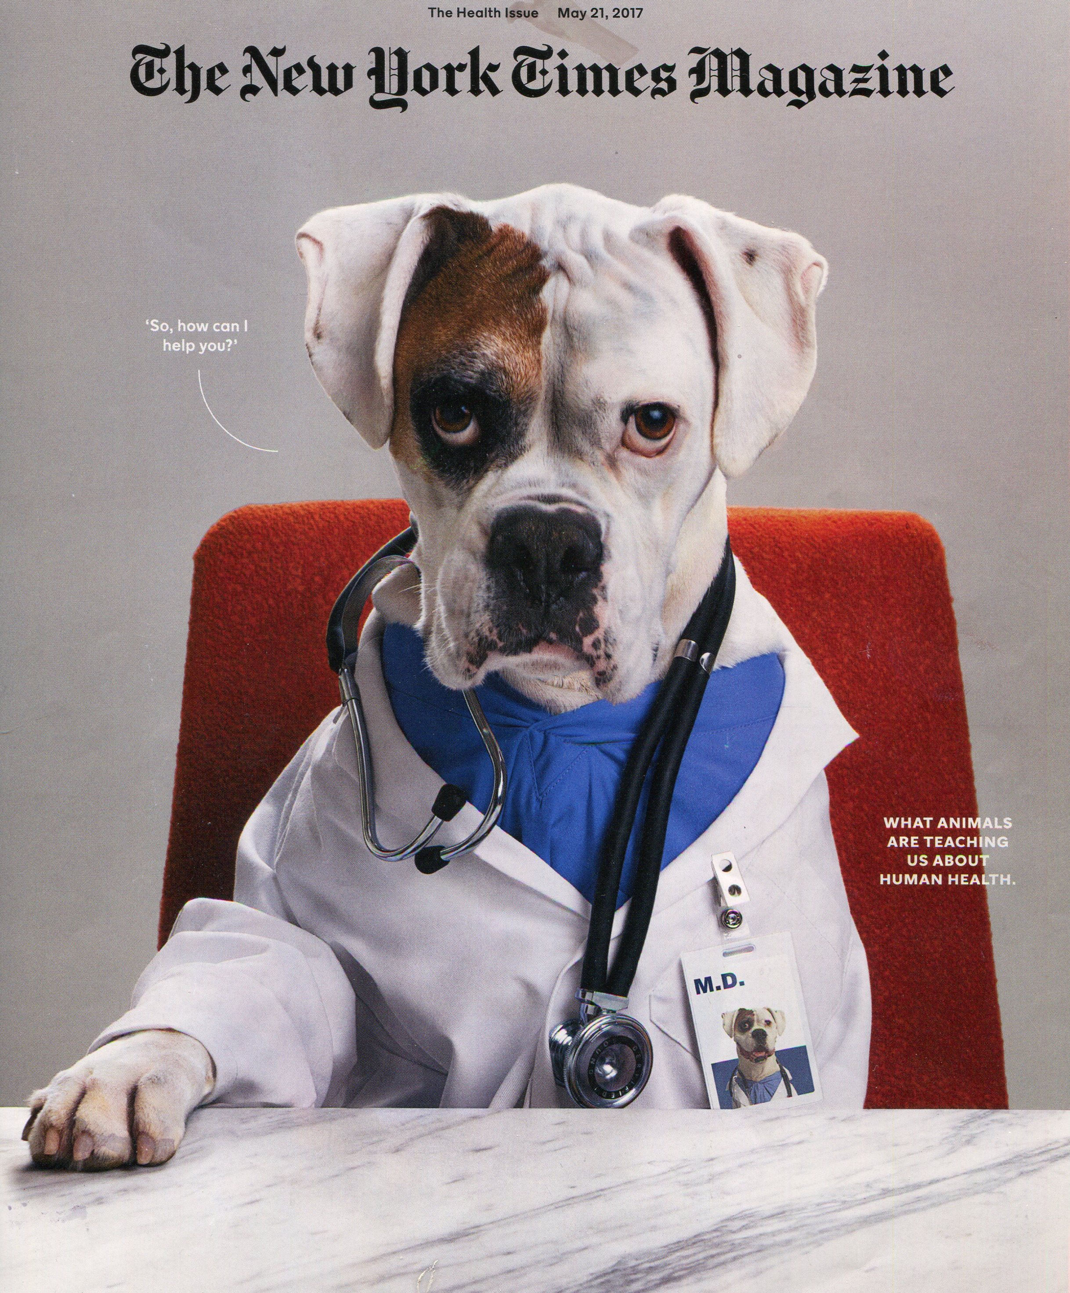
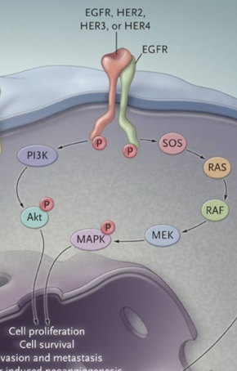
Why now? EGFR/HER2 positive tumors, including breast and colon cancers, are aggressive human cancers with poor outcomes.
EGFR/HER2 overexpression is associated with
Poor prognosis, tumor growth and metastasis.
EGFR/HER2 family cancers in humans:
Osteosarcoma
Breast Cancer
Colon Cancer
Lung Cancer
Brain Cancer
Ovarian Cancer
Prostate Cancer
Pancreatic Cancer
*Human and Canine neoantigen identical amino acid sequence at EGFR and HER2.
Notes:
Tran, MIF – D-DT (https://ventures.yale.edu/yale-technologies/bispecific-mif-d-dt-targeting-enhance-immunotherapy-responses) – 0:15-0:36
Manifest (https://ventures.yale.edu/yale-technologies/manifest-technologies-inc) – 0:45-1:00

Slide 4
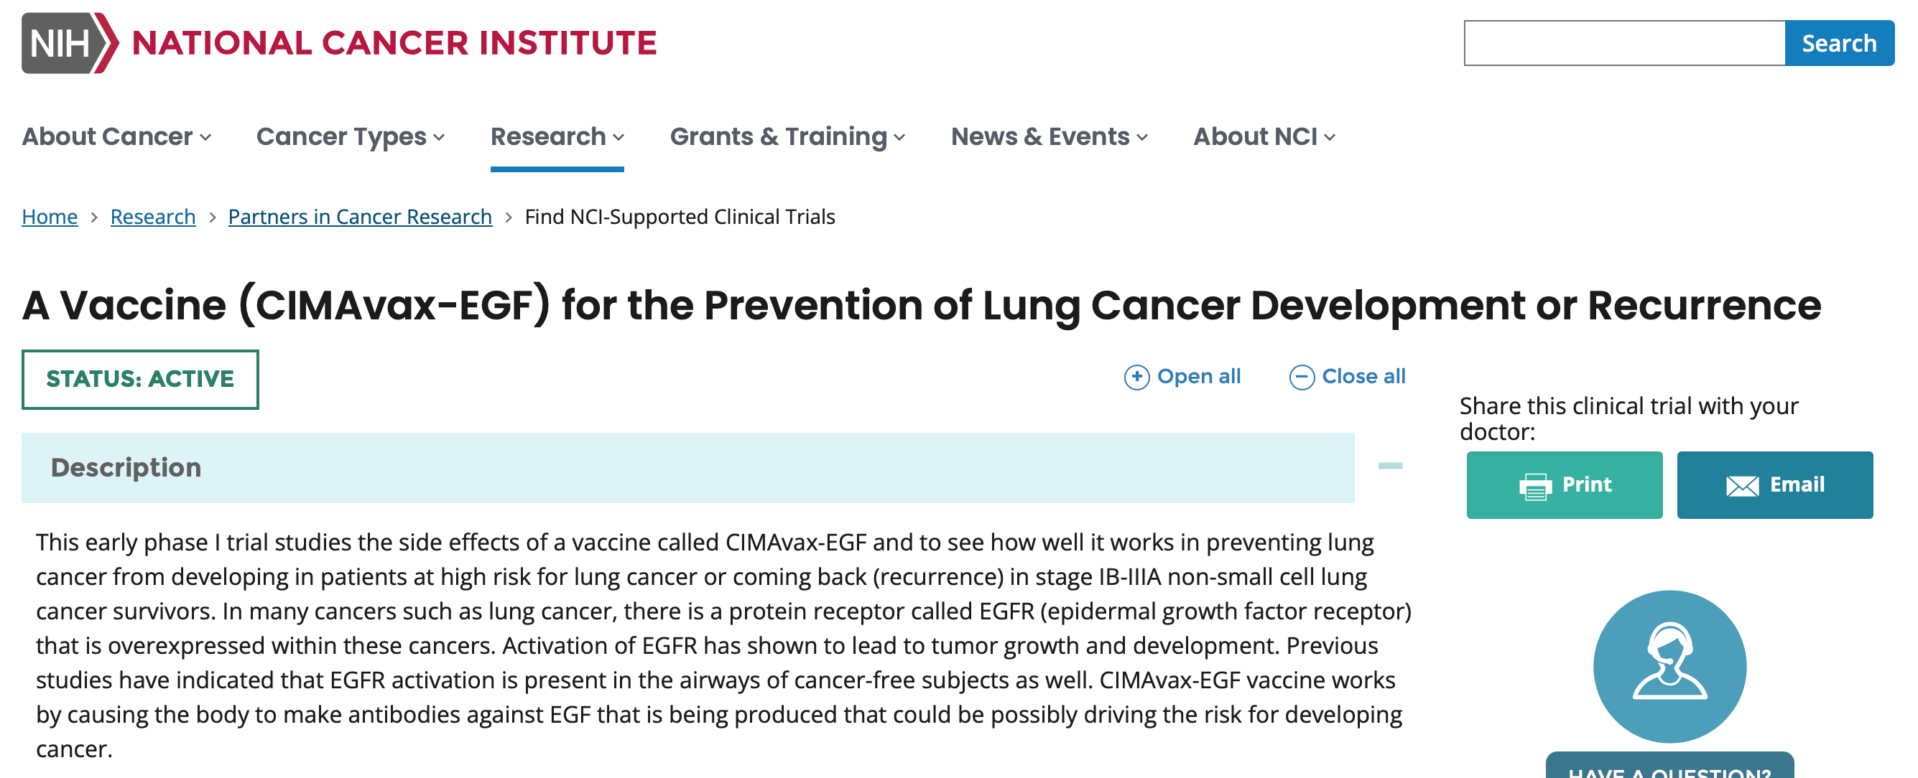
COMPETITIVE LANDSCAPE (other neoantigen cancer immunization strategies)
Clinicaltrials.gov.
-189 trials listed using neoantigens
-personalized neoantigens
-DNA neoantigen vaccines
-dendritic cell vaccines
Strengths of the neoantigen therapy:
Low cost of product (compared to monoclonal anti-EGFR/HER2 antibody)
Ease of administration (injection vs. repeated long term IV infusion with monoclonal antibody therapy)
No significant side effects noted in canine cancers (over 3 years in individual patients)
Granted Claims/IP issued to Yale for human applications
Vaccine therapy to inhibit EGF (the protein that binds EGFR)
Notes:
Examples:
ConsultUS (https://ventures.yale.edu/pitch/consultus-your-digital-addiction-consultants) – Problem setup 0:32 – 1:31
Medzhitov, Inflammatory (https://ventures.yale.edu/pitch/identify-new-class-therapeutics-inflammatory-diseases) – 0:30-2:17
Lee/Cortes-Briones, Fetal EEG (https://ventures.yale.edu/yale-technologies/non-invasive-fetal-brain-monitoring) – 0:12-2:25
A few questions you could ask yourself, among others:
Who are your competitors?
Are they local, regional, national or global?
Are there any product alternatives to your product?
What about their IP / technological advantage?

Slide 5
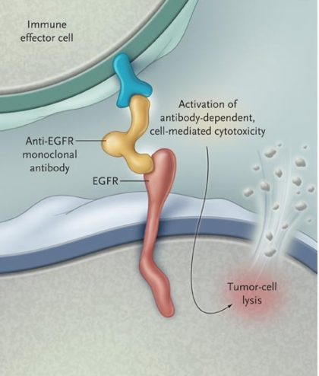
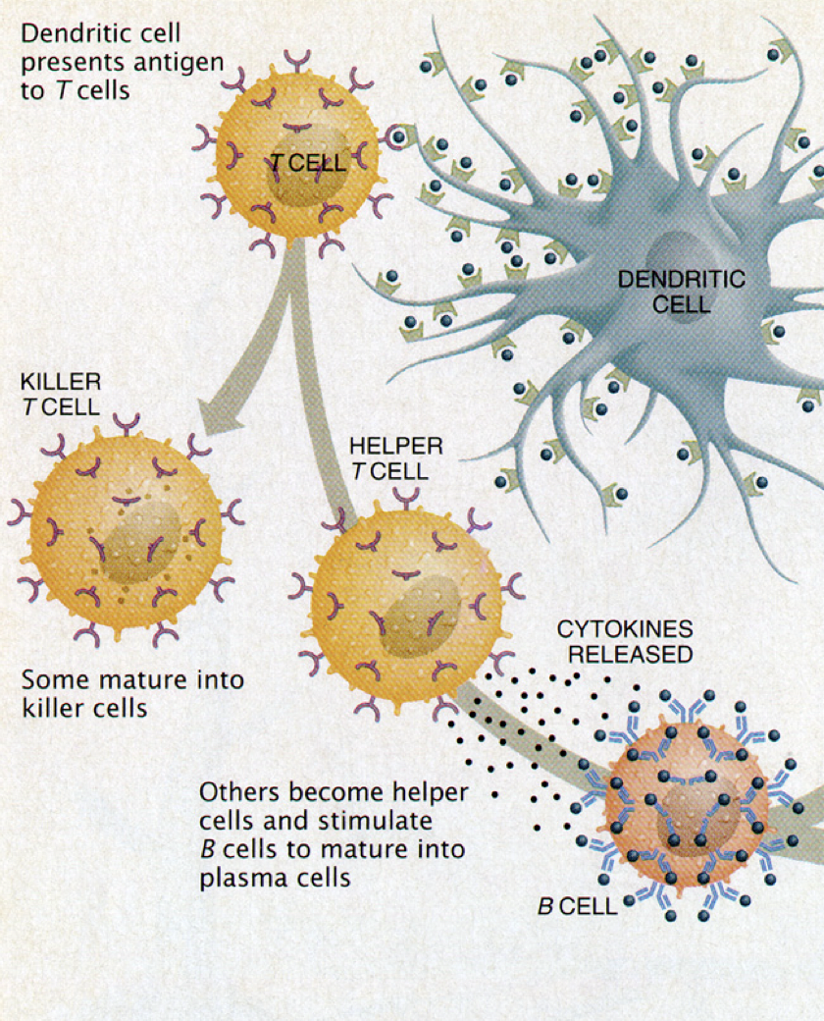
Our solution is to enhance immune T cells AND antibody to attack EGFR/HER2+ tumors.
EGFR/HER2
Peptide Neoantigen
Immunization
Anti-EGFR/HER2
Antibodies
And T Cells
Homing to Tumor and Tumor Killing
Neoantigen EGFR peptide binds HLA class I of 98% of humans, 62% of human class II.
IQCAHYIDGPHCVKTCPAG (EGFR)
Notes:
Examples:
ConsultUS (https://ventures.yale.edu/pitch/consultus-your-digital-addiction-consultants) –0:32 – 1:31
Medzhitov, Inflammatory (https://ventures.yale.edu/pitch/identify-new-class-therapeutics-inflammatory-diseases) – 0:30-2:17
Lee/Cortes-Briones, Fetal EEG (https://ventures.yale.edu/yale-technologies/non-invasive-fetal-brain-monitoring) – 0:12-2:25

Slide 6
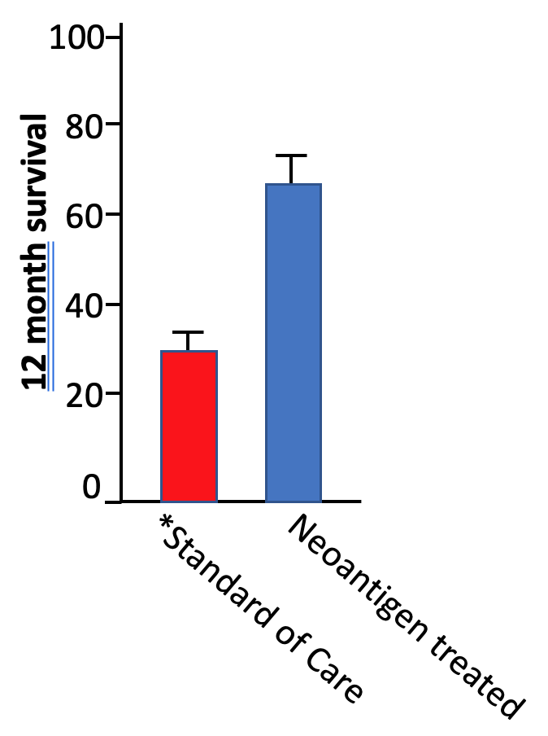
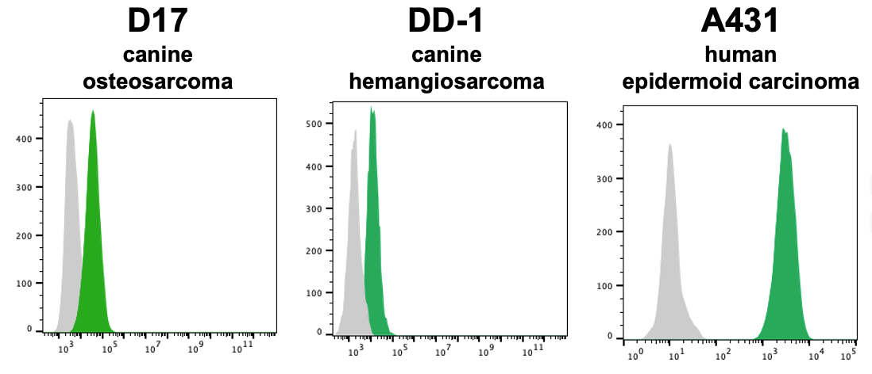
Translating Canine Cancer Therapy to Human Disease
Anti-EGFR binds human and canine tumor cells
Proof of Concept for Neoantigen Immunization
Resolution of metastases
Increased Survival Compared to
Standard of Care (n=80 patients)
Doyle, et al, Translational
Oncology 2021
Notes:
Examples:
ConsultUS (https://ventures.yale.edu/pitch/consultus-your-digital-addiction-consultants) – Problem setup 0:32 – 1:31 – the problem setup is great, and particularly like 1:30-2:00 where the solution is described to fit into the problem
Medzhitov, Inflammatory (https://ventures.yale.edu/pitch/identify-new-class-therapeutics-inflammatory-diseases) – 0:30-2:17 – both setup and introduction the solution is good, in both problem and solution Medzhitov simplifies for the audience so they can understand a highly scientific/mechanistic solution
Lee/Cortes-Briones, Fetal EEG (https://ventures.yale.edu/yale-technologies/non-invasive-fetal-brain-monitoring) – 0:12-2:25 – Another example of problem/competitive (Standard of Care) wrapped into one and sets up the solution itself. You get to the end of her personal stories and left wondering “well what can be done?”

Slide 7
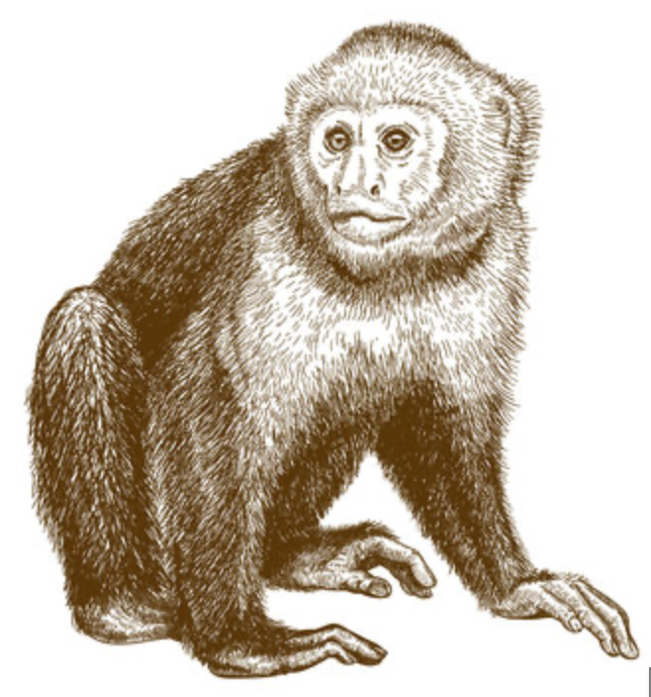
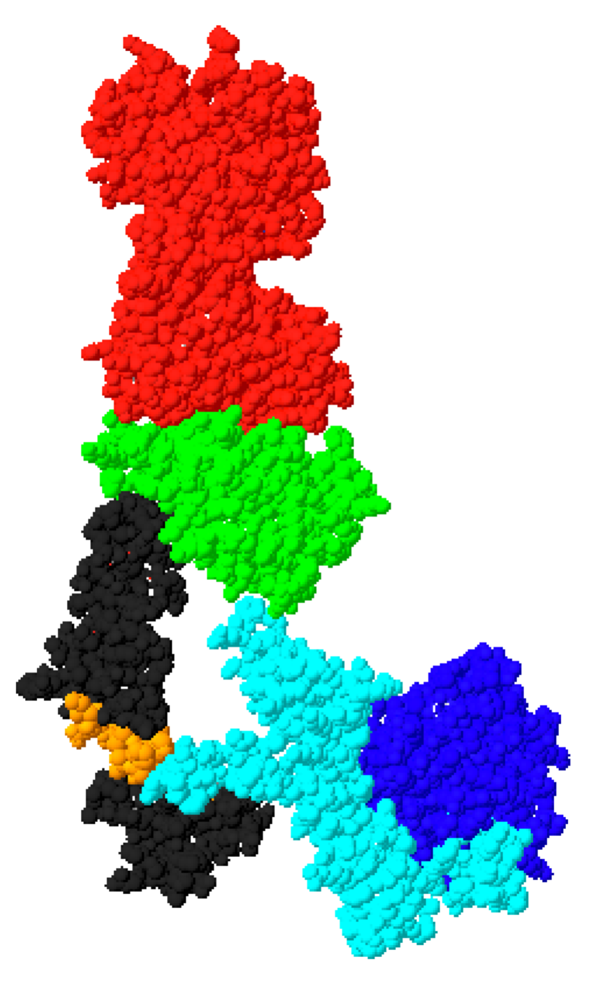
BUDGET/MILESTONES ($300K over 24 months)
Timeline of Product Development
MONTHS
Pre-IND
0
2
3-6 months
6-12 months
12-18 months
18-24 months
($30K)
**Synthesize
Product
($20K)
Primate
Immunization
($145K)
Assess anti-EGFR
Responses
($35K)
Tumor Killing
Studies in vitro; Binding to Human Tumors
Toxicology, pathology
Durability of immunity
Booster immunizations?
($70,000)
Final toxicity studies
Final tumor killing studies
n=6
EGFR
**Components of the vaccine for canine cancer are identical to that utilized in human cancer:
**Human GMP manufactured adjuvant (already used in other human vaccines)
Tumor cell
Notes:
Examples:
ConsultUS (https://ventures.yale.edu/pitch/consultus-your-digital-addiction-consultants) – Problem setup 0:32 – 1:31
Medzhitov, Inflammatory (https://ventures.yale.edu/pitch/identify-new-class-therapeutics-inflammatory-diseases) – 0:30-2:17
Lee/Cortes-Briones, Fetal EEG (https://ventures.yale.edu/yale-technologies/non-invasive-fetal-brain-monitoring) – 0:12-2:25

Slide 8
Highly Conserved Sequence Similarity Between EGFR, Her2 and Her3
(how we chose neoantigen peptide immunogens)
IQCAHYIDGPHCVKTCPAG human/mouse EGFR p580-598
IKCAHYIDGPHCVKTCPAG canine EGFR p527-545
VACAHYKDPPFCVARCPSG human HER2 p585-603
CAHYIDGPHCVKTCPAG canine HER2
AQCAHFRDGPHCVSSCPHG human HER3 p574-592
AQCAHYIDGPHCVKTCPAG canine HER3
Sequence homology between canine EGFR, HER2, HER3 (bold black letters)
Antibodies to immunization with p527 EGFR bind HER2 and HER3

Slide 9
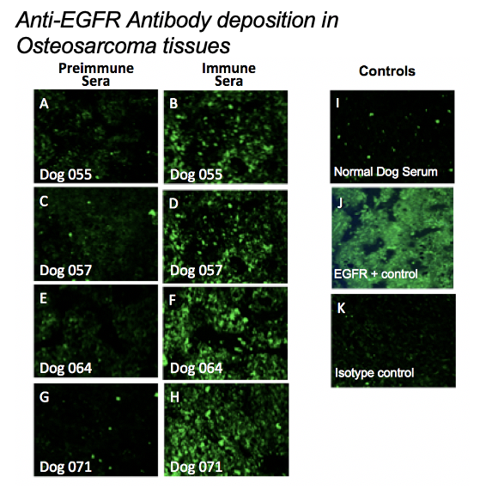

Slide 10
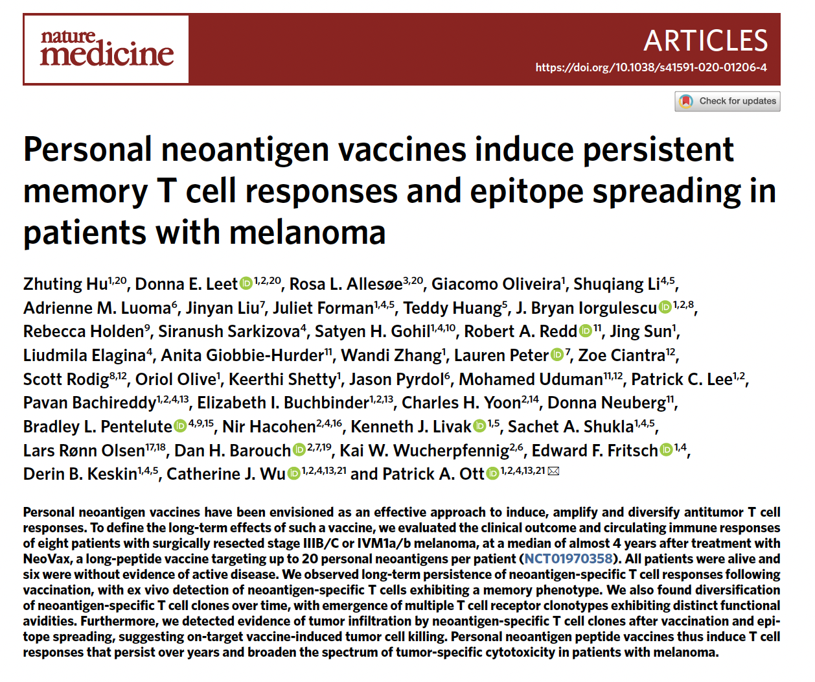
Epitope Spreading:
A fundamental immune pathway for survival
Ott, et al, Nature Med; 2021

