Slide 1


NuFoll: Programming skin cells to regrow natural hair
Peggy Myung, MD, PhD
Associate Professor
Department of Dermatology/Dermatopathology
Notes:
Good afternoon, My name is Peggy Myung -Im really excited to have this opp to share our project with you today.
Before i begin, I want to first make sure we are on the same page bc it’s fundamental to our technology: You may not know that the structure that gives us our visble hair and teeth is invisible and lies just below the skin surface.
And In my lab, we want to recreate this structure to regrow hair.

Slide 2
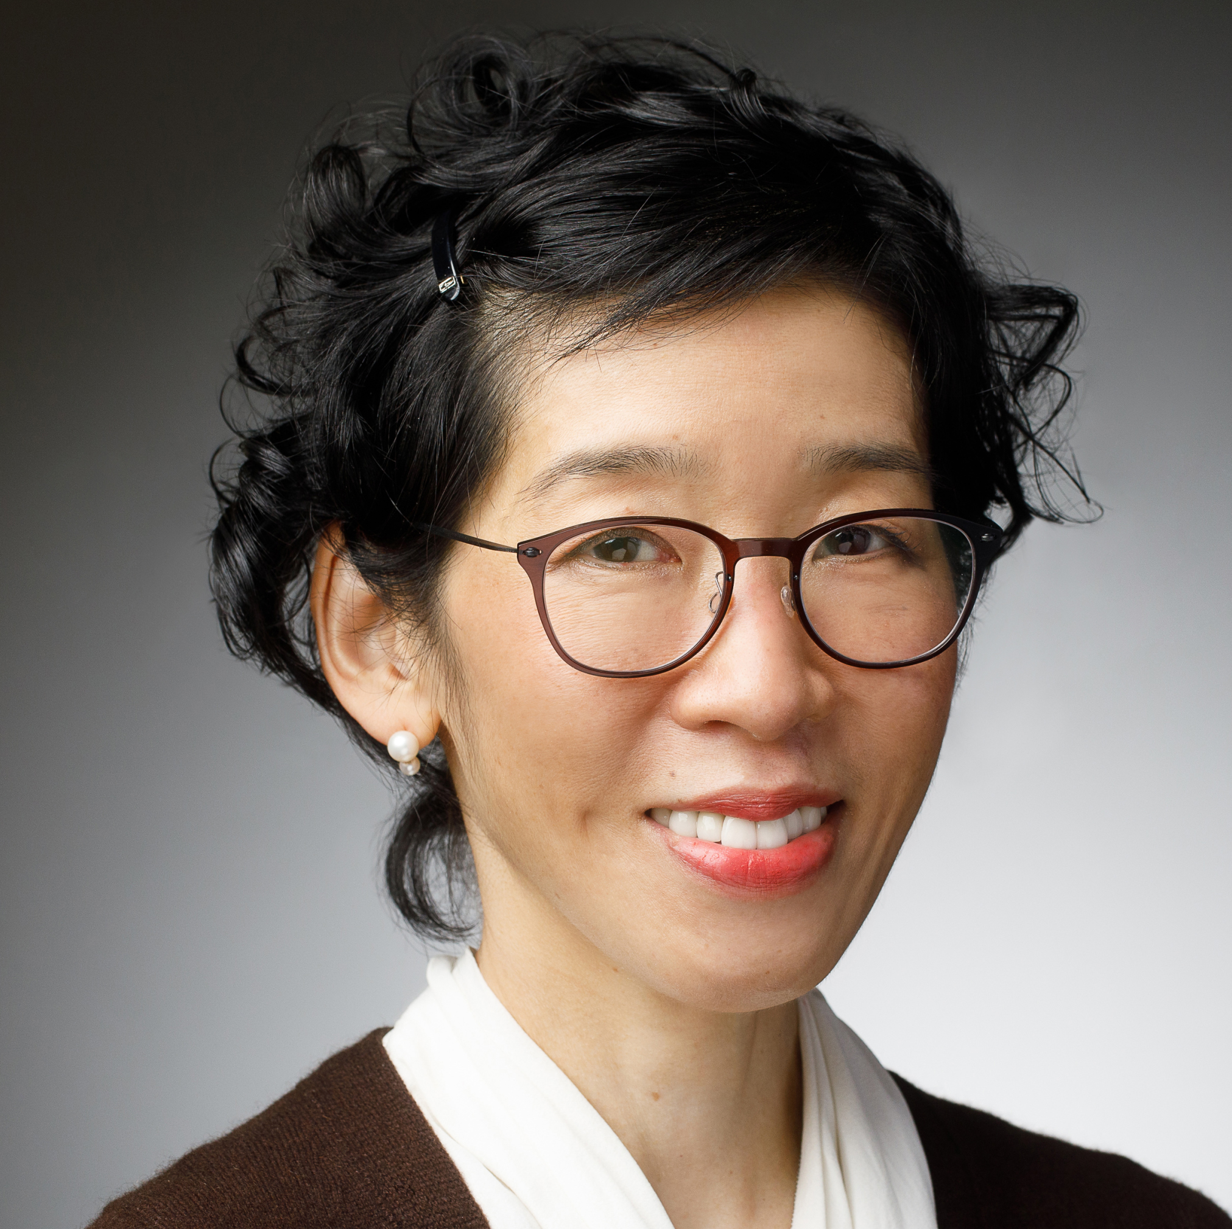
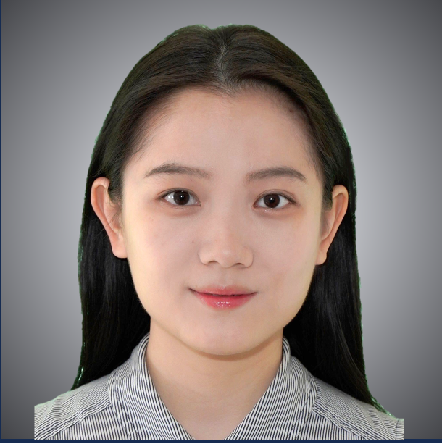
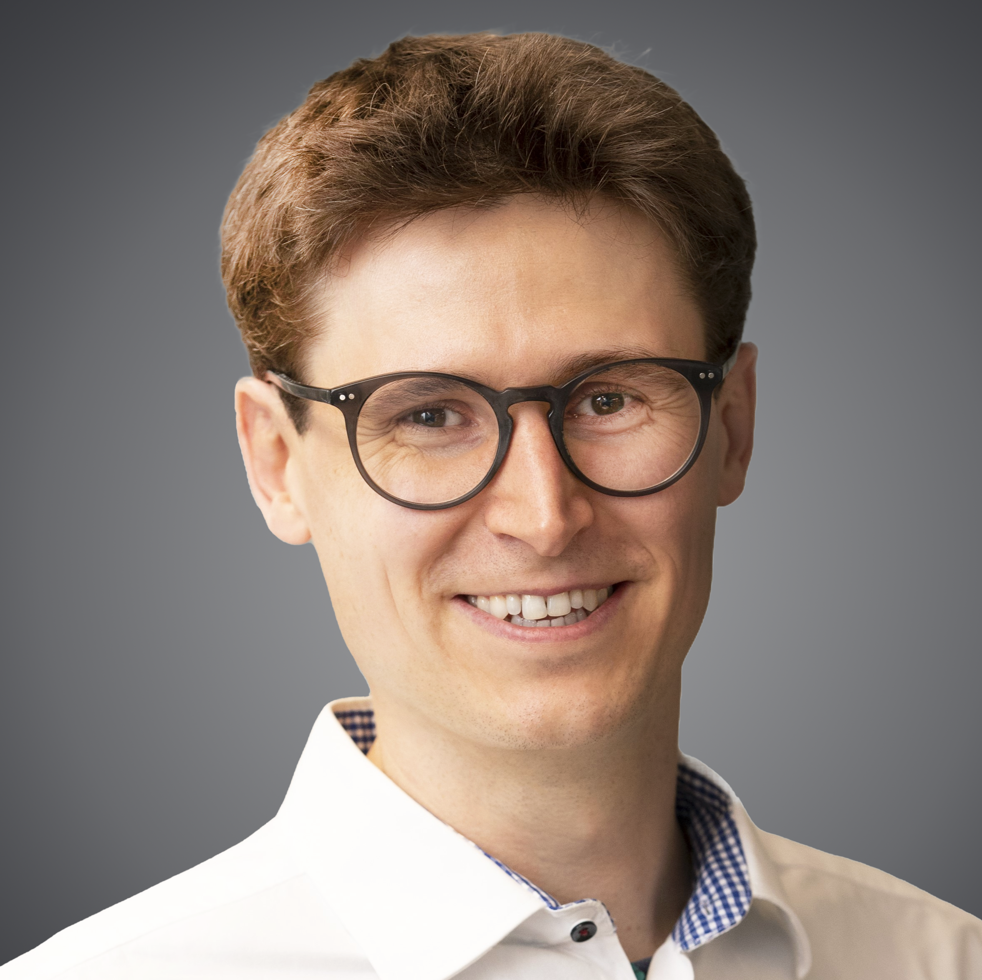
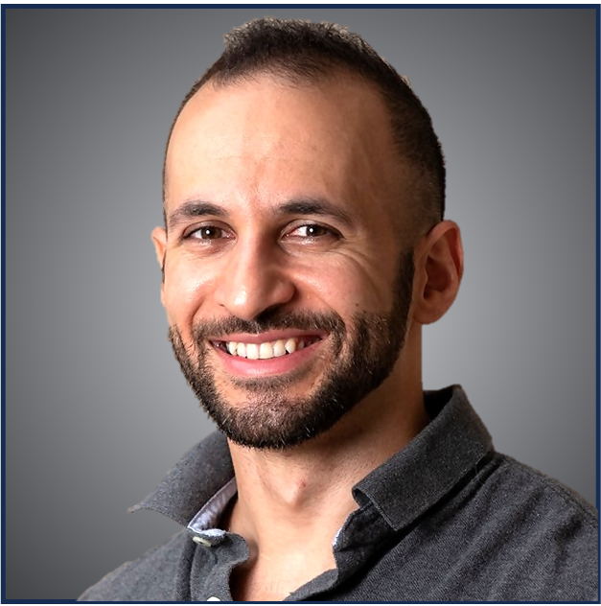
The Team
Peggy Myung, MD-PhD
Assoc. Prof. for Dermatology at Yale University
>15 years experience in hair regeneration
Yiqun Jiang
PhD candidate in the Myung Lab
Hair follicle development and hair regeneration
Manuel Mohr, PhD
Molecular Biotechnologist
Yale Blavatnik Entrepreneurial Fellow
Biotech leadership experience
Ali Hamodi Alshuwaykh, PhD
Assoc. Res. Scientist Yale Dept. Neuroscience
Yale Blavatnik Assoc.
Notes:
I want to intro you to our team. I am PS in derm with over 15 years of experience studying HF regeneration and development
My team is composed of scientists with complementary skillsets AND a common vision which is to regrow hair for adult men and women.
Yiqun Jiang a PhD student in my lab who has expertise in studying stem cells across diverse tissues as well as Manuel and Ali who are are helping us translate our biological discovery into therapies to treat hair loss
Examples:
ConsultUS (https://ventures.yale.edu/pitch/consultus-your-digital-addiction-consultants) – Problem setup 0:32 – 1:31
Medzhitov, Inflammatory (https://ventures.yale.edu/pitch/identify-new-class-therapeutics-inflammatory-diseases) – 0:30-2:17
Lee/Cortes-Briones, Fetal EEG (https://ventures.yale.edu/yale-technologies/non-invasive-fetal-brain-monitoring) – 0:12-2:25
A few questions you could ask yourself, among others:
Who are your competitors?
Are they local, regional, national or global?
Are there any product alternatives to your product?
What about their IP / technological advantage?
https://www.dreamstime.com/illustration/hair-loss.html
https://www.creativefabrica.com/product/severe-baldness-alopecia-in-women-vecto/
https://www.sciencedirect.com/science/article/pii/S2590255521000020

Slide 3
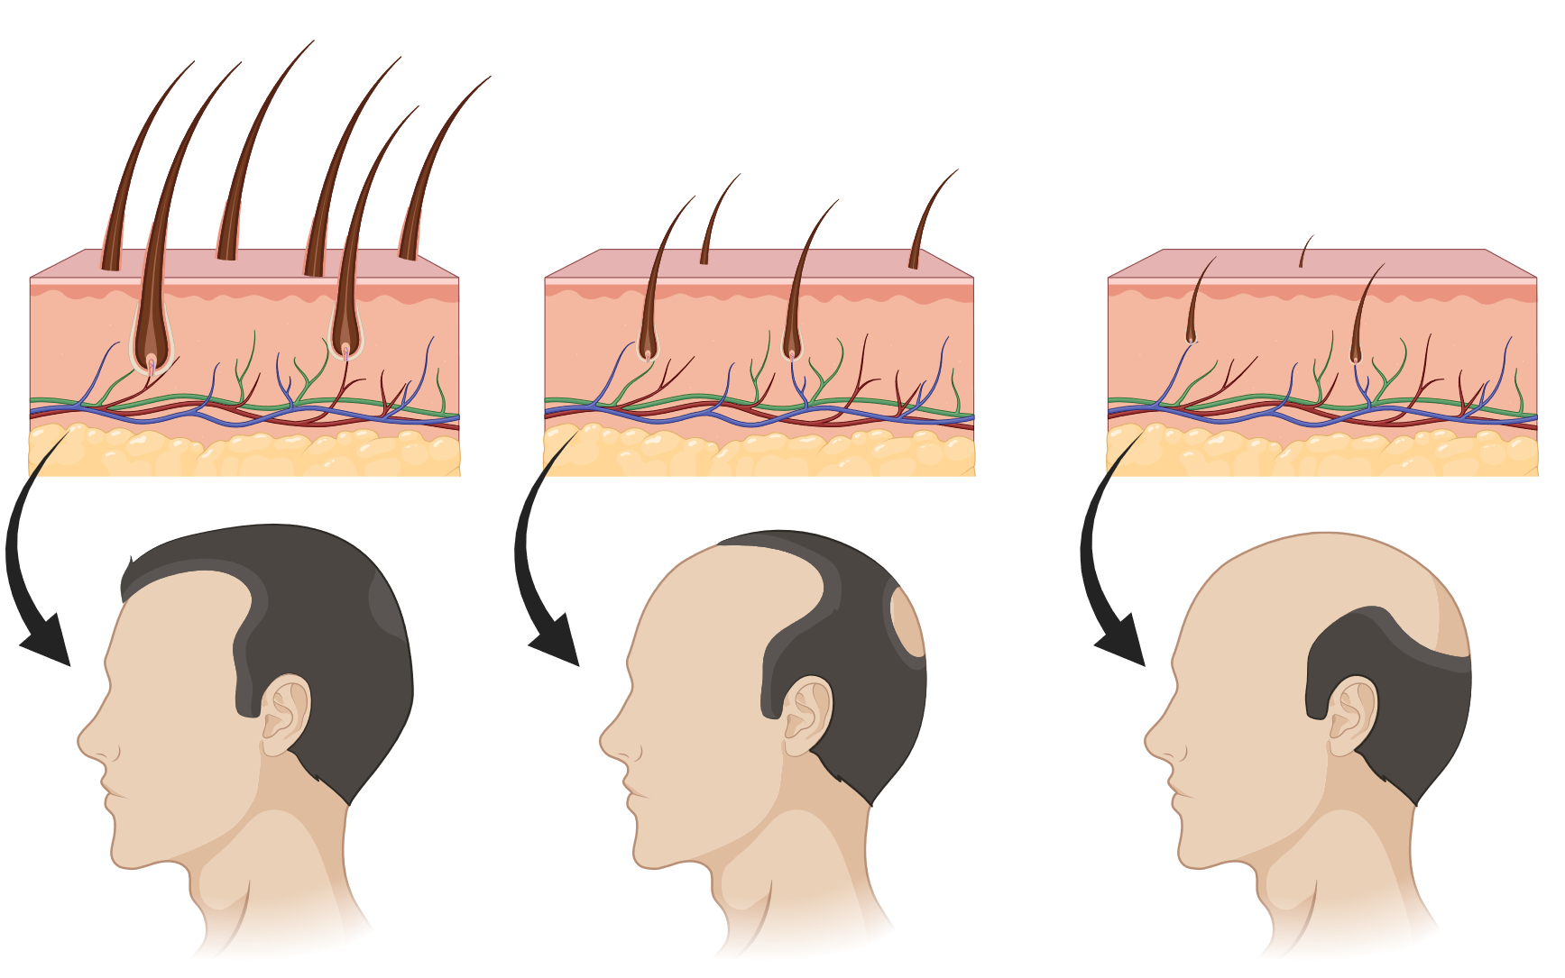


Problem/Indication
Alopecia Prevalence
(Many competitors target alopecia areata)
Male Patterned Hair Loss
Standard of care
>40% prevalence by age 35 ⁴
Minoxidil
1st Line
>65% prevalence by age 60 ⁴
Alopecia
Areata
0.5% ^{1,2}
Finasteride
>70% prevalence by age 80 ⁴
Hair transplantation
2nd Line
Female Patterned Hair Loss
Alternatives
Androgenetic Alopecia
99.5% ³
No NEW hair!
>40% prevalence by age 50 ⁴
Strazzulla et al. (2018). J Am Acad Dermatol.
Safavi KH, et al. (1995). Mayo Clin Proc.
Rinaldi F, et al. (2019). J Dermatol. Treat.
Hair Loss Statistics 2023 (Types, ...) medihair.com
confidential
Notes:
The most common type of hair loss is androgenetic alopecia (or commonly known as male patterned baldness) in which hair follicles in bald areas become irreversibly miniaturized to the point where they seem invisible. This is in contrast to many other causes of hair loss such as alopecia areata which is largely reversible and already has curative treatments available.
Despite the overwhelming prevalence of MPHL, current treatments are sorely unsatisfactory
Treatment: https://www.ncbi.nlm.nih.gov/pmc/articles/PMC10251289/
Cartoon: https://hairdoc.com.my/female-pattern-hair-loss/
Disease demographics: https://www.ncbi.nlm.nih.gov/books/NBK538178/
Examples:
ConsultUS (https://ventures.yale.edu/pitch/consultus-your-digital-addiction-consultants) – Problem setup 0:32 – 1:31
Medzhitov, Inflammatory (https://ventures.yale.edu/pitch/identify-new-class-therapeutics-inflammatory-diseases) – 0:30-2:17
Lee/Cortes-Briones, Fetal EEG (https://ventures.yale.edu/yale-technologies/non-invasive-fetal-brain-monitoring) – 0:12-2:25
A few questions you could ask yourself, among others:
Who are your competitors?
Are they local, regional, national or global?
Are there any product alternatives to your product?
What about their IP / technological advantage?
https://www.dreamstime.com/illustration/hair-loss.html
https://www.creativefabrica.com/product/severe-baldness-alopecia-in-women-vecto/
https://www.sciencedirect.com/science/article/pii/S2590255521000020

Slide 4
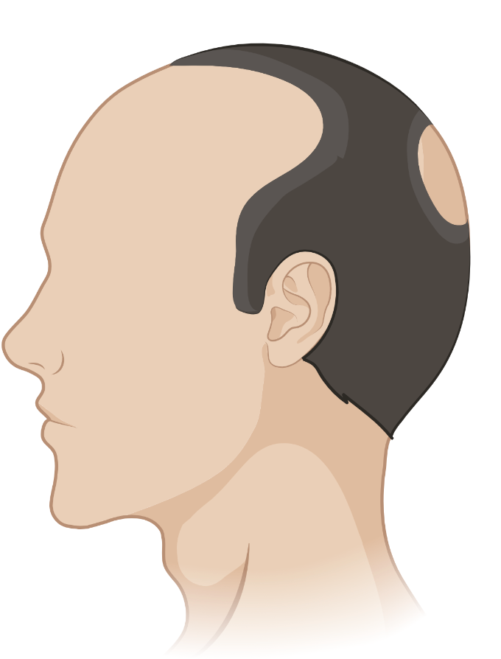
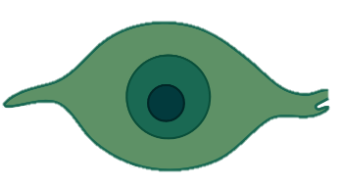

Current hair loss treatments grow
NO NEW HAIR
Option 1:
MAINTAIN existing hair
Option 2:
TRANSPLANT existing hair
Miniaturized hair
Existing Normal-sized hair
i.e. Minoxidil, Finasteride
confidential
Notes:
many of you may know that most first line treatments (inc minoxidil or finasteride) are targeted at just slowing down the inevitable loss of pre-existing hair follicles.
More durable and noticeable treatments entail transplanting existing normal-sized hair follicles from unaffected areas of the scalp to the area of hair loss, but the procedure is invasive, costly and difficult to recreate the natural texture and density of hair esp over the hair line giving an artificial look.
What is needed are methods to replace exhausted OLD hair follicles with brand new HFs

Slide 5
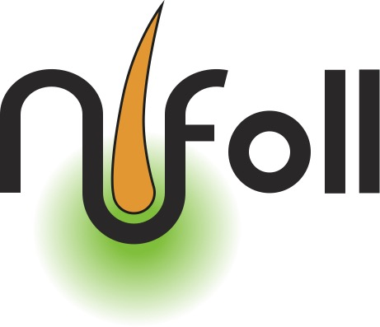
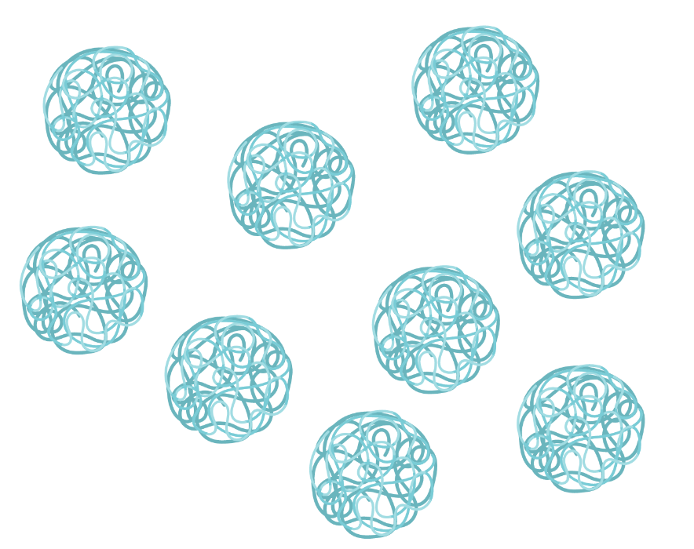
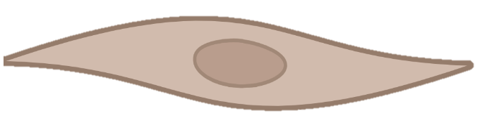
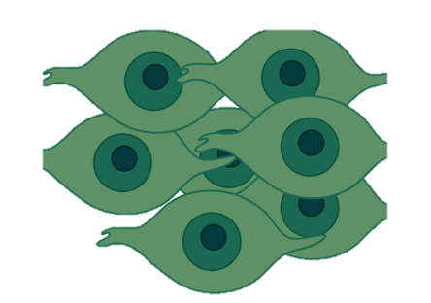
GROWS NEW HAIR
Hair-inductive
factors
Adult hair follicle
DC
Dermal condensate (DC)
progenitor cells
“embryonic”
hair follicle
NEW healthy hair
Our strategy:
Induce NEW hair follicles
confidential
Notes:
However, the HFs you have are the ones you were born with and if lost, they cannot grow back on their own.
Therefore, our strategy is to go back in time to recreate your original hair by resurrecting embryonic pathways of hair formation.
But to do this, we need to recreate the structure that initiates HF formation. This has not been done before.
As i said in the beginning, This structure lies beneath the skin surface and is called the dermal condensate. The dermal condensate or DC is composed of specialized dermal cells that induce hair formation during development. In adult skin, this DC persists as the permanent signaling center responsible for hair growth.
In other words, by generating DC’s in skin, we can induce New hair growth in balding areas.

Slide 6
Hair Loss: A large and growing market
Hair Loss Market
U.S. Available/Addressable Population
$9.5Bn
80M
US population diagnosed with androgenic alopecia (AGA)
6.0
US population diagnosed with
Male/female patterned alopecia (AGA)
$6.2Bn
+54.8%
80M
50M
Patients seeking
treatment
Patients seeking
treatment
U.S.
50M
CAGR: 5.6%
E.U.
Unsatisfied
patients
2022
‘23
‘24
‘25
‘26
‘27
‘28
‘29
2030
25M
Unsatisfied patients
25M
Hair Loss Statistics 2023 (medihair.com)
https://www.bosley.com
https://www.mayoclinic.org/diseases-conditions/hair-loss/
confidential
Notes:
The market potential is huge. The global market for hair loss treatments is projected to increase more than 50% by 2030. Given that hair transplants cost approx. $10k per patient, we believe that the potential gains from a novel approach can easily top $5B in U.S alone.

Slide 7
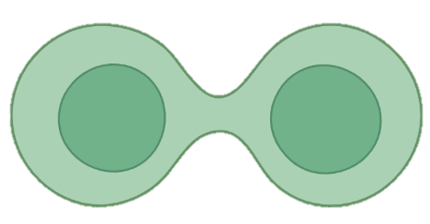
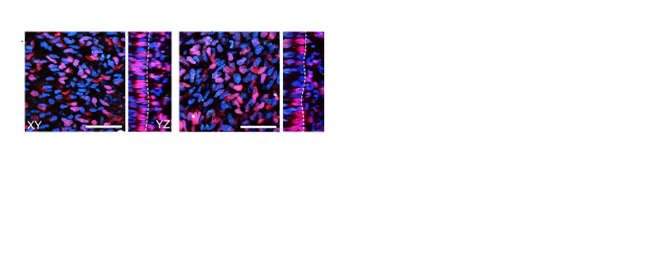

Solution: We identified TWO signals required and sufficient for hair regrowth
stimulates TWO targets required and sufficient for hair regrowth
Target X
Target Y
DC
Potential DC progenitor
Proliferating DC progenitor
DC cell
Control
Target X
Target X + Target Y
DC
Proliferating cell
DC cell
Skin with in vivo genetic activation of Target X and/or Target Y
Notes:
So what’s stopping us? The molecular signals required to make DC cells in the first place have been unknown for decades.
However, that changed recently. We are the first team to identify the signals essential for DC formation. We call these signals X and signal Y

Slide 8
Solution: We identified TWO signals required and sufficient for hair regrowth
stimulates TWO targets required and sufficient for hair regrowth
Target X
Target Y
DC
Potential DC progenitor
Proliferating DC progenitor
DC cell
Control
Target X
Target X + Target Y
DC
Proliferating cell
DC cell
Level and Duration of Targets X & Y stimulation modulates DC size
Skin with in vivo genetic activation of Target X and/or Target Y
Notes:
We showed that these two signals are necessary and sufficient to expand and grow DCs in skin. Even more, these two signals can be tuned to modulate DC size.
That is important Bc the size of DC control the size of your hair shaft- that means we can not only restore the coveted youthful thickness of hair in men AND women while also recreating the natural gradient hair line

Slide 9
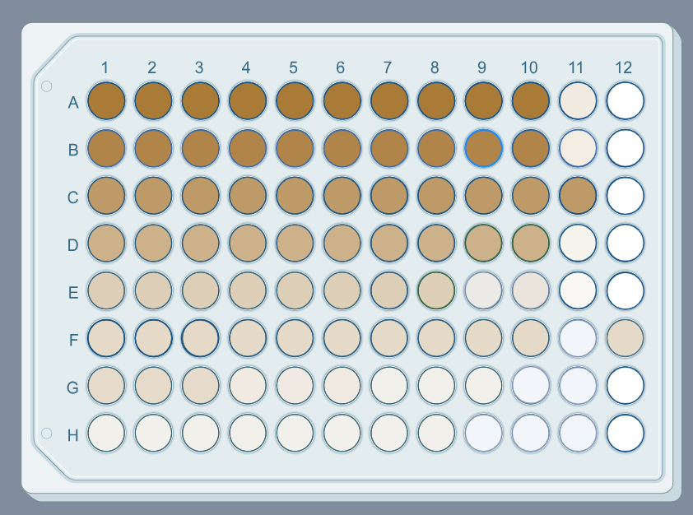
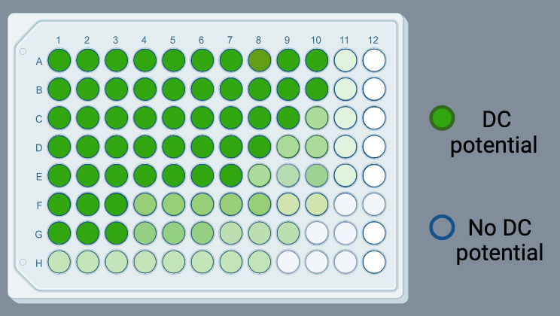
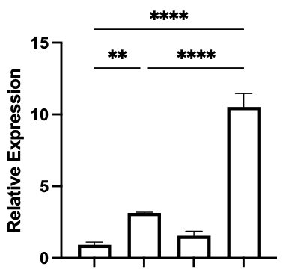
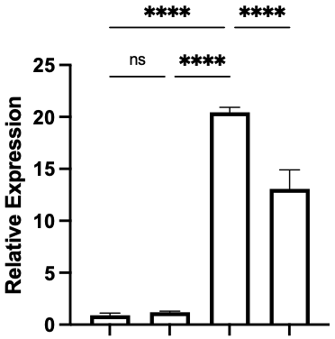
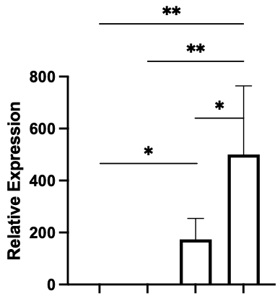
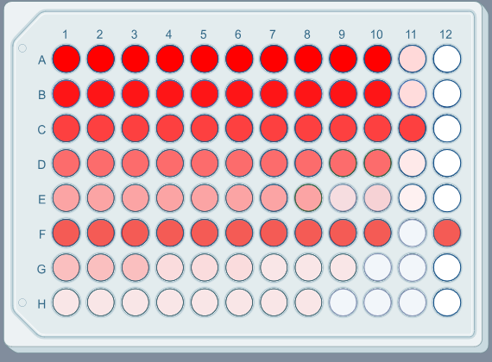
Where we are: Novel in-vitro platform to generate DC cells with X and Y agonists
HTPS* platform for
new compounds
Target X agonist
Target Y agonist
Robust DC expansion
Robust DC gene expression
DC progenitor
Proliferating DC progenitor
X marker Y marker DC marker
CONT X Y X+Y
CONT X Y X+Y
CONT X Y X+Y
*96 well format validated. 384 well format under development
confidential
Notes:
Further, we established a novel in vitro platform to induce DC cells using signal X and Y that outperforms current state-of-the-art culturing platforms.
In other words, we can make high quality DC cells to more efficiently screen for new signal X and Y HIT compounds that induce different levels DC gene responses.

Slide 10

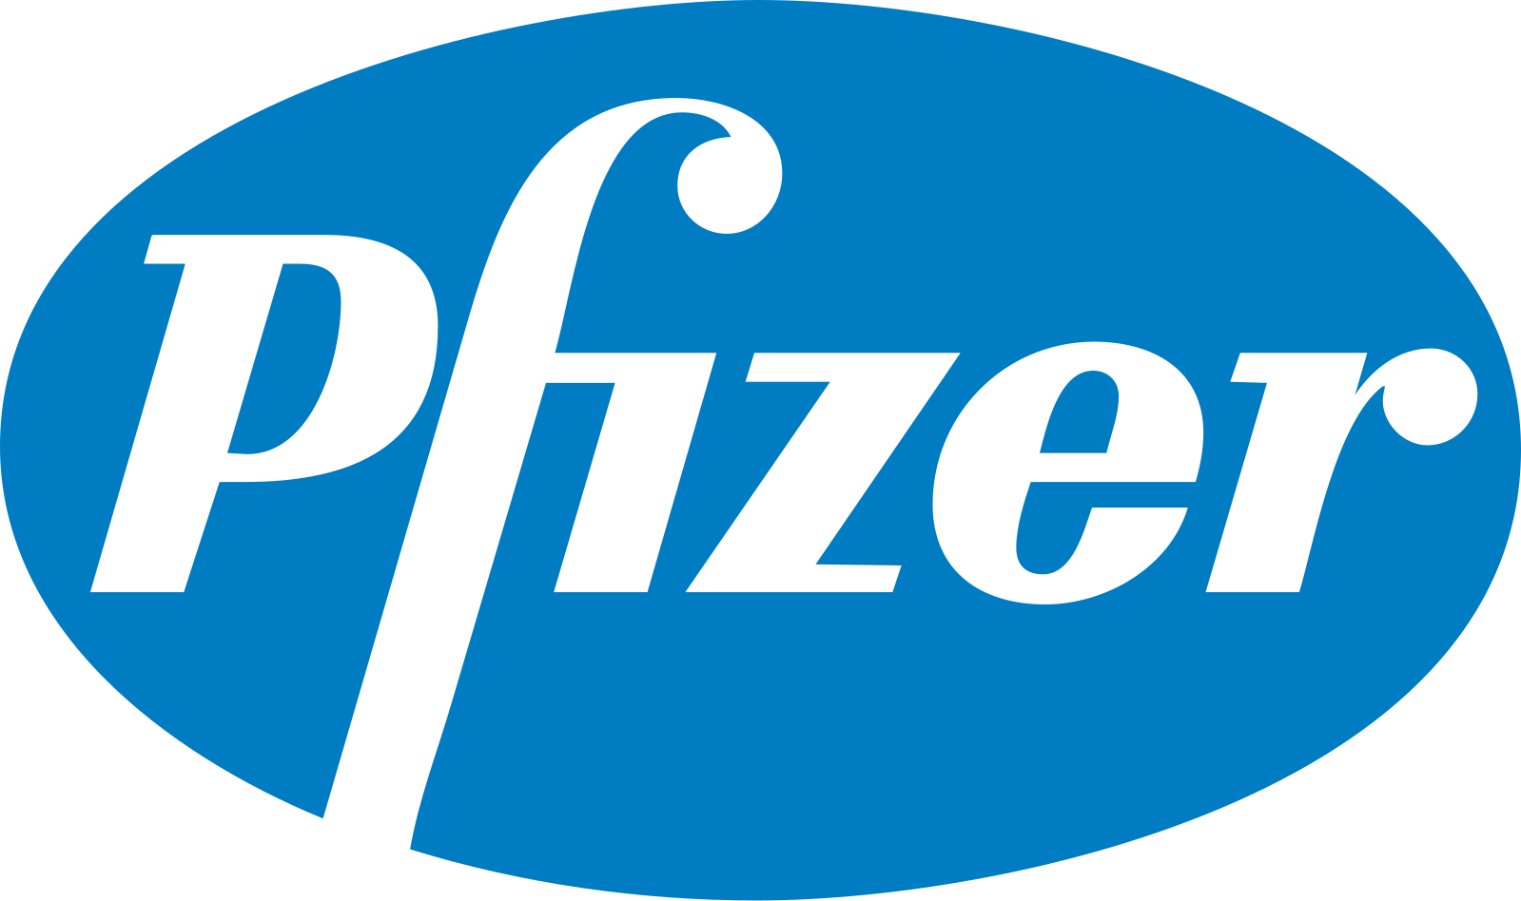
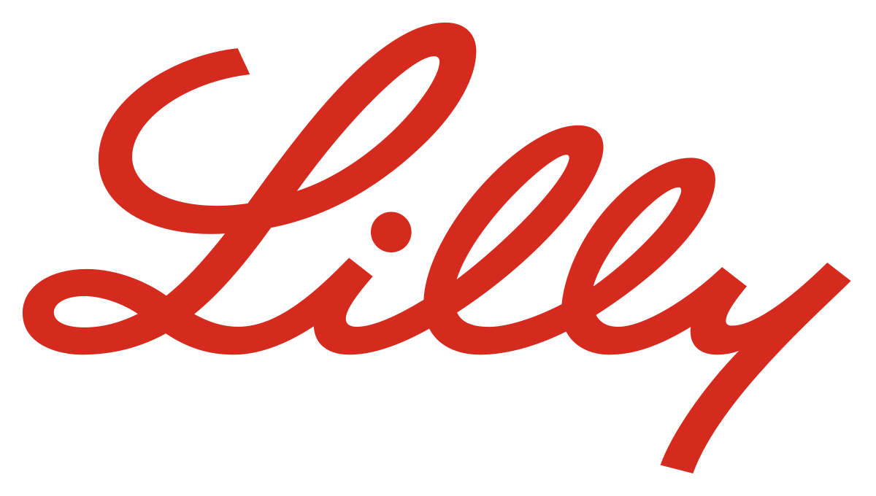
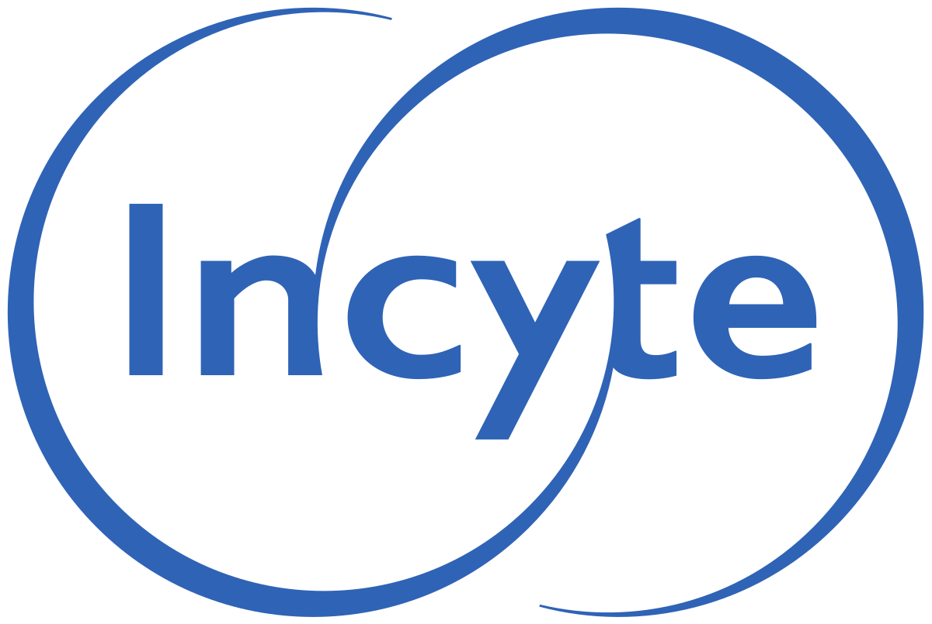

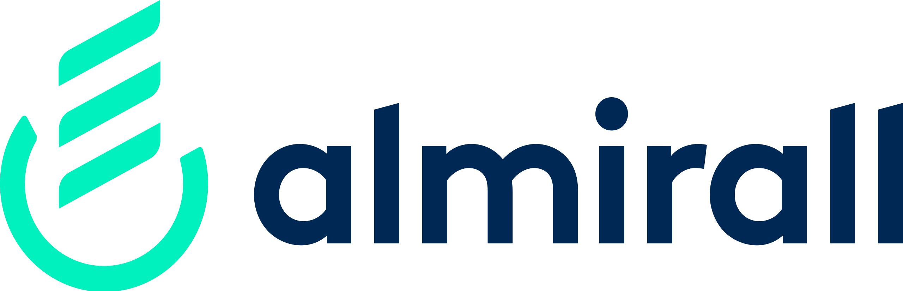


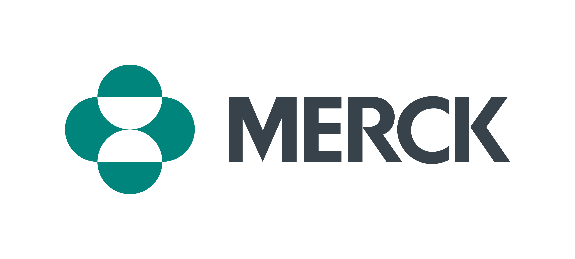


Competitive Landscape
Company | Target | New Hair Growth | One-time treatment | Side effects | ROA
 | Target X + Target Y |  |  | TBD | Topical
 | Janus kinase |  |  |  | Oral
 | Steroid 5 Alpha reductase |  |  |  | Oral, topical
 | Potassium channel |  |  |  | Oral
confidential
Notes:
Importantly, our target is completely different from our competitors. And no other treatment can induce NEW hair formation.
As DCs are durable, this would in principle only require a one-time treatment

Slide 11
Milestones and use of Blavatnik funds
Now
6-8 months
12-14 months
18-20 months
24 months
30K Accelerator Funding
Optimized dose and duration of X and Y Functional validation of high throughput screening
Identify hit compounds
Screen YCMD Bioactive collections ($60-80k) Perform hit compound validation in vitro Orthogonal assay ($15k) File IP
Lead compound nomination
Combinatorial screen Hair graft assay ($60k) Hit expansion and rescreen ($40-50k for med. chem.) File additional IP on optimized compounds
IND enabling studies
in vivo validation in mice+ dose escalation ($35k) Rat/NHP tox ($80k) Inc. company
Post Blavatnik
DMPK Develop/optimize Formulation IND Clinical trials
$95K
$110K
$115K
Total ask: $320K
confidential
Notes:
With the recent accelerator award, validated our new high throughput screening tool. At this stage, we want to advance this project to
Identify new hit compounds for signal X and Y
optimize drug target specificity through hit expansion and rescreening
and finally we want to perform in vivo validation and pharmacological studies of optimized HIT compounds
In total, we request $320 to execute these stages of drug development.
Drug metab and pharmacokinetics

Slide 12
Dermal condensate size controls hair follicle size
DC
DC
Notes:
Examples:
ConsultUS (https://ventures.yale.edu/pitch/consultus-your-digital-addiction-consultants) – Problem setup 0:32 – 1:31
Medzhitov, Inflammatory (https://ventures.yale.edu/pitch/identify-new-class-therapeutics-inflammatory-diseases) – 0:30-2:17
Lee/Cortes-Briones, Fetal EEG (https://ventures.yale.edu/yale-technologies/non-invasive-fetal-brain-monitoring) – 0:12-2:25
A few questions you could ask yourself, among others:
Who are your competitors?
Are they local, regional, national or global?
Are there any product alternatives to your product?
What about their IP / technological advantage?

Slide 13
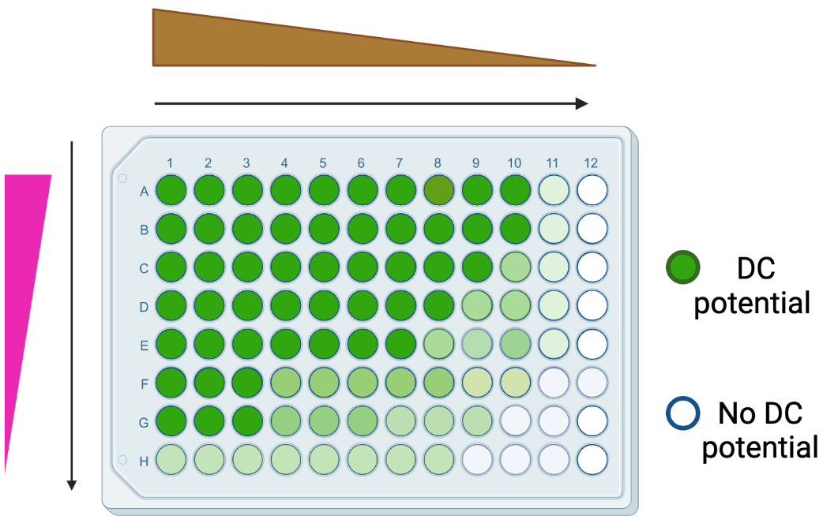
Where we are: Novel in-vitro platform to generate DC cells with X and Y
Signal X agonist
Signal Y agonist
Robust DC expansion
Robust DC gene expression
DC progenitor
X marker Y marker DC marker
CONT X Y X+Y
CONT X Y X+Y
CONT X Y X+Y
Notes:
Examples:
ConsultUS (https://ventures.yale.edu/pitch/consultus-your-digital-addiction-consultants) – Problem setup 0:32 – 1:31
Medzhitov, Inflammatory (https://ventures.yale.edu/pitch/identify-new-class-therapeutics-inflammatory-diseases) – 0:30-2:17
Lee/Cortes-Briones, Fetal EEG (https://ventures.yale.edu/yale-technologies/non-invasive-fetal-brain-monitoring) – 0:12-2:25
A few questions you could ask yourself, among others:
Who are your competitors?
Are they local, regional, national or global?
Are there any product alternatives to your product?
What about their IP / technological advantage?

Slide 14
Dermal Condensate (DC): specialized dermal cells essential for hair formation
Epidermis
Embryonic hair follicle
Adult hair follicle
DC
Dermis
Dermal condensate (DC)
progenitor cell
Dermal condensate (DC) cell
Millar, J Invest Derm, 2002
Hardy, Trends Genet, 1992
Xin, Greco, Myung, Cell 2016
Notes:
Examples:
ConsultUS (https://ventures.yale.edu/pitch/consultus-your-digital-addiction-consultants) – Problem setup 0:32 – 1:31
Medzhitov, Inflammatory (https://ventures.yale.edu/pitch/identify-new-class-therapeutics-inflammatory-diseases) – 0:30-2:17
Lee/Cortes-Briones, Fetal EEG (https://ventures.yale.edu/yale-technologies/non-invasive-fetal-brain-monitoring) – 0:12-2:25
A few questions you could ask yourself, among others:
Who are your competitors?
Are they local, regional, national or global?
Are there any product alternatives to your product?
What about their IP / technological advantage?

Slide 15
Dermal condensate size controls hair follicle size
DC
DC
Notes:
Examples:
ConsultUS (https://ventures.yale.edu/pitch/consultus-your-digital-addiction-consultants) – Problem setup 0:32 – 1:31
Medzhitov, Inflammatory (https://ventures.yale.edu/pitch/identify-new-class-therapeutics-inflammatory-diseases) – 0:30-2:17
Lee/Cortes-Briones, Fetal EEG (https://ventures.yale.edu/yale-technologies/non-invasive-fetal-brain-monitoring) – 0:12-2:25
A few questions you could ask yourself, among others:
Who are your competitors?
Are they local, regional, national or global?
Are there any product alternatives to your product?
What about their IP / technological advantage?

Slide 16
The Barrier: How do dermal condensates form?
DC
Notes:
Examples:
ConsultUS (https://ventures.yale.edu/pitch/consultus-your-digital-addiction-consultants) – Problem setup 0:32 – 1:31
Medzhitov, Inflammatory (https://ventures.yale.edu/pitch/identify-new-class-therapeutics-inflammatory-diseases) – 0:30-2:17
Lee/Cortes-Briones, Fetal EEG (https://ventures.yale.edu/yale-technologies/non-invasive-fetal-brain-monitoring) – 0:12-2:25
A few questions you could ask yourself, among others:
Who are your competitors?
Are they local, regional, national or global?
Are there any product alternatives to your product?
What about their IP / technological advantage?

