Slide 1
Dermcyt Incorporating immunologic biomarkers into personalized treatment selection in dermatology
Taking the guess work out to get it right

Slide 2
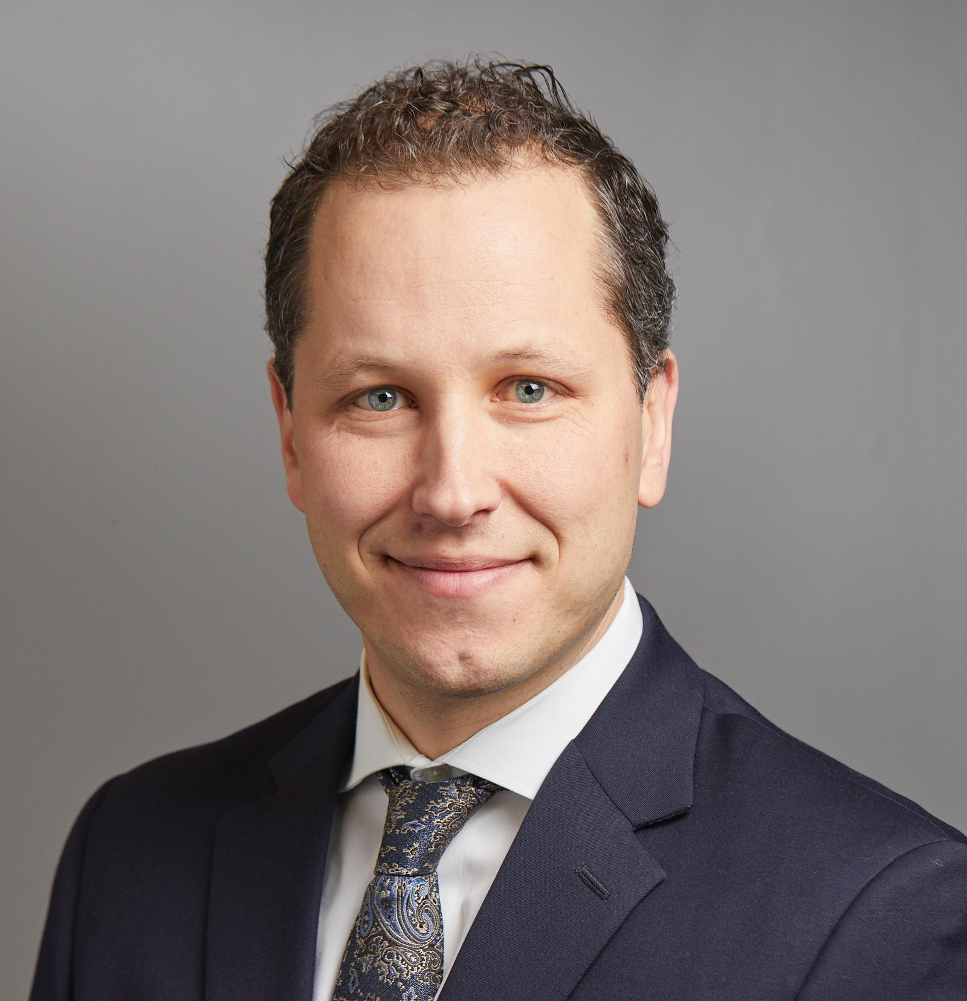
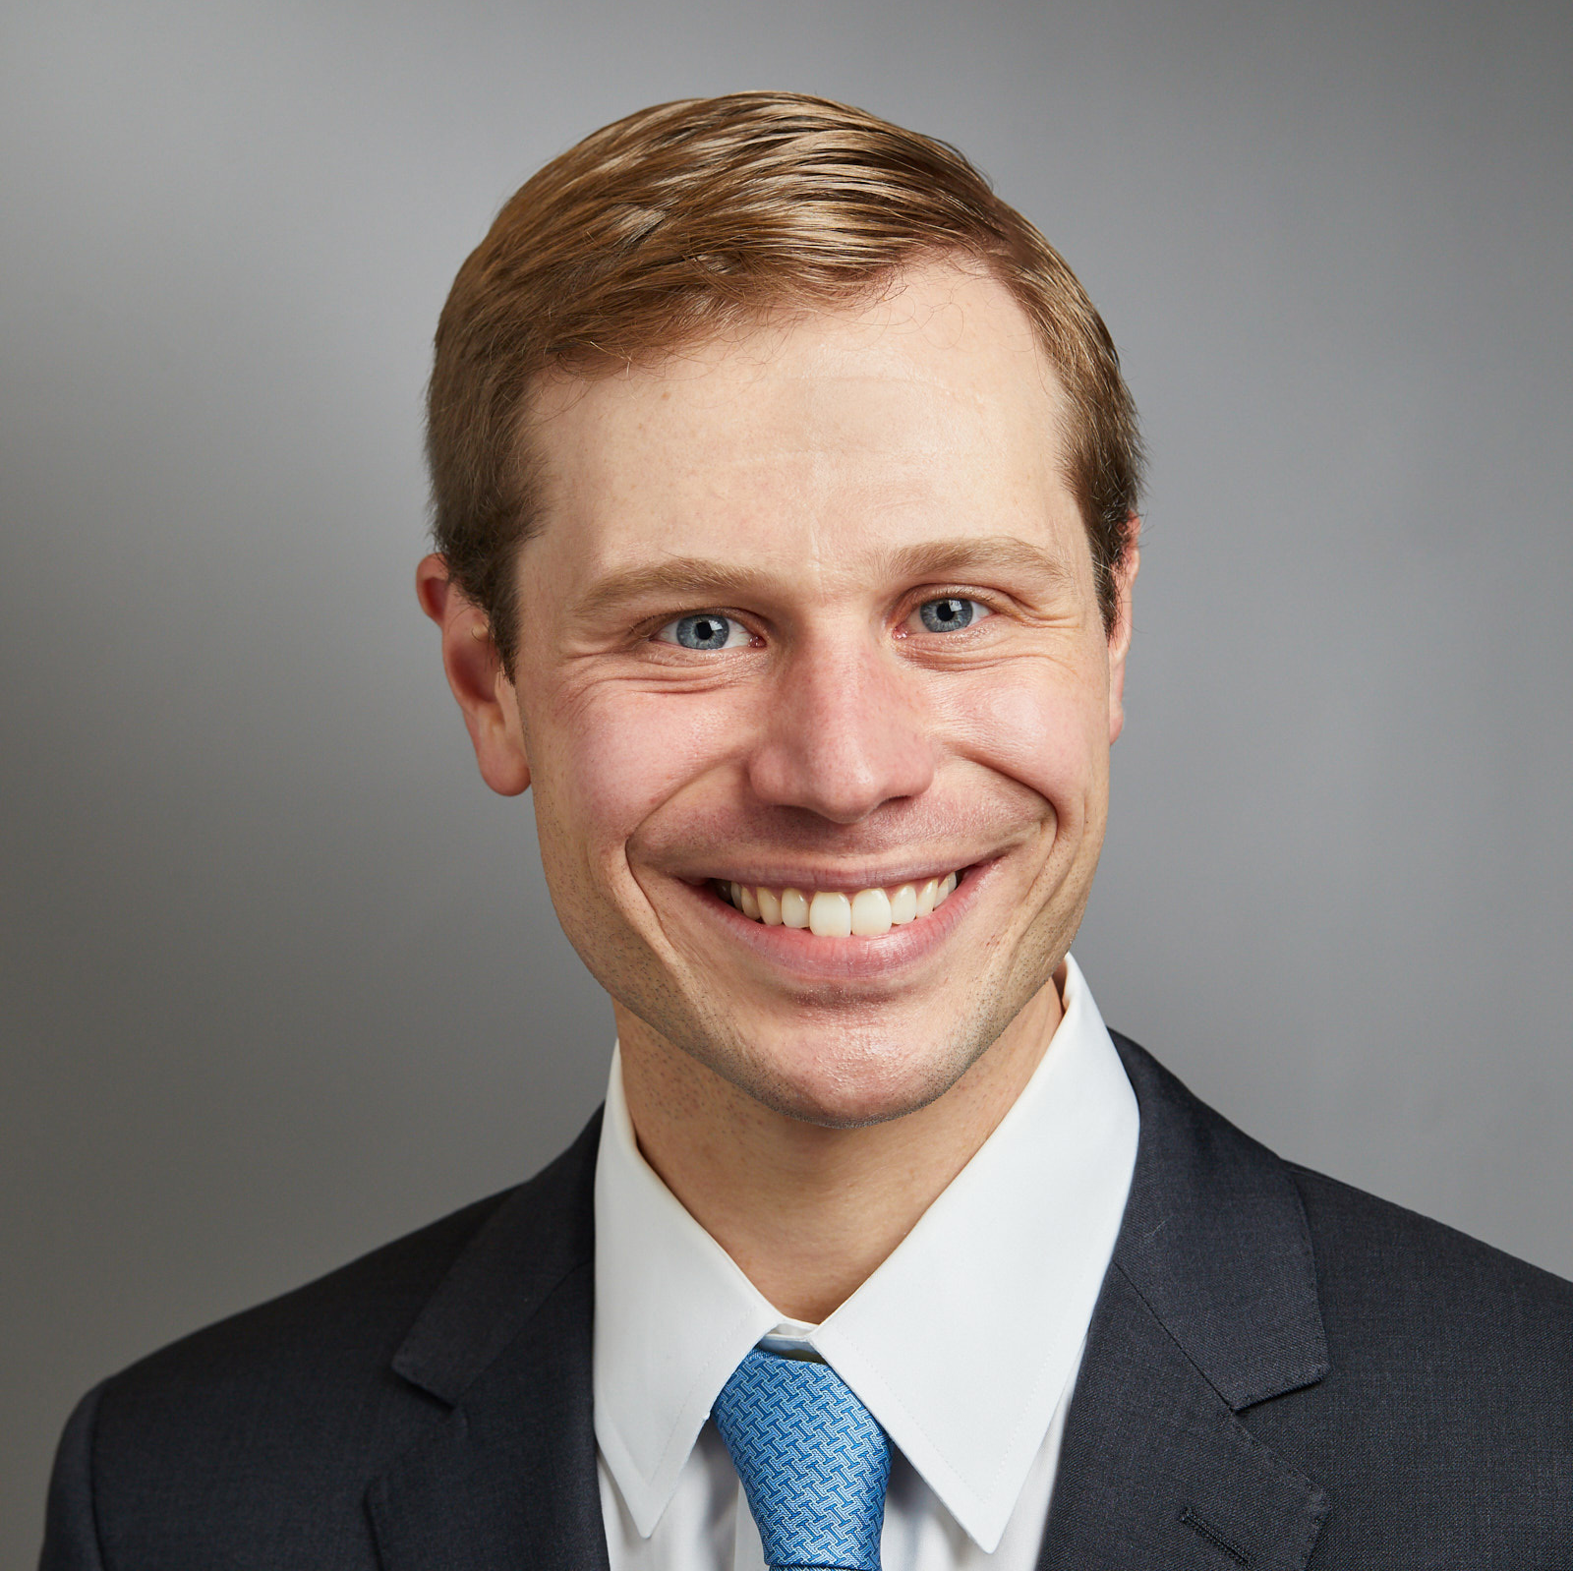
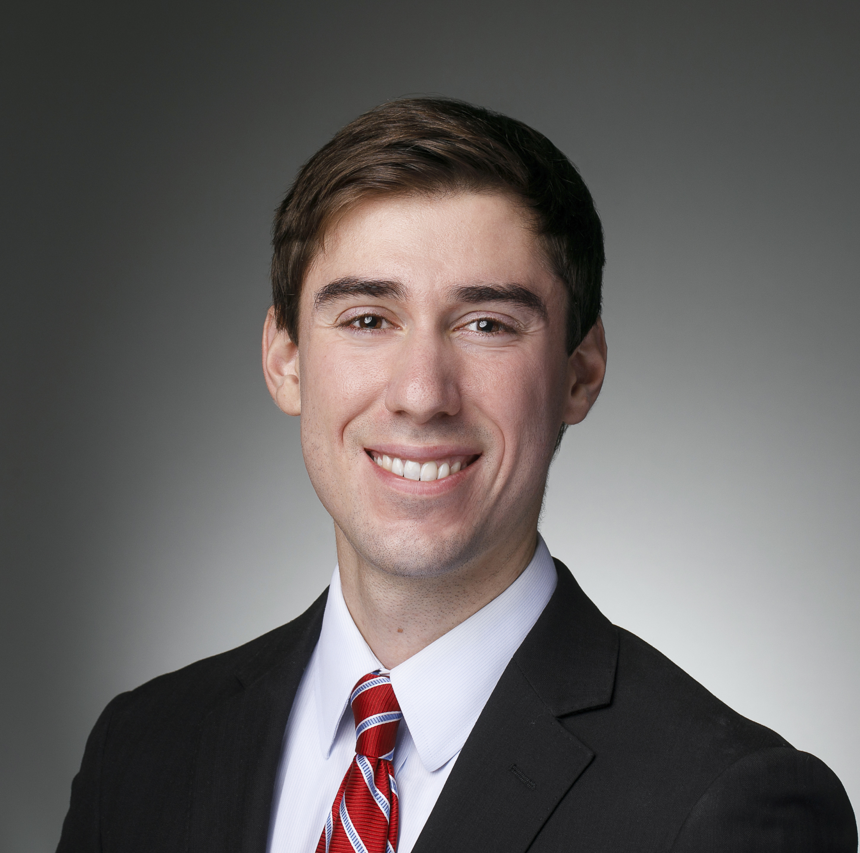
Our founding team is comprised of dermatologists, immunologists, and engineers
William Damsky MD, PhD
Co-Founder
Assistant Professor of Dermatology and Dermatopathology
Yale School of Medicine
Jeffrey Cohen MD
Co-Founder
Director: Psoriasis Treatment Program
Assistant Professor of Dermatology
Yale School of Medicine
Michael Murphy
Co-Founder
Medical Student & Engineer
Yale School of Medicine
Extensive biorepository
(>400 samples and counting)
Track record in therapeutic innovation in dermatology
Intellectual Property protection
Engineering and regulatory partnerships

Slide 3
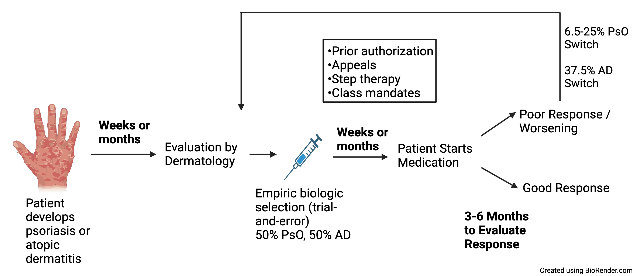
Psoriasis and eczema are treated with biologics by trial-and-error
UNMET NEED
No current ability to rationally select the best treatment for the patient’s unique underlying immune profile
Wastes time
Wastes money
Causes frustration
FDA APPROVED CYTOKINE TARGETS: PSORIASIS
TNF IL-17 receptor
IL-17A IL-23
IL-17A/F IL-12/23
IL-36 More coming
FDA APPROVED CYTOKINE TARGETS: ECZEMA
IL-4R⍺ (IL-4 and IL-13)
IL-13 specific
More coming

Slide 4
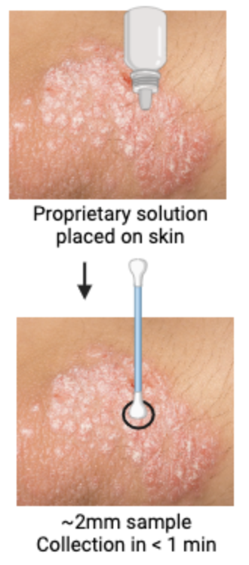
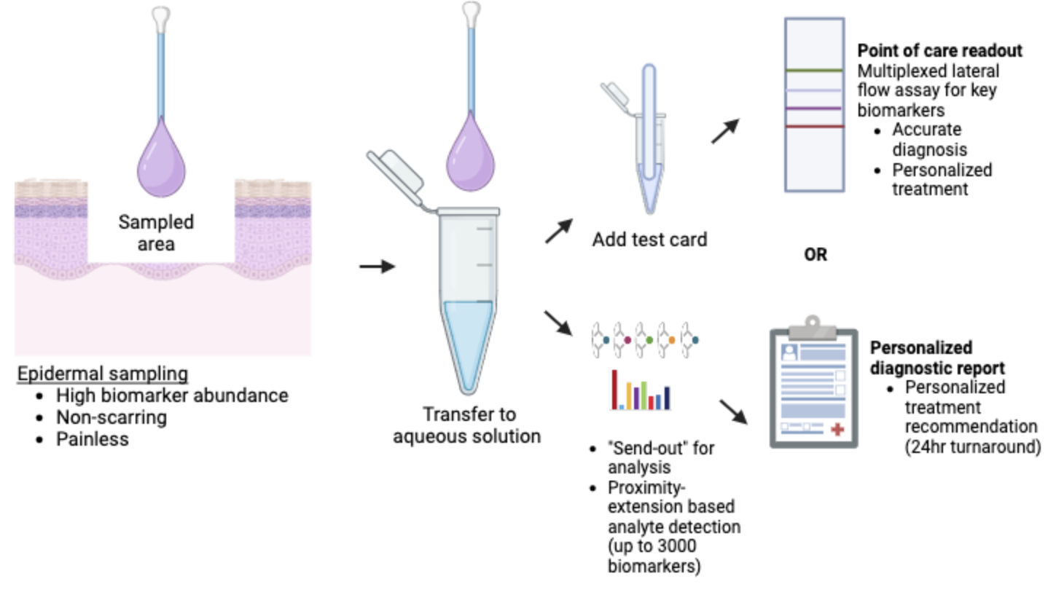
Dermcyt: painless and rapid personalized medicine
Quick to
collect (<1 min)
Does not leave
a scar
Analyzes most relevant tissue level (epidermis)
Rapid turnaround
(Immediate or 24 hours)
Painless

Slide 5
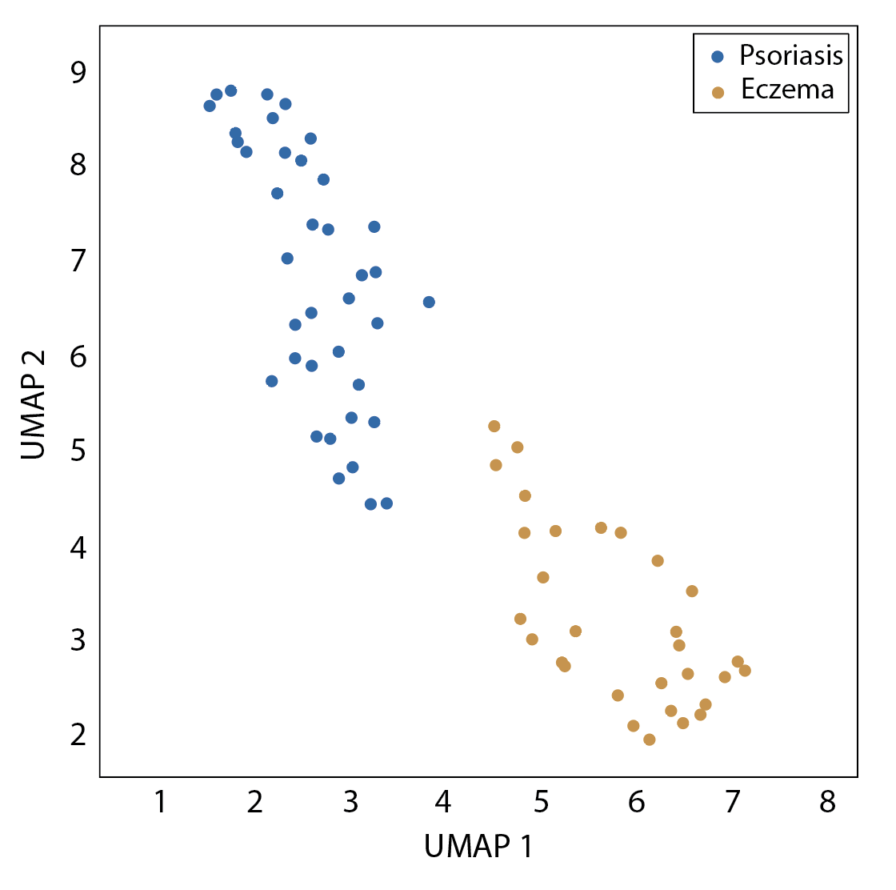
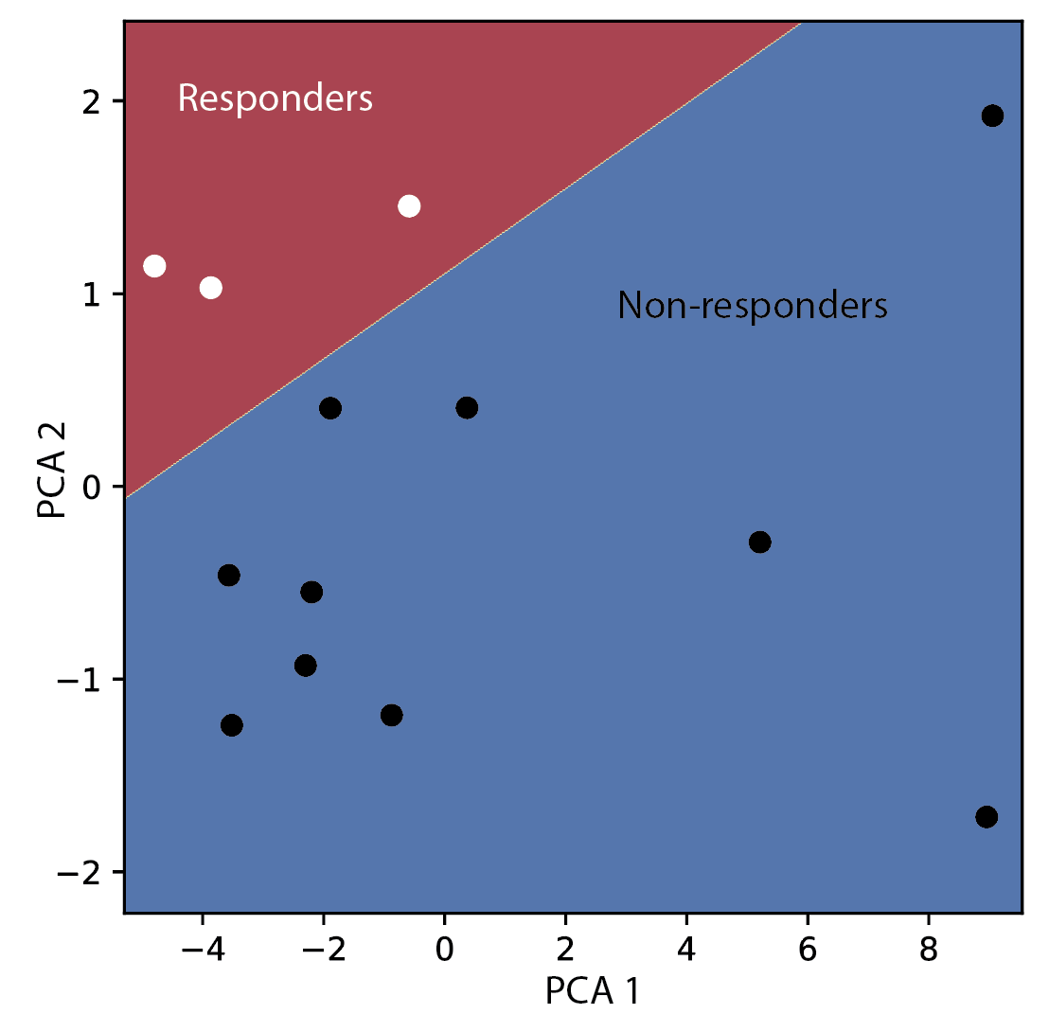
Dermcyt correctly classifies diagnosis and predicts treatment response
100% accurate distinction between psoriasis and eczema
100% accurate distinction between dupilumab responders & non-responders in eczema
Intellectual Property
Pending patent applications:
Appl # 63/594,532 (filed 10/31/23)
Appl # 63/579,364 (filed 8/29/23)
Appl # 17/471,972 (filed 9/10/21)
Claims encompass methods
and compositions for
treatment selection in dermatology
81 patient samples analyzed
(>400 collected)
Proprietary biomarkers overlap with our related proof-of-concept work in 70 patients with atopic dermatitis treated with dupilumab*
* Murphy et al. 2023 Br J Dermatol. In press
*Singh et al. 2023 J. Am. Acad. Dermatol. 88: 1094.
*Wang et al. 2021. J Invest Derm Innov 1: 100021

Slide 6
Potential Market $3.3Bn Per Year with ~4 Million Treatment Switches Prevented
Psoriasis Market Opportunity
Atopic Dermatitis (Eczema) Market Opportunity
US Population: 333 Million
US Population: 333 Million
Total US Market: ~$8Bn
Annual Growth: ~$260M
Assuming same cost as Mind.Px ($3600 per test)
Total US Market: ~$35Bn
Annual Growth: ~$3Bn
Assuming same cost as Mind.Px ($3600 per test)
US Psoriasis: 9.99 Million
US Eczema: 24.3 Million
Mod-to-Severe: 2.15 Million
72k New Mod-to-Severe / year
Mod-to-Severe: 9.7 Million
930k New Mod-to-Severe / year
Mod-to-Severe: 45-65% on Systemic Tx
Mod-to-Severe: 50% on Systemic Therapy (4.85 million)
6.5-25% Switch Therapy
within 1 year
($1.4-5.4B excess costs)
37.5% Switch Therapy
within 1 year
Total Potential Market Size: ~11.8 million patients with an additional 1 million patients per year
Total Potential Market: ~$42.6Bn with additional ~$3.3Bn per year

Slide 7
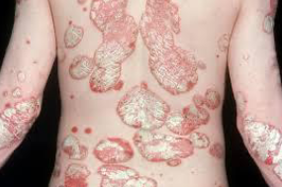
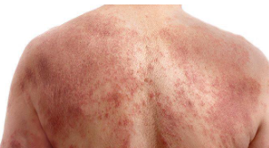
Dermcyt can save ~$10,000-$12,000 per patient per year
Psoriasis
Atopic Dermatitis (Eczema)
Up to 25% chance of switching systemic therapy
×
Up to 37.5% chance of switching systemic therapy
×
$9.9K per year in increased medical costs compared to those who don’t switch/discontinue
+
$32K for 4.5 months of ineffective treatment (approximate time to switch/discontinuation)
$6.9K per year in increased medical costs compared to those who don’t switch/discontinue
+
$25K for 5 months of ineffective treatment (approximate time to switch/discontinuation)
$10.5K per patient in expected yearly costs saved by preventing switching or discontinuation
=
$12K per patient in expected yearly costs saved by preventing switching or discontinuation
=
Psoriasis
Eczema
Significant cost-savings to the healthcare system
Life-changing impact on the patient experience

Slide 8
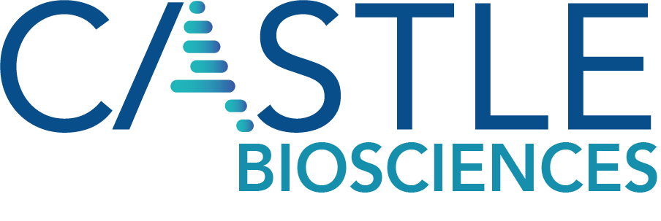
Dermcyt has key advantages over existing approaches
 | Useful for distinguishing psoriasis from eczema | Rapid, clinically useful turnaround time | Painless sample collection in under one minute | Analysis occurs at protein, not mRNA level | Provides information for tailored treatment | Easy to adapt to other inflammatory disorders | Test price
Mindera Health |  |  |  |  |  |  | $3600
Castle Biosciences |  |  |  |  |  |  | $2000-8000
Dermcyt |  |  |  |  |  |  | est $2500
 | Dermcyt’s rapid test can accurately distinguish between psoriasis and eczema | With our proprietary test card, we aim to obtain results at point of care and do not need to send to a lab for analysis | Dermcyt uses a novel method for collecting sample that is non-scarring, painless, and rapid (<1 min) | mRNA levels do not always correlate with protein levels and may miss important biomarkers | Using molecular biomarkers, results from Dermcyt can guide tailored treatment | Dermcyt can readily develop assays for a wide range of skin and non-skin conditions | The Dermcyt test price will be comparable to other dermatologic tests, with additional features
Building for success:
Partnership with regulatory affairs consultant: Roaida Johnson (Lambint, LLC)
Preparing for upcoming discussion with FDA regarding Q-Submission

Slide 9
Broad range of customers with potential for expansion
Customer Base
ADDRESSES A LONG-FELT UNMET NEED FOR DERMATOLOGISTS*
98% reported they would use a personalized diagnostic test
93% would alter first-line therapy based on the test result
100% would use if part of prior authorization process
Primary Care Practices
*Strober et al. 2021. Dermatol Ther (Heidelb) 11:1851.
Dermatology Practices
Pharma Organizations / Research Institutions
Articles per year
Biomarker directed trial enrollment
Health Plans / Insurance Companies
Year
Psoriasis and atopic dermatitis represent only a small fraction of the possible market
Interest in non-invasive biomarker testing in dermatology is rapidly expanding
Biomarker based drug approvals*
*Mindera recently signed a contract with Contigo Healthcare Network

Slide 10
$300k in support will enable a randomized controlled trial by Q1 2026
Q2 2024: Lateral flow test card prototype
Q1 2025: Small-scale production of test card
Q3 2025: IRB protocol and IDE pathway
Q1
2024
Q4
2026
Q3 2024: Sample analysis in CLIA lab
Q2 2025: Optimize predictive algorithms
Q1-Q4 2026: Prospective clinical trial
Uses of Blavatnik Funding ($300k)
Development and production of a prototype for point-of-care test in partnership with MPR Associates ($130,000)
Development and production of collection swab and test kit components for send-out test ($40,000)
Additional sample analysis in CLIA lab and optimization of predictive biomarkers ($70,000)
Accelerate regulatory and reimbursement pathway development in partnership with Roaida Johnson (Lambint) ($60,000)
Submit IRB and IDE to perform prospective clinical trial

